Slide 1
Fatherhood and Family Wellness: understanding the root causes and solutions for addressing father absence
Presenters: Keston Jones, MHS, CASAC

Slide 2
Outline
Introduction
New Familial Equation
Myths
Solutions
Final Thought

Slide 3
History of the problem
According to Cheadle, Amato & King, (2010):
Changes in family structure during the second half of the twentieth century resulted in large numbers of fathers living apart from their biological children—a unique situation in the history of the American Family.

Slide 4
MoynihaN Report (1965)
At the heart of the deterioration of the fabric of Negro society is the deterioration of the Negro family.
It is the fundamental source of the weakness of the Negro community at the present time.
The family is the basic social unit of American life; it is the basic socializing unit. By and large, adult conduct in society is learned as a child.
The Breakdown of the Negro Family Has Led to a Startling Increase in Welfare Dependency
- See more at: http://www.blackpast.org/primary/moynihan-report-1965#sthash.GfowewcC.dpuf

Slide 5
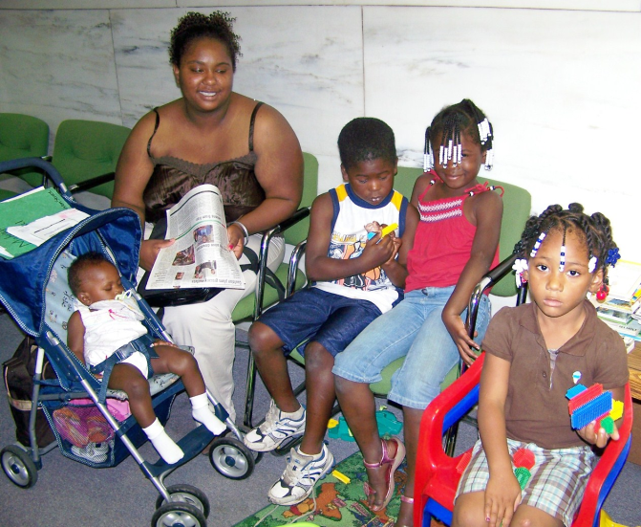
New Familial Equations

Slide 6
Adverse Effects
Researchers have pointed to incarceration as a primary cause of fathers being missing from the home, citing because of which, there is acute marital and social stress, which places couples at a high risk for divorce and separation.
(Geller, Garkinkel & Western, 2011)

Slide 7
Consolidated Abuse/Neglect investigations (2017)

Slide 9
MYTHS
If fathers wants to be involved in their children’s lives they need only to step up (that simple)!
The system supports cohesive family units.
Human service agencies have the same level of commitment to the father as they do for the mother.

Slide 10
"A mother's a mother for life, a father's a father only with a wife."

Slide 11
1) Married Fathers
A man who is married to the mother of the child at the time of the child’s conception or birth will be presumed to be the child’s legal father. If the man is not married to the mother at the time of the conception or birth, he will not automatically be considered the child’s legal father – even if he is listed as the father on the birth certificate!

Slide 12
2) Fathers Who Sign An Acknowledgment of Paternity
At any point after a child is born, the child’s father and mother can sign an acknowledgement of paternity (form LDSS-4418) to establish that the man is the child’s father. An acknowledgment of paternity that is voluntarily signed by both parents, and is filed with the registrar, has the SAME legal significance as being adjudicated the legal father by a court of law.
which is available on the New York State Division of Child Support Enforcement website (www.childsupport.ny.gov/dcse/pdfs/4418.pdf)

Slide 13
3) Fathers Adjudicated Through Paternity Action
Fathers and mothers can both file paternity actions to determine who is the legal father of the child. If a father files a petition to have a court determine paternity, and the father or mother is uncertain about who the biological father is, the court will order genetic testing to determine if the man named in the paternity action is the biological father of the child.

Slide 14
Paternity: Children Benefit
The child receives both emotional and financial benefits from paternity establishment, such as Reassurance that the parents cared enough to acknowledge paternity.
Having the father's name on the birth certificate.
Medical or life insurance from either parent, if available.
Information about family medical history
Financial support from both parents, including
Social Security
Veterans benefits
Inheritance rights, and
Child support.

Slide 15
Myth # 2
If fathers wants to be involved in there children’s lives they need only to step up (that simple)!
The system supports cohesive family units.
Human service agencies have the same level of commitment to the father as they do for the mother.

Slide 17
COSTS
Non-custodial parents, mostly fathers owe 105 Billion in unpaid child support. What is not being shared is two thirds of this amount is owed by fathers who make less than 10,000 annually.
$2billion collected
$5.6 billion in administrative costs to collect that $2 billion.
$22 million was returned to families

Slide 18
Based on decades-old stereotypes that single mothers are raising children alone and single dads are “deadbeats,” the majority of United States anti-poverty programs almost exclusively serve women and children.
Because the welfare system was designed to act as a sort of “surrogate husband” to single mothers, the government looked to fathers as a way to repay the cost.

Slide 19
Participating in Temporary Assistance for Needy Families (TANF) requires the custodial parent (most often the mother) to identify the father for the purposes of obtaining a formal child support order.
The order is then used to repay the TANF system, and not the family directly
Income thresholds preclude two family homes from receiving benefits

Slide 20
Consequences for Children
Upwards of 71.5% are being raised in single parent households (CDC, 2015)
Single income – greater risk of poverty
Greater risk for hypertension and high blood pressure
Sex abuse
Alcohol and drug abuse
Suicide
Emotional Distress
Confused Identities
Acting Out
Child Abuse

Slide 21
Contributing to the stigma
While there are plenty of examples of supportive fathers who contribute to their child and family’s well-being, often the picture is portrayed of a dead-beat dad who is absent from their home.
(Walker, Reid & Logan, 2010)

Slide 22
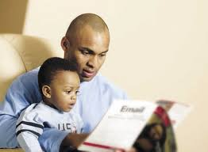
Debunking the Myth
According to Levs, 2015, in his book All In, 2.5 million of 4.2 million black fathers — or about 59.5 percent — live with their children.
According to the CDC, African American fathers are more likely than white and Hispanic fathers to feed, eat with, dress, bathe, diaper, play with, and read to their children on a daily basis.

Slide 24
Dead-beat VS Dead-broke

Slide 25
DISTRUST

Slide 26
Myth # 3
If fathers wants to be involved in there children’s lives they need only to step up (that simple)!
The system supports cohesive family units.
Human service agencies have the same level of commitment to the father as they do for the mother.

Slide 27
Implicit Bias
Occurs when someone consciously rejects stereotypes and supports anti-discrimination efforts but also holds negative associations in his/her mind unconsciously.
Implicit bias and social justice” Haley Roberts, 2011

Slide 28
The Role of Family Court
Does the family court system positively assist fathers in their efforts to engage their children? Please elaborate.
Not really. Fathers are judged more harshly than mothers. It makes them jump thru hoops, but doesn’t necessarily consider whether those hoops actually assist the family. Most of the players (judges, attorneys, caseworkers), are female, which impacts how young fathers are viewed/treated.

Slide 30
Introduction

Slide 31
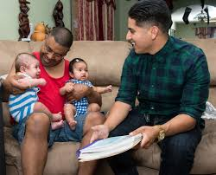

Slide 32
Advocate –vs- Provider

Slide 33
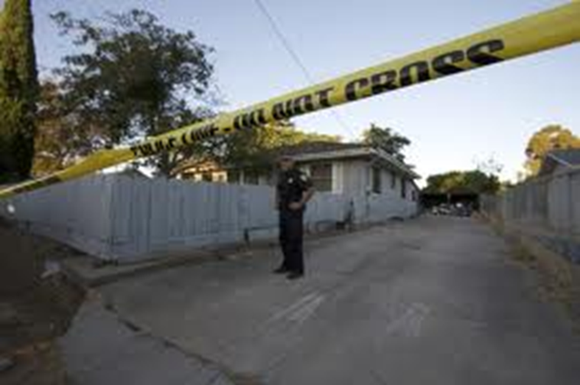
A Father’s reality world
Phenomenological world view
Culture
Upbringing
Education
Mental state

Slide 34
Current Reality
Active family court case
Active criminal court case
Child support
Evicted from his home
Cannot see his children
Unemployed
Or…..

Slide 35
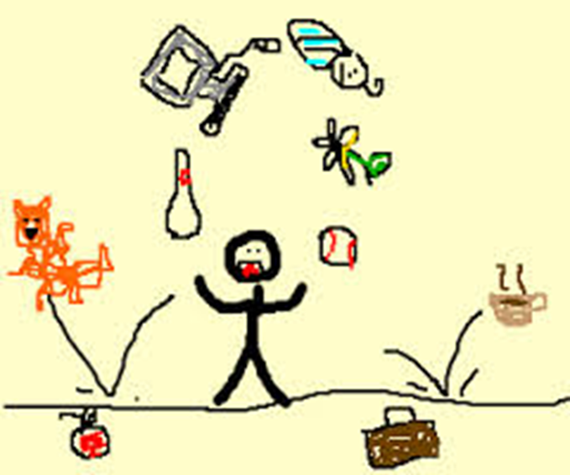
Employed….But!
Must attend: Anger Management, parenting, Domestic Violence, mental health services, substance abuse, A.C.S. conferences, and court appearances

Slide 36
Suggestions
Train staff to consider the fathers perspective
Hire male staff members not only as outreach workers, but also as leadership
Create more father friendly programs
Invest in programs that provide services after normal business hours
Consider fathers as resources

Slide 37
In the Circle

Slide 38
Ideally
Sustained parenting
Family reintegration
Improved Self-Esteem
Improved relationships
Development of new skills and coping methods
Decreased legal involvement

Slide 39
Which will provide:
Continuity
Familiarity
Expert Support
Measurable Outcomes
Less Recidivism
Stronger Families

Slide 40
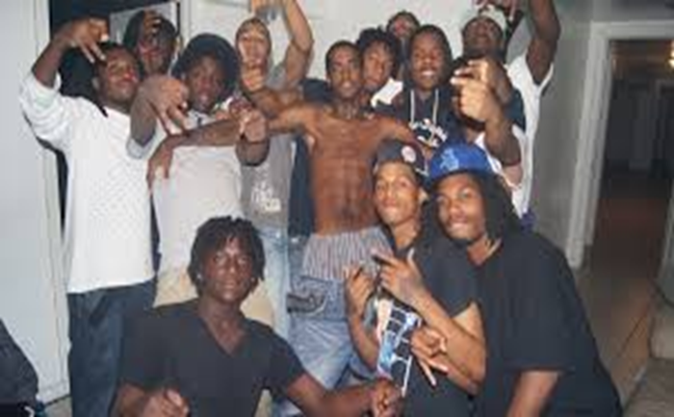
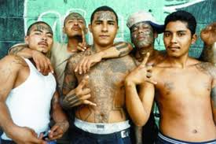

Slide 41
Client and Organizational Success

Slide 42
Our Pledge

Slide 43
Final Thought

Slide 44
References
Black man's burden: myth of the deadbeat (A Voice for Men)
Cheadle, J., Amato, P., & King, V. (2010). Pattern of nonresident father contact. Demography, 47(1), 205-225.
Geller, A., Garkinkel, I., & Western, B. (2011). Paternal incarceration and support for children in fragile families.Population Association of America,
Gorman-Smith, D. (2008). Urban neighborhoods, families, and juvenile delinquency. The Prevention Researcher,15(1), 17-20.
http://www.avoiceformen.com/misandry/alexacaliente-alyssapry-anitasarkeesian-jaclynf-abc-black-mans-burden-myth-of-the-deadbeat
Lemay, C., Cashman, S., Elfenbein, D., & Felice, M. (2010). A qualitative study of the meaning of fatherhood among urban fathers . Public Health Nursing, 27(3), 221-231. doi: 10.1111/j.1525-1446.010.00847.x
Levs, J. (2015). All in: How our work-first culture fails Dads, families, and businesses--and how we can fix it together. New York, NY: HarperOne.
Nobles, W. (1986). African psychology: Toward its reclamation, reascension& revitalization. Oakland, CA: The Institute for the Advanced Study of Black Family Life and Culture
Stuart, E. (2014, February 14). How anti-poverty programs marginalize fathers. The Atlantic. Retrieved from http://www.theatlantic.com/politics/archive/2014/02/how-anti-poverty-programs-marginalize-fathers/283984/
Walker, R., Reid, C., & Logan, T. (2010). Race differences among noncustodial fathers noncompliant in child support: Involvement and self-perceptions of fathering. Journal of Family Studies, 16(1),
Wampler, R., & Downs, A. (2009). Parent and peer attachment in minority males at high risk for delinquency. Springer Science Business Media, LLC 2009, doi: 10.1007/s10615-009-0239-8

