Slide 1
NYSDOH Commissioner’s
Listening Sessions:
Sharing Birth Stories to
Promote Birth Equity
MEAGHAN CARROLL
NEVILLENE WHITE

Slide 2
Commissioner’s Listening Session Planning

Slide 3
Background
Increasing rates of maternal mortality
  U.S. maternal mortality rate doubled over the past two decades.
  NYS was ranked 30th in the nation for maternal mortality in 2016
Disproportionate impact among black women
  Black women are over three times more likely to die than white women
Notes:
Add info. On agenda

Slide 4
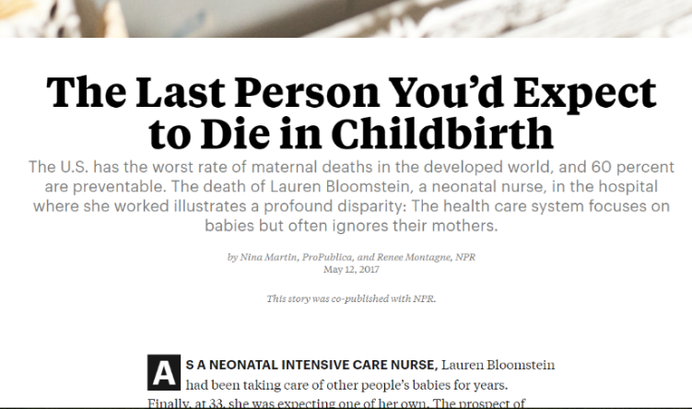
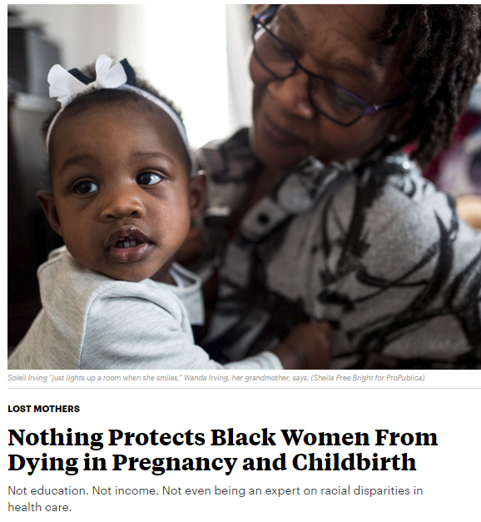
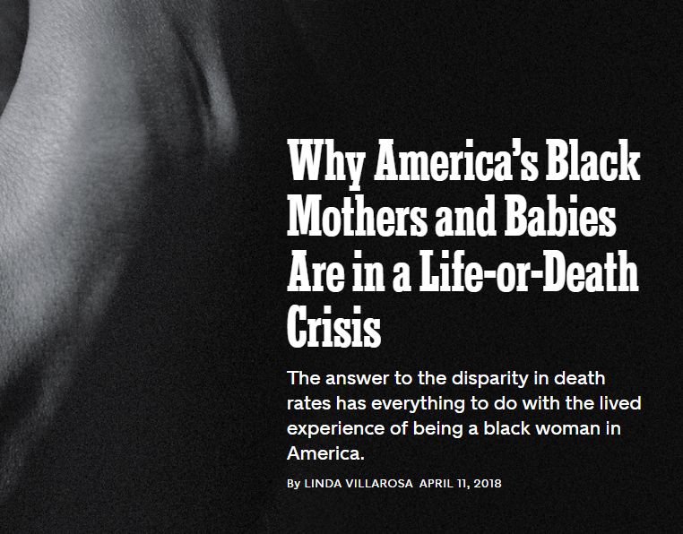
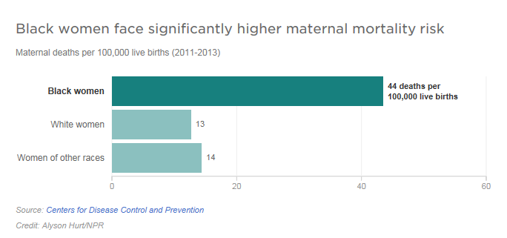
Maternal Mortality in Focus
Notes:
Add info. On agenda

Slide 5
New York State’s Comprehensive Initiative
Create the Taskforce on Maternal Mortality
Establish the Maternal Mortality Review Board
Launch Best Practice Summit with Hospitals & OB-GYNs
Pilot the expansion of Medicaid coverage for Doulas
Support Centering Pregnancy Demonstrations
Require Continuing Medical Ed & Curriculum Development
Expand NYS Perinatal Quality Collaborative
Launch Commissioner’s Listening Sessions
Notes:
Add info. On agenda

Slide 6
Listening Session - Purpose
Empower Individuals
Create bridging social ties
Create cooperation among CBOs
Explore Barriers
Discuss strategies
Obtain feedback on the community’s experience with and concerns about maternal mortality.
Provide an outlet for community members to share their story and identify solutions that may work for them.
Notes:
**adapted from office of minority health slides**
Many of the problems that affect the health and happiness of people in communities cannot be solved by any one person, organization, or sector
Community listening sessions give people a way to draw attention to issues that would otherwise be ignored.
Community Listening Forums:
1) empower individuals by getting them directly and actively involved in addressing problems that affect their lives
2) create bridging social ties that bring people together across society’s dividing lines, build trust and a sense of community, and enable people to provide each other with various kinds of support
3) create cooperation among CBOs and community members. It is a good idea to create work groups or committees that will continue the work of the listening forum.

Slide 7
Listening Session Development
Identify framework
  NYSDOH Office of Minority Health & Health Disparities Prevention
Identify location based on NYSDOH birth outcome data
Engage Maternal and Infant Community Health Collaboratives (MICHC) organizations to partner
Recruit participants
Conduct listening session
Notes:
Add info. On agenda

Slide 8
Voice Your Vision & Share Your Story:
A Community Conversation on Maternal Health
Overall Goal: Engage African American women in communities most impacted by poor birth outcomes in a conversation about their birth experience
Conversation Topics:
Planning for Pregnancy
Pregnancy
Giving Birth
Birth Outcomes
Notes:
Framing Questions :
1. Before coming to today’s session, did you know that black mothers face higher rates of maternal mortality (death) than white women?
2. Why do you think black women experience unequal rates of death from pregnancy?

Slide 9
Planning Session
Maternal & Infant Community Health Collaboratives (MICHC)
Announcement
Workplan
Weekly Prep Calls
Collaborating with community partners
Notes:
All 7 MICHC organizations participated together in several planning and training meetings before each forum.
MICHC orgs with previous experience hosting forums provided tips and tricks that helped with recruitment.
Each MICHC org. debriefed with DOH after all of the individual forums and DOH passed that information along to the other MICHC partner organizations.
As the sessions went on we refined the topics, made small tweaks to the timing, and updated questions based on feedback from previous forums.

Slide 10
Recruiting Participants
Incentives
Location
Time
Transportation
Childcare
Notes:
Moderator to Colette: We often hear that a major barrier to conducting sessions like this, or other kinds of events that involve community members, is how to successfully recruit participants. What did you do that worked well in recruiting community members?
NYSDOH also committed funds to support each of the listening sessions. This allowed us to provide:
Transportation assistance
Food
Child care
Incentives for each participant ($50 gift card)
Follow-up: What kind of factors did you take into account when making your event more accessible to your priority population?

Slide 11
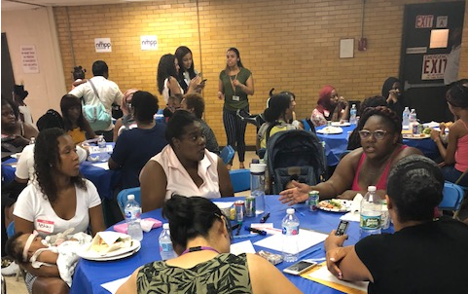
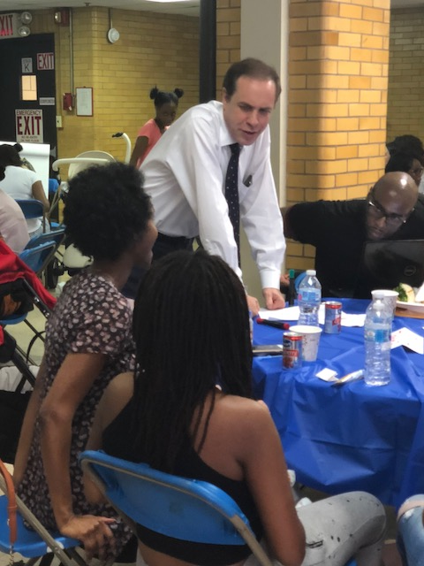
Conducting Listening Sessions
MICHC Welcome
Commissioner Zucker Framing the Discussion
Table Discussion
Table Speak Back
Commissioner Zucker Response & Closing
Notes:
Moderator to Colette: In terms of the actual listening sessions, can you describe the flow of the day?
Intro questions to get convo started
About 80 minutes of conversation broken into four topic areas: planning for pregnancy, pregnancy, giving birth, and postpartum.
Follow-up: How did you encourage participants to speak?
Follow-up: What role did Dr. Zucker play?
Dr. Zucker went from table to table, listening to participants, sometimes asking follow up questions.
At the end of the session he engaged with participants in a 20 min. “speak back”
Each table (there were about 8 tables per session) selected one community member to share with Dr. Zucker one thing that they wanted him to remember from that day.
This allowed community members to speak directly to the Commissioner where he could hear their concerns first hand and respond to their issues and questions.

Slide 12
Locations & Community Partners
Location | Date | MICHC Partner Organization | Total Participants
Brooklyn | 8/9/18 | CAMBA & Wyckoff Heights Medical Center | 27
Albany | 8/13/18 | Albany County Dept. of Health | 29
Bronx | 8/16/18 | Urban Health Plan | 26
Buffalo | 8/21/18 | Buffalo Prenatal/Perinatal Partnership | 43
Queens | 8/23/18 | Public Health Solutions | 43
Harlem | 8/30/18 | Northern Manhattan Perinatal Partnership | 40
Syracuse | 9/14/18 | Onondaga County Dept. of Health & REACH CNY | 37

Slide 13
Emerging Themes

Slide 14
Health Systems
Providers
Racism
Education
Disrespect
Social Supports

Slide 15
Health Systems
Hospitals
Payor
Systems
“They’re trying to push for you to do other things that cost more money…They push the drugs on us like an experiment.”
“I knew my prenatal appointments were going to be all day.”
“You are already labeled. You are already treated a certain way.”
“Always saw a different doctor that didn’t know me.”
“Hospitals look at good insurance that makes them happy… they should think of us all as the same.”
“I switched health plans to go to a better hospital, not ‘the bad one.’”
Notes:
Hospitals:
Two tiered systems of care:
In NYC moms want to deliver in “the city” feel that hospitals in outer boroughs are not as good. Feel that public hospitals are not as good.
Upstate – less hospital choice, less focus on hospital. More discussion of your payor (i.e. private insurance vs. Medicaid)
Quality of care:
Many moms quested the quality of care they received.
Believed doctors weren’t as well trained as those in other facilities, those who treat wealthy women etc.
Almost universal dislike of student doctors, perception that they see more student doctors because they are low income, black, etc.
Decisions about care made by policy not doctor/mom:
C-Sections pushed because hospitals want to clear beds or its more convenient for the providers.
Women think they’re getting epidurals to keep them compliant, to keep them in bed
Overwhelmingly women wanted a natural birth experience
Feel pressured into medical interventions (esp. inductions and epidurals) by constant questioning or threats. Believe this is done to earn the hospital more money.
Payor:
Medicaid vs. Private Insurance:
“Whatever the insurance allowed me to get, that’s the best quality I can get.”
Treated differently because of money:
Systems:
Long wait times:
Universal issues with wait times.
Results in loss of money from jobs, increased expense because they need to make childcare and transportation arrangements.
Know that they’re going to be at visit all day
Continuity of care:
Never seeing the same doctor

Slide 16
Providers
Communication
Judgement
Time
“Nobody would answer you.”
“You never really see your doctors.”
“Individually we all have our own stories… not all pregnancies are unplanned or don’t have a father around.”
“I was never told why I was high risk.”
“I have yet to hear why
“Appointments felt too quick.”
“You have to show them you are somewhat educated.”
“Doctor listens because she has to write it down, but she doesn’t really listen.”
6 C-sections.”
I had
Notes:
Communication:
“It feels so robotic, there is no relationship! I feel that the yare not truly listening to them, they’re just trained to keep going.”
Taking babies away without explanation, not allowing mom to go to the NICU.
Not providing adequate information on procedures.
Mistrust – “Some doctors are liars – they say you’re going to die or baby will be sick, but everything is fine.”
Almost universally moms were told they were “high risk” but most could not explain why, or felt they were told what medical condition they had.
Major impact on pregnancy planning: large number of participants reported being told by a doctor that they were infertile, had low fertility etc. before they got pregnant.
Suggestion from several sessions – increase use of health educators in doctor’s offices. Need for someone who is better at communicating with patient, and willing/able to take the time to better explain issues, answer questions etc. Several participants suggested pairing health educators with doctors would help increase understanding.
Judgement:
“They think the book knowledge over trumps the knowledge that you have about your body. They need longer internships.”
Lengthy discussion of provider bias including judgmental questions, lack of compassion etc.
This included doctors and nurses.
Discussion around midwives and doulas was the exception. When referenced it was to clarify that the mom’s experience with those providers was more affirming.
Time:
Time with provider is very limited, most mentioned no more than 15 min. with a provider.
Insufficient time to answer questions, develop relationship with provider.
Moms reported feeling like they were being brushed off

Slide 17
Racism
Unequal Treatment
Bias
Rights
After having the baby, “… nurse came in at 3 a.m. asking what family planning method she wants to use… Just because she’s Black or Latina they want to make sure we stop having babies.”
“Women of color are tired of feeling like we have to fight for rights that should just be given to us.”
“They look at your skin color and your pocket and judge you based on that.”
“We’re high risk because we’re black.”
“Always want to induce black women.”
“Receptionist puts single on the form, automatic assumption because you’re black.”
“You gave your rights away when you walked in.”
“Black doctors understand us because they are us.”
Notes:
Unequal Treatment:
Participants clearly identified racism (both personal and institutional) as an underlying cause for maternal mortality as well as the specific treatment they’ve received.
Feedback discussed a constant awareness of unequal treatment for them and their families because they were black. This included an awareness of being esp. polite, or otherwise conforming to meet “white” expectations.
Regular theme of women being threated with police and/or CPS involvement during labor and delivery based on their behavior. Much of this was in response to unfair or rude treatment from hospital staff, or a lack of information provided (esp. on their infant).
Bias:
Participants gave numerous examples of bias manifesting in their treatment.
Several women mentioned health providers assuming their partners (aka the fathers of their children) were incarcerated if they weren’t present at birth.
Also bias including assumptions about lifestyle choices, family structure, and health behavior.
Major emphasis at all locations on the necessity of getting more providers (at all levels, but esp. doctors) who share the same racial/ethnic (and economic) background as their patients. Participants believed if they were given the opportunity to have black doctors it would improve their experience/outcomes.
Rights:
Participants discussed the challenging balance of feeling the need to assert their rights, as providers and institutions were apt to try and exert undue authority over them while also having to conform to “white” expectations lest you be labeled “an angry black woman.”
This often manifested for women in feeling as though medical procedures were pushed on them, that the individuals performing those procedures were less qualified than those working with white women.
In particular this came up with regard to birth control. Women consistently expressed concern that birth control methods (often with major side effects) were being forced/pushed/coerced on them because of their race.

Slide 18
Information & Education
Lack from Providers
Classes
Self-Taught
“You have to make a plan yourself because they don’t tell you.”
“.. Most of the information came from apps.”
“NFP helped me understand how to care for my baby.”
“… you’re just on your own.”
“Continually fighting to prove that you can understand.”
“…internet is your best friend.”
“If I can get it [free birthing classes] on 86th St. I should also be able to get it on 116th St.”
Notes:
Lack from Providers:
Participants discussed very limited information from providers.
Specifically related to: high risk status, necessity of c-sections, and fertility
A particular emphasis was on the women feeling the need to demonstrate their intelligence because of a perceived bias form providers that the women were not well educated or able to understand their issue because of their race/ethnicity.
Classes:
Overwhelming support for childbirth education classes and parenting classes.
Participants wanted more opportunities for educational classes, esp. where they can meet and socialize with other parents.
This included specific request that those classes be provided in low income neighborhoods, accessible to the participants and free.
Self-Taught:
In the absence of provider information and out of a desire to make informed choices most women talked about the usefulness of the internet, apps, and advice from friends/family.
Overall, participants felt very comfortable trusting the accuracy of information on line and believed it to be important and, in some cases, superior information than what providers were sharing.

Slide 19
Disrespect
With Providers
Sensitivity
In Practice
“People are giving respect based on insurance status, it affects treatment by providers.”
“Speak to young mothers. Do not speak around them.”
“At the end of the day, we’re people first.”
“Treat me like you treat your mother.”
“You have the right to be spoken to.”
“Pulling to get respect.”
“I know my body, don’t question me.”
“I feel like they brushed my concerns off…”
“Caring doctors are a must.”
“Doctors don’t respect us because they don’t value us.”
Notes:
With Providers:
Included conversation about all types of providers, at all levels
Related to racism and other bias, women described feeling that their concerns were not taking seriously.
In particular believed that their poor treatment/experience was tied to their income or race/ethnicity.
Sensitivity:
Participants discussed a wish that providers and support staff gave more emotional support to women, esp. during labor and delivery.
Overwhelming need for more “bedside manner”
In Practice:
Disrespect extends beyond the patient to their family as well.
Several stories of mothers, partners, etc. being treated poorly during birth or thrown out of facility for seemingly no reason or related to vague hospital policy.
Mom told story of son coming with her for labor and hospital threatening to call CPS because he wasn’t being adequately supervised.

Slide 20
Social Supports
Postpartum
Community
Advocates
“Doctor’s should talk more about postpartum depression.”
“Men need support services, they also are going through something.”
“Moms need support bottom line.”
“I needed support from my community.”
“When I had my kids I didn’t have no help. Family dropped me off and left me.”
“We used to have a village and today its gone.”
“My CHW helped me while my baby was in the NICU and kept me pumping for him.”
Notes:
Postpartum:
Mental health was a major focus of many conversations. Esp. the need for doctor’s to better screen for PPD at every opportunity.
Women described the abrupt loss of services/support once the baby is born and extreme feelings of isolation when left to care for their infants without support.
Mom’s discussed the common focus on caring for the baby over themselves. Mom suggested that tying mom’s postpartum visit, PPD screening, etc. to baby’s well visits would be a good way to make sure gets services and takes care of herself, because she’s always going to take care of the baby first.
In Buffalo – women discussed the need for more frequent postpartum visits, esp. early after the baby is born. They believed waiting six to eight weeks was too long for some moms to go without support and/or medical care.
Community:
“It’s hard doing it by yourself.”
Women described an overwhelming need for a stronger sense of community, in particular more women/mothers who can support each other.
Some suggestions included: moms mentoring programs or other ways to connect new and experienced moms/parents so they can support each other as they raise their kids together.
One suggested pen pals for birth – some way to connect new moms with social support after they’ve had the baby.
People:
Men/Fathers need to be more engaged in supporting women after they’ve given birth.
CHWs
Postpartum doulas.

Slide 21
Positive
Experiences
“I don’t know what I would have done without the support of my doula and obstetrician.”
“It (having a CHW) was like going through something with a friend.”
“I wouldn’t have made it through without my CHW.”
Notes:
Positive feedback centered on:
When mom’s and providers worked together
When mom’s felt they were being heard and respected
When mom felt she had sufficient support (from providers and family)

Slide 22
Participant Proposed Solutions
Social Support
More postpartum support:
  Doctors follow up before postpartum visit
  Mom & Baby postpartum visit
Birthing/Parenting Classes
Community Services and Resources
Providers:
  More Black and Hispanic providers
  Understand disparities
  Open later in the day and on weekends
Notes:
Social Support – more opportunities to meet/connect with other moms in the community. Many women described having very limited support from family/friends (esp. living far away from family, having partners who work/do not provide significant support). Simple requests included:
Regular baby friendly place to meet other moms
Classes
Help est. social networks (i.e. postpartum support visits, child care assistance etc.)
Increased access to midwives and doulas
More postpartum support:
Doctors follow up before postpartum visit – call/follow up from doctor to check in before the 6 week PPV. Waiting six weeks is too long.
Mom & Baby postpartum visit – mom’s always willing to bring in baby for care, often ignore themselves. If you schedule baby’s check up at the same time as mom’s mom is more likely to attend.
Community Services & Resources: esp. services from MICHC and partner organizations
All sessions included praise for CHWs and their services. Overall a desire to expand availability of CHW services.
Other home visiting programs were praised as well.
Birthing/Parenting Classes – that are free, in their neighborhood and accessible. Mom’s aware that classes are free or available to others but not in their community.
Providers:
More black and Hispanic providers – mom’s want providers that reflect them, believe those providers will better understand them and care for them.
Understand disparities – want providers who understand structural inequalities, who give them advice they’re able to follow through with.
Open later in the day and on weekends

Slide 23
Next Steps
2019 Executive Budget
Maternal Mortality Task Force Recommendations
Community Listening Session Reports
  Local Reports
DFH Procurements/Planning

Slide 24
Questions & Answers

