Slide 1
Stress Management, Burnout, & Compassion Fatigue
Amy Cunningham

Slide 2
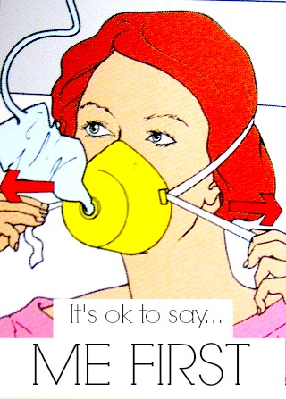

Slide 3
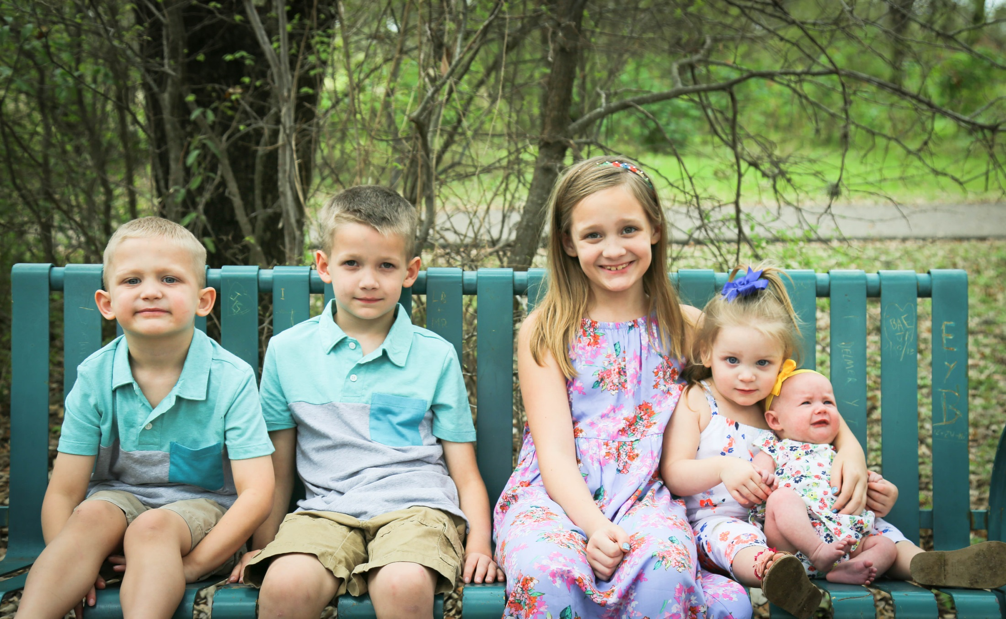

Slide 4
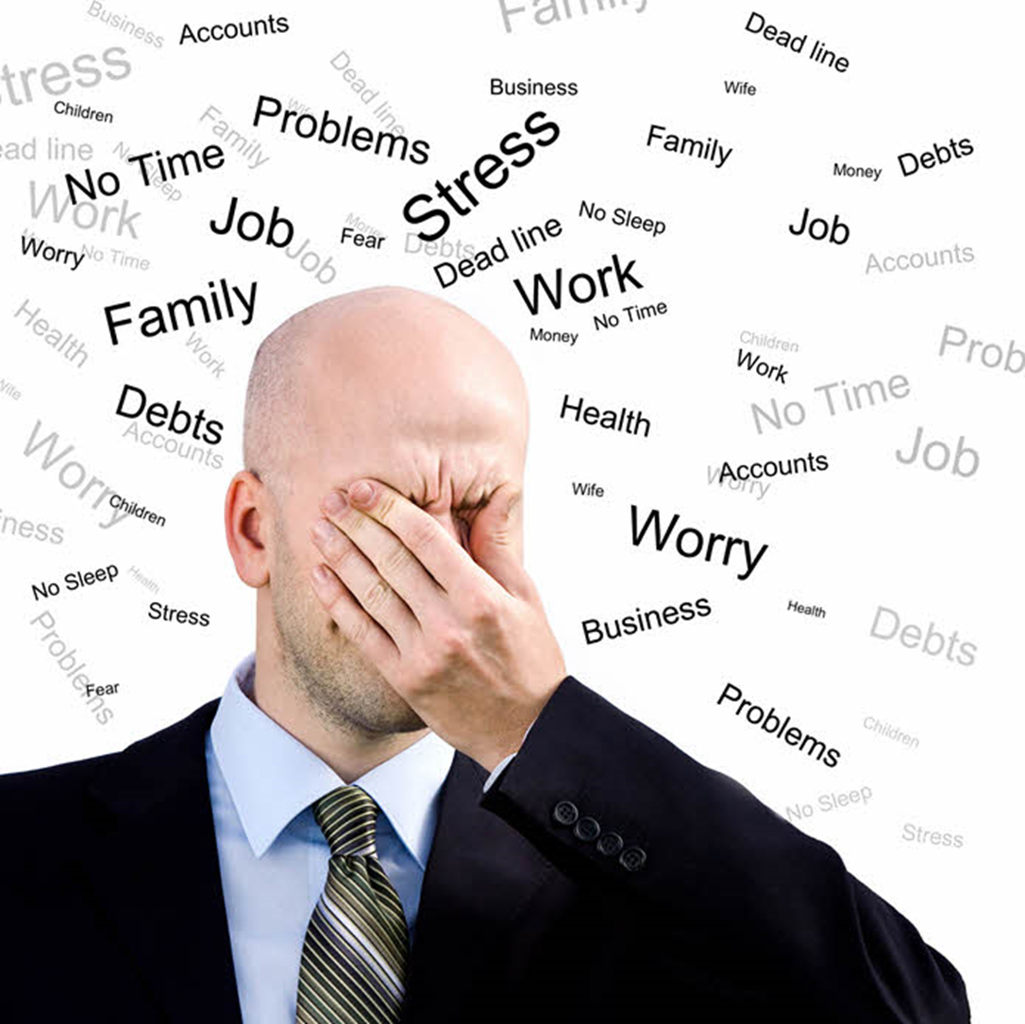

Slide 5
How many different hats do you wear?
How does this effect your stress level?
What is the cost to your Health? Family? Organization?

Slide 6
Take Ten.

Slide 8
What is
Compassion Fatigue?
The negative aspects of helping people
Notes:
The negative aspects of helping people
Also called “vicarious traumatization”
Refers to the PTSD-related symptoms due to working with patients and families who have trauma or grief
Differs from burn-out, but can co-exist
Can occur due to exposure on one case or can be due to a “cumulative” level of trauma

Slide 9
What is
Compassion Fatigue?
“vicarious traumatization”
Notes:
The negative aspects of helping people
Also called “vicarious traumatization”
Refers to the PTSD-related symptoms due to working with patients and families who have trauma or grief
Differs from burn-out, but can co-exist
Can occur due to exposure on one case or can be due to a “cumulative” level of trauma

Slide 10
What is
Compassion Fatigue?
PTSD-related symptoms due to working with trauma or grief
Notes:
The negative aspects of helping people
Also called “vicarious traumatization”
Refers to the PTSD-related symptoms due to working with patients and families who have trauma or grief
Differs from burn-out, but can co-exist
Can occur due to exposure on one case or can be due to a “cumulative” level of trauma

Slide 11
What is
Compassion Fatigue?
exposure on one case or from “cumulative” level of trauma
Notes:
The negative aspects of helping people
Also called “vicarious traumatization”
Refers to the PTSD-related symptoms due to working with patients and families who have trauma or grief
Differs from burn-out, but can co-exist
Can occur due to exposure on one case or can be due to a “cumulative” level of trauma

Slide 12
CF Defined
A state of tension and preoccupation with the individual or trauma of clients as manifested in one or more ways including
1) re-experiencing the traumatic event
2) avoidance /numbing of reminders of the event
A natural consequence and by-product of caring for, listening to and helping those traumatized – and learning about and hearing stories of those traumatized

Slide 13
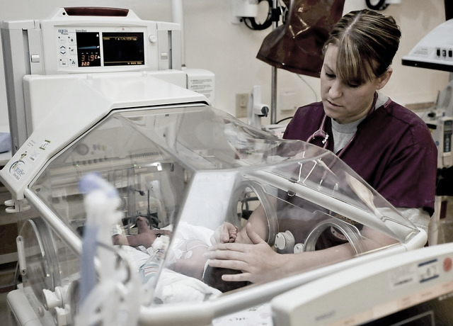
Compassion Fatigue vs. Burnout

Slide 14
Compassion Fatigue
State of tension and preoccupation with traumatized survivors
Work-related secondary exposure to extremely or traumatically stressful events
STS is about being afraid

Slide 15
Burnout
State of extreme dissatisfaction with one’s work
Work-related hopelessness and feelings of inefficacy
Burnout is about being worn out

Slide 16
Ask Yourself:
DO I LOVE MY WORK?

Slide 17
Indicators
01
02
PHYSICAL
EMOTIONAL
03
04
PERSONAL
WORK

Slide 18
Emotional Indicators
Anger / Irritability
Sadness, Depression
Prolonged grief
Anxiety
Numb
Notes:
Anger / Irritability: Blaming others for your problems. Feeling “angry at the world.”
Sadness, Depression: Lost your joy
Prolonged grief
Anxiety: View the world as dangerous, and increasingly vigilant about personal/family safety
Numb: Feeling hopelessness. Overwhelmed and exhausted. Don’t care anymore.

Slide 19
Personal Indicators
Isolation
Cynical, Pessimistic, Critical
Mood swings
Substance abusing
Memory/ Concentration problems
Self - Entitlement
Notes:
Isolation
Cynical, Pessimistic, Critical
Mood swings: Irritable with family
Substance abusing: drugs, alcohol, food or sex. Secretive self-medication
Memory / Concentration problems
Self - Entitlement

Slide 20
Physical Indicators
General Sickness
Flu or cold like symptoms
Lethargy
Sleep problems
Notes:
General Sickness: Headaches, Stomach aches, Dizziness, Heart palpitations, shortness of breath
Feeling panicky.
Flu or cold like symptoms. There is some evidence that CF leads to a weakening of the immune system.
Lethargy: Chronic lateness, Exhaustion (mental and physical)
Sleep problems: Can’t sleep, or sleep all the time, Nightmares from client’s stories

Slide 21
A Word About Sleep
Disruption of normal sleep patterns can be a primary cause of Compassion Fatigue
Notes:
It is during normal “deep” sleep that much of the processing of the traumatic experiences occur. When sleep is disrupted (either shorten or disturbed), the traumatic experience can become lodged in the sympathetic nervous system. Over time an accumulation of these unprocessed traumatic experiences can lead to Compassion Fatigue.

Slide 22
Work Indicators
Avoiding certain people
Missed appointments
Tardiness
Lack of motivation
Workaholism
Demoralized and question one’s competence and effectiveness
Un-appreciated and under-resourced
Notes:
Avoiding certain people
Missed appointments
Tardiness
Lack of motivation
Workaholism
Demoralized and question one’s competence and effectiveness
Un-appreciated and under-resourced

Slide 24
A Compassion Fatigue Trajectory

Slide 25
The Zealot Phase

Slide 26
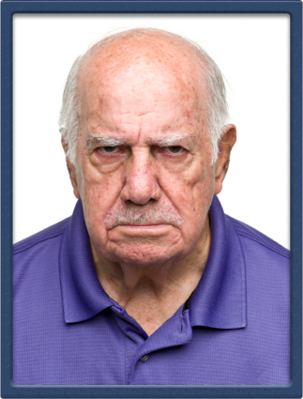
The Irritability Phase

Slide 27
The Withdrawal Phase

Slide 28
The Zombie Phase

Slide 29
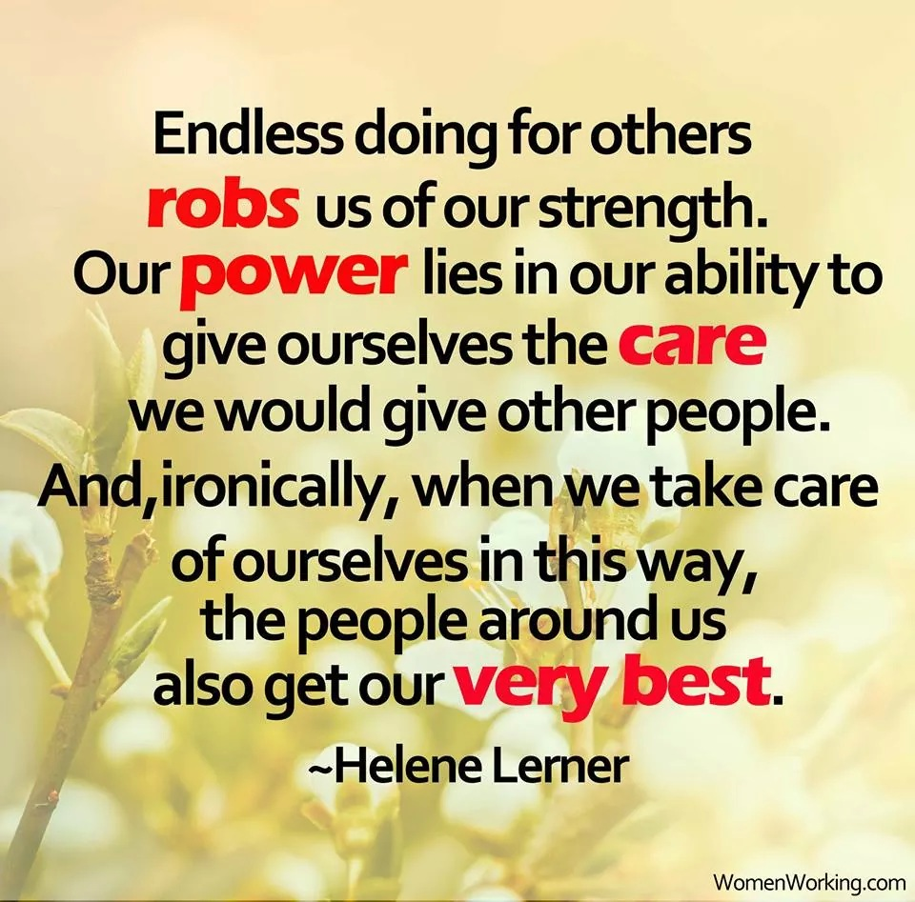

Slide 30
Recovery & Resiliency Planning

Slide 31
S.E.E. to it the 3 Wells become a Lifestyle

Slide 32
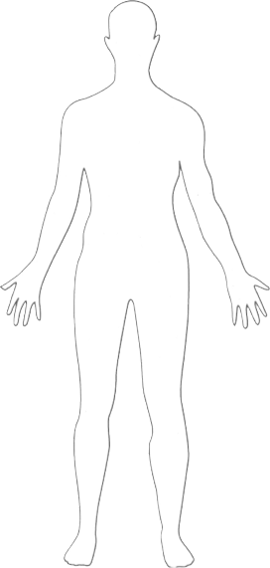
Physical
Sleep Well
Eat Well
Exercise Well

Slide 33
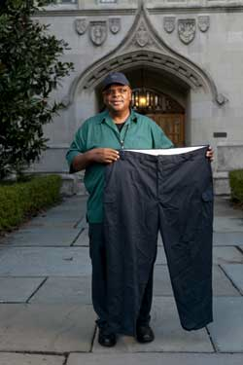
Gregory Minor
Lost 80 pounds in 18 months through Duke University’s Employee Wellness Program

Slide 34
Spiritual
Prayer
Meditation
Relationships

Slide 35
Emotional
Cry
Give/get physical contact
Laugh

Slide 36
Celebrate Victories!

Slide 37
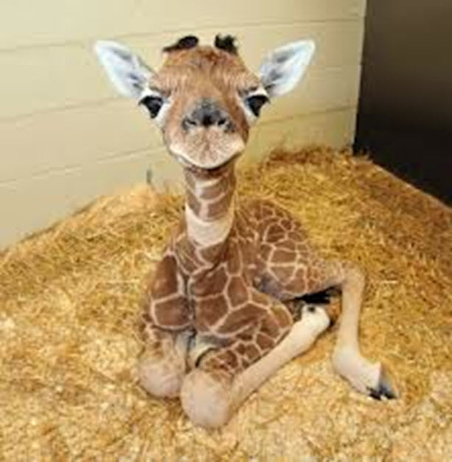

Slide 38
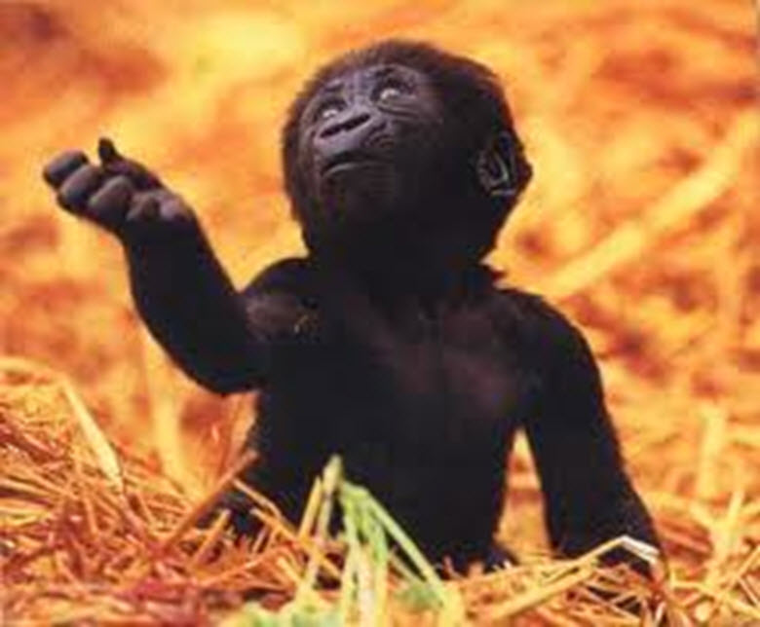

Slide 40
Psychological

Slide 41
https://www.youtube.com/watch?v=3m-LBusfIe4
Notes:
Please embed

Slide 42
Psychological & Mental Resilience:
Reflection
Learn to Say NO!
Love with Limits
Assess your trauma exposure
Spend quality time alone
Tackle Tiny goals daily
Notes:
Reflection –Know your motivation for serving.
Tackle Tiny goals daily to boost your will power

Slide 43
Workplace

Slide 44
Workplace Resiliencies
Self-care
Transitions
Awareness
Continuing Education
Set limits
Self Entitlement

Slide 45
Our goal is to transform “victims” into “victors”
Notes:
Maintain your emotional health
Develop good problem solving skills
Develop your inner self
Discover the skills and attribute in highly resilient people.
Shoot for the highest level of resiliency

Slide 46
Our goal is to transform “victims” into “victors”.
Maintain your emotional health
Develop good problem solving skills
Develop your inner self
Discover the skills and attribute in highly resilient people.
Shoot for the highest level of resiliency
Notes:
Maintain your emotional health
Develop good problem solving skills
Develop your inner self
Discover the skills and attribute in highly resilient people.
Shoot for the highest level of resiliency

Slide 47
Serendipity: The ability to turn misfortune into good fortune.

Slide 48
Compassion Satisfaction
The Positive aspects of helping
Pleasure and satisfaction derived from working in helping, care giving systems
Notes:
The Positive aspects of helping
Pleasure and satisfaction derived from working in helping, care giving systems
May be related to
Providing care
Dedication to the system
Work with colleagues
Beliefs about self
Altruism

Slide 49
Compassion Satisfaction
The Positive aspects of helping
Providing care
Dedication to the system
Work with colleagues
Belief in self
Altruism
Notes:
The Positive aspects of helping
Pleasure and satisfaction derived from working in helping, care giving systems
May be related to
Providing care
Dedication to the system
Work with colleagues
Beliefs about self
Altruism

Slide 50
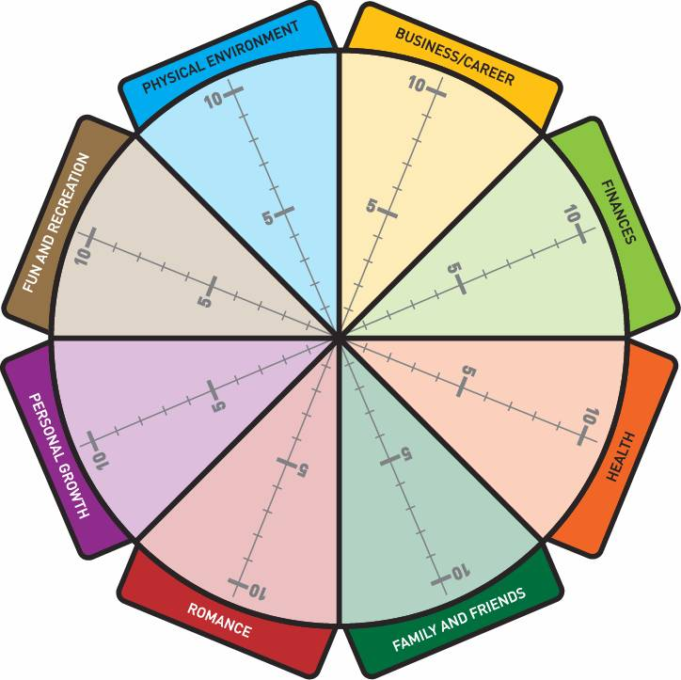

Slide 53
Thank you
www.cunninghamcompassion.com

