Slide 1
Working in Rural Settings: A conversation
Jennifer Abrams
Victim Advocacy Services of Planned Parenthood Mohawk Hudson, Inc.

Slide 2
Introductions
Name
Agency
What has been your experience working with rural communities?
What is your favorite part about working in a rural community?

Slide 3
Jennifer Abrams, CASAC Program Manager

Slide 4
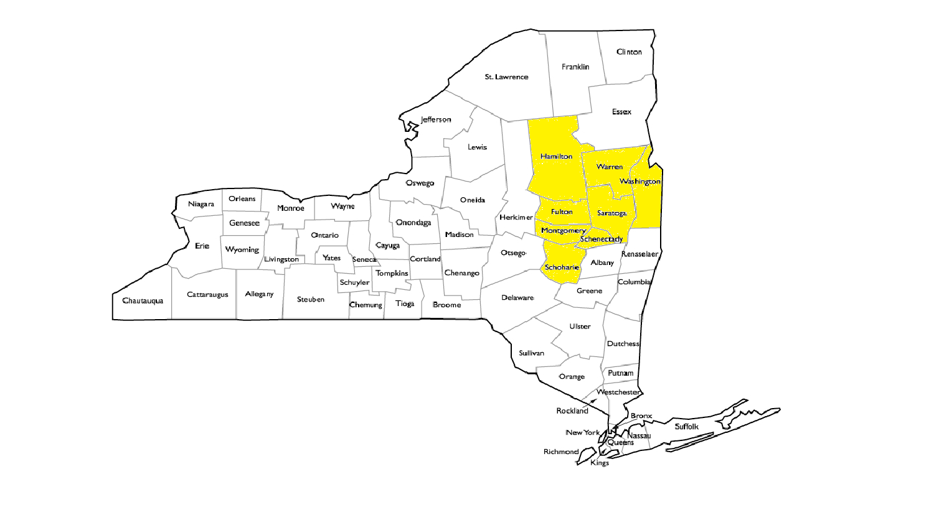
Victim Advocacy Services Coverage Area

Slide 5
Victim Advocacy Services Provides:
24-hour sexual violence hotline
Crisis counseling, both in person and over the phone.
Information about medical treatment, law enforcement reporting and criminal justice process
Accompaniment through forensic rape exam, police statement, and criminal justice process
Community referrals for information and aftercare
Assistance in accessing crime victims compensation from NYS Office of Victim Services.

Slide 6
Victim Advocacy Services Also provides free educational programming to school systems, community, and professional groups.
Topics Include
What is Sexual Assault?
Sexting and Cyber Safety
Dating Violence
Crime Prevention and Personal Safety
Bystander Intervention Training
Safe Campus
The Role of First Responders
Child Sexual Abuse
Trauma Informed Response for Law Enforcement and First Responders

Slide 7
Rural Programs
You are NOT ALONE

Slide 8
Rural Communities
Geographic isolation and poverty increase risk
Everybody knows everybody
Difficulties and risks for clients
Difficulties for service providers
Cultural norms of privacy, self-sufficiency
Family pressure to preserve reputation
Multi-generational, familial abuse

Slide 9
Rural Communities
Low service-seeking
Distrust of institutions
Lack of privacy (and safety)
Limited local services
Uncertain access or no access to services
Clients may move, change phones often
Limited transportation

Slide 10
Challenges
Isolation
Social Attitudes
Limited Resources
Staffing
Closeness of community
Diversity

Slide 11
What challenges have you experienced?

Slide 12
Strengths
Isolation
Social Attitudes
Limited Resources
Staffing
Closeness of community
Diversity

Slide 13
What Strengths have you experienced?

Slide 14
Questions?

Slide 15
Thank you DOH

Slide 16
Thank you LeaH Green, Resource Sharing Project, Iowa Coalition Against Sexual Assault

Slide 17
Thank you!
Jennifer Abrams, Program Manager
Victim Advocacy Services of PPMH, Inc.
(518)813-8914
j.abrams@ppmhchoices.org

