Slide 1
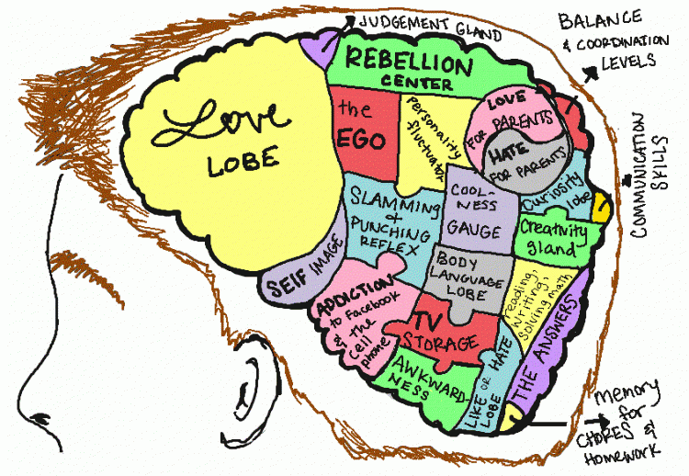
What’s Going On in the Adolescent Brain?
Jutta Dotterweich
ACT For Youth Center For Community Action
BCTR, Cornell University
BWIAH Provider Meeting
Albany, May 2019

Slide 2
Learning Objectives
Review basics of adolescent brain development
Discuss impact on adolescent behavior
Explore adult youth interaction
Identify promising strategies
Resources

Slide 3
Adolescence: It starts with …
Puberty, a complex process driven by hormones produced by the sex organs
Highly variable:
~ Girls 8-10
~ Boys 10-12

Slide 4
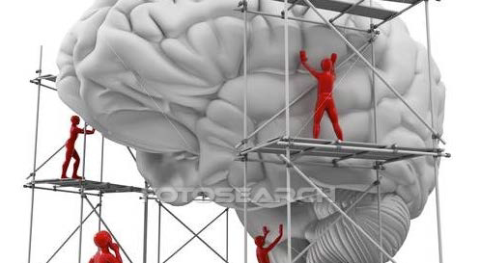
Every brain is built like a community
Cells (neurons) are the building blocks of different structures within the brain (gray matter)
Nerve fibers/tracts form the highways between them
Major critical regions are built first, then joined together, then specialized
Stimulation and activity molds how strongly each pathway works
The Developing Brain: Implications for Youth Program. 2014
http://www.childtrends.org/our-research/the-kristin-anderson-moore-lecture-series/

Slide 5
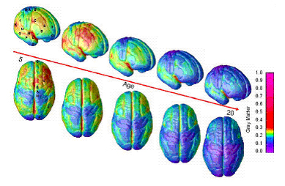
Timeline of Brain Development
Birth to 3 -- Time of rapid intellectual, emotional & physical growth of brain & brain “wiring”
By age 6 -- 95% of brain development completed
By age 10-12 -- 2nd major brain growth spurt
Adolescents (13-20s) Pruning and organizing

Slide 6
Nerve Proliferation
Tree growing branches and shoots
Nerve Pruning
Nerves that fire together
Get wired together!!!

Slide 7
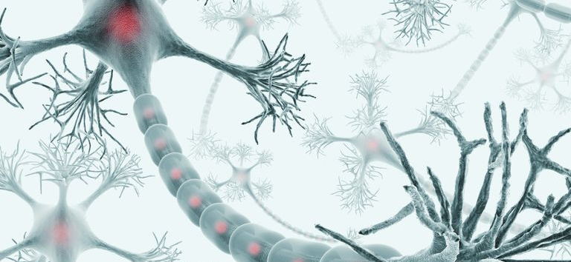
A Time of Opportunity and Growth
Video:
http://developingchild.harvard.edu/science/key-concepts/brain-architecture

Slide 8
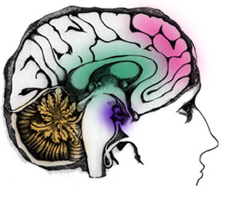
Brain Centers Mature at Different Times
Cerebellum/Stem Limbic System Prefrontal Cortex
Birth
Age 25

Slide 9
Limbic System
Emotion and reward center:
Arousal
Desire
Fear
Grief
Hot Cognition

Slide 10
Prefrontal Cortex
Reasoning Center
Planning
Attention
Judgment
Reflection
Impulse control
Second thought
Working memory
Modulating mood
Response flexibility
Goal-directed
Cold Cognition

Slide 11
Maturation Imbalance
Adolescent cognitive skills and capacities are comparable to adults
Reasoning and impulse control not yet fully development
When the emotional (limbic) system is aroused, pleasure and reward seeking will be dominant

Slide 12
Vulnerability & Opportunity
Increased risk taking and thrill seeking, substance and alcohol use, mental health issues
Increased injury/morbidity
Quick learners; early adapters
Trying out new things, developing own identity
Civic engagement; create social change
Skills become more efficient

Slide 13
Moderating Factors
Temperamental dispositions
Youth who mature early (early onset of puberty) are more likely to engage in risky behaviors
Peer group increases risk taking
Environmental supports make a difference
Supportive environments → better executive functions
Adverse environments → poor executive functions

Slide 14
Living in Adverse Environments
Impacts of chronic stress
Lack of planning
Lack of future orientation
Poor decision making
Compromises memory

Slide 15
Brain Plasticity
Good News!
The brain has a powerful ability to change, adapt, and rewire itself throughout life.
Individual neurons grow, and new ones are added to the active circuits
It changes how it uses its genetic code, in response to life experiences
Stimulation, nutrition, exercise, stress, all modify this growth rate of neurons
The Developing Brain: Implications for Youth Program. 2014
http://www.childtrends.org/our-research/the-kristin-anderson-moore-lecture-series/

Slide 16
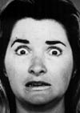
Adolescent Social Brain
Along with firing up the reward center puberty causes changes in other regions of the brain that oversee reactions to other people
Adolescents are more likely to “misinterpret” facial expressions
See anger, rather than fear →
respond with fight/flight
Over-interpret social cues from peers
Notes:
16

Slide 17
Adolescence: Key Points
Adolescence lasts longer than ever before
Time of growth & increasing efficiency
Emotional brain is in the driver’s seat
Reasoning and self-control are on the back seat

Slide 18
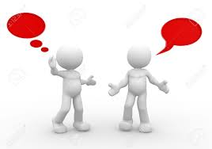
Conversation
How does this impact our work with adolescents?
What are some of the challenges?
Notes:
White board

Slide 19
Co-Regulation Model
Build supportive, responsive relationships
Coach self-regulation skills
Structure the environment

Slide 20
Activity: How do we make this model work for us?
Skills we need to coach
Goal setting, problem-solving, stress management, time management
Organization, planning
Supportive, responsive relationships
Support and empathy, responsive to needs, positive regard, model skills
Validation of emotional experiences, persistent reliable presence
Structure the environment
Limit risk opportunities; clear expectations and consequences
Time and space to relax and calm down
Notes:
In small groups

Slide 21
Empathic Communication
Active Listening
Practice Kindness

Slide 22
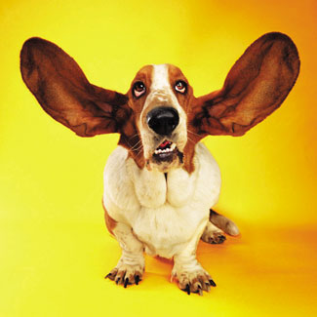
Active Listening
Listening for meaning
Attentive to speaker
Reflecting facts and feelings
Interpreting meaning, feelings
Withholding opinions and judgment

Slide 23
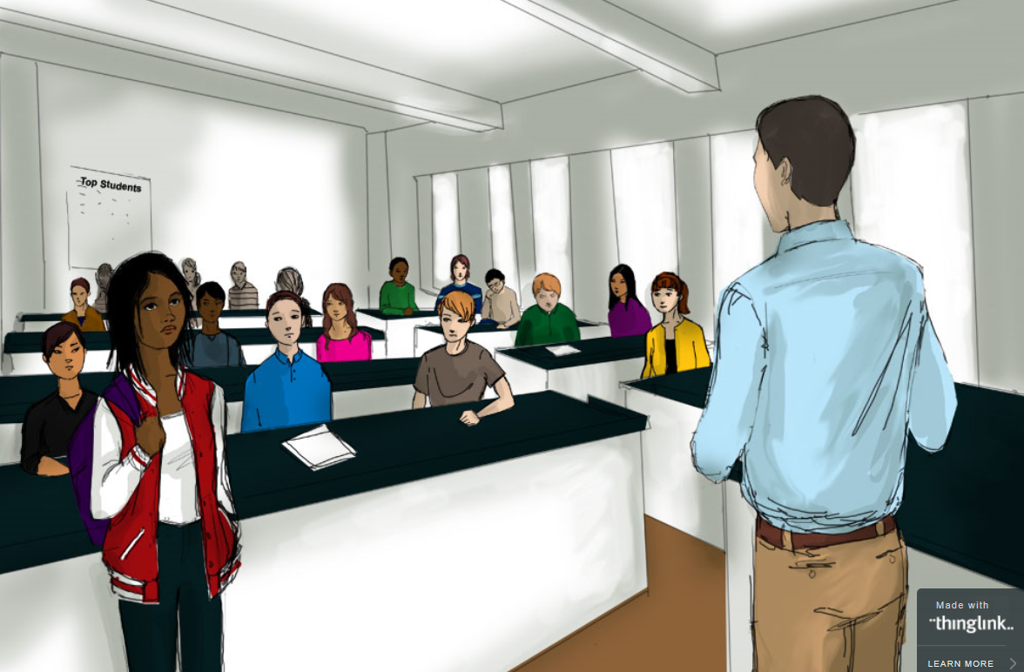
https://www.edweek.org/ew/section/multimedia/illustration-microaggressions-in-the-classroom.html
Beware of Microaggressions

Slide 24
Kindness - Microaffirmations
https://www.gse.harvard.edu/news/uk/16/12/accentuate-positive
Nodding and making eye contact with youth while they’re talking
Making sure to call on all youth equally
Referring to every young person by their name
Using inclusive language — for instance, talk about “families” instead of “parents”
Openly giving praise for a wide-range of actions, from answering a question right to sitting still during a lesson
Staying enthusiastic when interacting with youth

Slide 25
Strengthen Executive Functions
Working memory governs our ability to retain and manipulate distinct pieces of information over short periods of time.
Mental flexibility helps us to sustain or shift attention in response to different demands or to apply different rules in different settings.
Self-control enables us to set priorities and resist impulsive actions or responses
Source: Harvard’s Usable Knowledge: Executive Functions & Self-Regulation
https://developingchild.harvard.edu/science/key-concepts/executive-function/

Slide 26
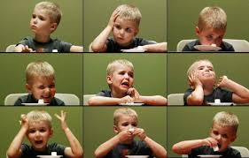
Self-Control
Walter Mischel: Marshmallow Experiment
https://www.youtube.com/watch?v=QX_oy9614HQ
Notes:
Self-control research goes back over 30 years - thanks to work of Walter Mischel who started his experimental work on self control at Stanford University and then moved it to NYC
Usually 1/3 of the children are able to control the impulse and delay immediate gratification.
Core findings:
Self-control is a great predictor for success later on in life (school, work, healthy lifestyle)
Self-control can be taught

Slide 27
How Does Self-Regulation Develop?
Weintraub, S. et al (2013)
Notes:
A range of tests measuring different forms of executive function skills indicates that they begin to develop shortly after birth, with ages 3 to 5 providing a window of opportunity for dramatic growth. This growth continues throughout childhood, with another spurt of development in late adolescence and early adulthood. These skills remain relatively intact over the adult years, followed by gradual decline in later life.
Source: Weintraub, S. (2013).NIH toolbox for the assessment of neurological and behavioral function: Cognition assessment using the NIH Toolbox.Neurology, 80 (11, suppl.3), S54-64.

Slide 28
Executive Function Activities
Provide experiences that promote emotional, social, cognitive, and physical development broadly, including strategies
Reduce stress
Foster social connections
Incorporate vigorous physical exercise
Increase complexity of skills step-by-step (scaffolding)
Include repeated practice over time
Activity Guides
https://developingchild.harvard.edu/resources/activities-guide-enhancing-and-practicing-executive-function-skills-with-children-from-infancy-to-adolescence/

Slide 29
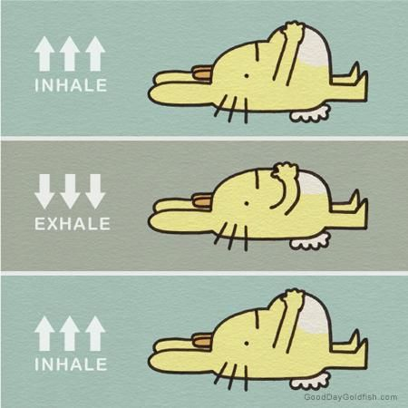
Integrate Stress Reducing Activities
- Relaxation exercises
- Physical activity
- Walks/activities in nature
- Creative/arts activities

Slide 30
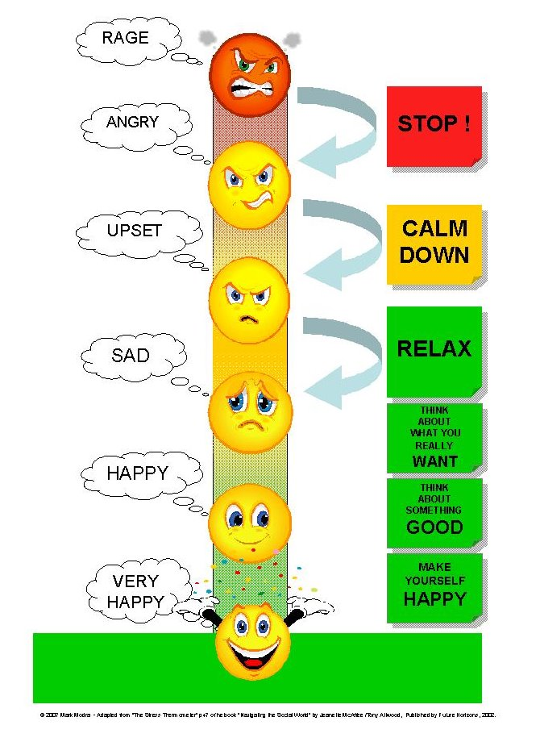
Self-Regulation
Self-Regulation
Emotional Thermometer
Calming Practice
If/Then Implementation
Calming Box

Slide 31
Hot Spots – If/Then Scenario
Identify stress: How do I feel?
.
Situational factor: What do I respond to?
.
Reaction: Aggression
Alternative behavior:
Walk away
.
Walter Mischel. 2014

Slide 32
http://www.actforyouth.net/youth_development/professionals/sel/

Slide 33
Problem solving & Goal setting

Slide 34
http://www.learnalberta.ca/content/insp/html/student/problemsolvingstrategy.pdf

Slide 35
NYU Character Lab: Self-Control https://www.characterlab.org/self-control/
Notes:
Different strategies to self –control/self regulation
Process model – first two strategies more effective
This model assumes that impulses/distractions develop and gather strength over time. and it’s more effective to intervene early than later
1 – chose situation – example sit in the front row of the class or chose your friends based on their behavior
2 – modify situation – change physical aspects. Example: cookie jar that is opaque is less tempting than a see through, small plate versus large plate; computer closed or phone put away
Less effective – more effort
3 – selective attention – make effort to track teacher or deliberately focus attention on somebody
4- re-appraising your situation, changing your mind – replay situation through your own eyes or from a distance like a youtube video
5 – will power – just do it
- Habits are also good like study habits
End by transition to WOOP – bringing strategies and practice executive functions together – setting goals and planning

Slide 36
And then there is WOOP
NYU Character Lab
https://www.characterlab.org/woop

Slide 38
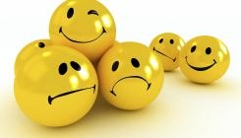
Any takeaways?

Slide 39
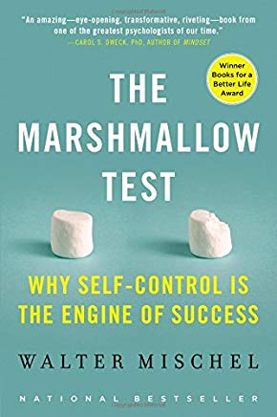
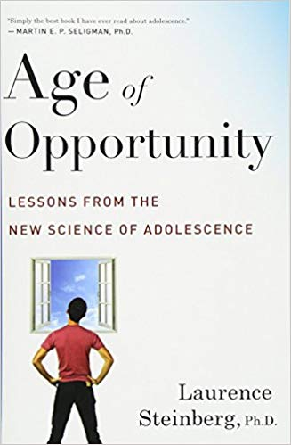
Resources
McNeely, C. et al. 2009. The Teen Years Explained: A Guide to Healthy Adolescent Development. Johns Hopkins University School of Public Health http://www.jhsph.edu/adolescenthealth/_includes/Interactive%20Guide.pdf
Walter Mischel. 2014. The Marshmallow Test. New York: Little, Brown Spark
Laurence Steinberg. 2014. Age of Opportunity. New York: Eamon Dolan/Houghton Mifflin Harcourt

Slide 40
Resources
Harvard’s Usable Knowledge:
- Fun and (Brain) Games https://www.gse.harvard.edu/news/uk/16/08/fun-and-brain-games
- Executive Functions & Self-Regulation https://developingchild.harvard.edu/science/key-concepts/executive-function/
Tools for Success https://www.gse.harvard.edu/news/uk/16/03/tools-success
ACF. Office of Planning, Research & Evaluation (OPRE):
Toxic Stress and Self-Regulations Reports https://www.acf.hhs.gov/opre/research/project/toxic-stress-and-self-regulation-reports

Slide 41
Resources
Brain Facts
www.brainfacts.org
Teen Brain - Frontline Special on PBS
http://www.pbs.org/wgbh/pages/frontline/shows/teenbrain
ACT for Youth – www.actforyouth.net
Adolescent Development (including toolkit)
http://www.actforyouth.net/adolescence
Professional development for youth workers
http://www.actforyouth.net/youth_development/professionals/

Slide 42
Jutta Dotterweich
Director of Training
ACT for Youth Center for Community Action
BCTR, Cornell University
www.actforyouth.net
jd81@cornell.edu
607-255-4108

