Slide 1
Medicaid Redesign Team (MRT)
Health Information Technology (HIT) Projects
Connecting pregnant women to needed services
Presented By DIVISION OF FAMILY HEALTH

Slide 2
Agenda
Slides
MRT HIT Background and Goals | 3-7
Key Partners | 8
Accomplishments & HIT Systems High Level Functionality | 9-10
How the HIT Systems Work? | 11-20
Who Sees What? | 21
DOH Reports Summary | 22
Network of Providers | 23
HIT Systems Walkthrough | 24
Challenges | 25
Next Steps | 26
Questions & Answers | 27

Slide 3
Background
MRT Health Disparities Workgroup’s Key Recommendations
Promote awareness of, and address health disparities in maternal and child health
Support initiatives to demonstrate the effective and efficient use of health information technology (HIT) among hospitals, health care systems and community-based organizations to improve coordination and delivery of care to eligible high-risk pregnant women
*Source: MRT Health Disparities Work Group Final Recommendations, October 2011

Slide 4
Monroe Plan*
Goal - Reduce NICU admissions by at least 15% & maintain that reduction during project
Methods
1. Submission of Prenatal Registration Form (PRF) covering social, maternal medical, psycho-neurological & obstetrical history and previous births findings.
2. Reimbursement for submission of PRF’s.
Period
1998 to 2003
Clients Served & Network
48,000 Medicaid Managed Care enrollees served by 3000+ providers
Results
NICU admissions decreased in Monroe, whereas there was a constant rise in the rest of the Upstate NY.
*Source: Reduction in Neonatal Intensive Care Unit Admission Rates in a Medicaid Managed Care Program - The American Journal of Managed Care, March 2005

Slide 5
MRT HIT Project Goals
Birth outcomes for women and babies can be greatly improved when high-risk pregnant and postpartum women receive early, comprehensive screening and timely referrals.
Early & comprehensive screening of risks for eligible women
Coordinated service delivery, leading to referrals among community providers
Timely medical and social interventions addressing risks

Slide 6
MRT HIT Goals
#1 Implement, refine, and enhance the technology infrastructure to meet the intended goals and objectives of the MRT-HIT initiative to support a comprehensive system of prenatal risk assessment, identification, and referral through linkage of a web-based referral and case management system responsive to the needs of the target Medicaid population.
The system serves a geographically defined Medicaid population.
The system integrates the Medicaid Prenatal Care Coordination form to assess pregnancy-related, medical and psycho-social risk factors as the basis for risk identification and referral to community partners.
Prenatal risk information is accessible by collaborative partners, including community-based health and human service organizations, Medicaid managed care plans, health care providers including prenatal care providers, behavioral health services, hospitals, health care systems and RHIOs to facilitate referrals to needed services.
#2 Addresses and include necessary client consents related to access and sharing of patient records. Issues related to data privacy, regulatory compliance, healthcare data management, health information sharing and retention are addressed.
Notes:
#3 Recruit additional partners responsive to the pregnancy-related, medical and psychosocial risks of the target community.
#4 Assess and develop linkages with the MRT-HIT systems, Electronic Medical Record (EMR) systems used by health care providers and RHIOs, to facilitate care coordination and data sharing among systems.
#5 Submit quarterly data to the NYSDOH, using the standard data reporting format developed in collaboration with the NYSDOH.
#6 Develop a sustainability plan for the MRT-HIT system, including expansion to additional and maintenance of current partners, and addressing associated costs of system implementation / operation.

Slide 7
#5007 Medicaid Prenatal Care Coordination Form
One of the foundational pillars of HIT systems
Developed by a workgroup of NY perinatal experts
Form finalized in 2011
Communication and referral tool to coordinate the provision of needed services

Slide 8
Key Partners
Grantees | Technology Partner | RHIO’s | Service Providers
Healthy Baby Network (HBN). A CBO, and also a MICHC provider. | PeerPlace Networks (Web-based Systems) | Greater Rochester Regional Health Information Organization (GRRHIO) | Prenatal Care Providers Hospitals/Medical Centers Social Service Agencies Home Visiting Programs FQHC’s MMCO’s Community Based Org’s Behavioral / Mental Health Outreach Programs CHW’s Others
Onondaga County Health Dept. (OCDH). Also a MICHC provider.
 |  | HealtheConnections (HeC)
Brooklyn Perinatal Network (BPN) – A community based orgn. |  | Healthix
Lower Hudson Valley Perinatal Network Discontinued - April 2017 |  | HealthlinkNY

Slide 9
Accomplishments So Far
Integrating DOH 5007 form, scalable HIT systems and DOH statistical summary reports are developed, tested and implemented for the three projects.
Consent language approved by DOH Division of Legal Affairs.
Two versions of PRF were deployed to limit access to PHI for non-clinical providers.
All three projects connection/re-connection established with the RHIOs’. Perinatal Care Summaries available at the RHIOs, with client consent.
HIT systems went live on 2/26/18 for all three projects – with full data collection 9/18.

Slide 10
HIT Systems High Level Functionality
Existing Operational Capabilities
A prenatal care provider completes an on-line Prenatal Care Coordination form assessing a women’s medical and psychosocial risk factors.
Referral service providers can be identified based on risks identified, and the contents of the assessment can be securely communicated as part of the referrals.
Service providers can then review referrals, accept/reject, document any services provided as part of the referral, and close the referral.
Patient demographics, summary record of assessments, related referrals and service provider notes can be made available to other providers through RHIO access.
A standard format for the submission of aggregate data to the Department on women served through this project has been developed and getting reported every quarter.

Slide 11
How the HIT Systems Work?
PeerPlace User
PeerPlace SaaS
Pitching Provider
Receiving Provider
Steps
2
3
4
5
Client accepts
referral
6
Conduct client search
Conduct screening and fill PRF
Search and view Referral Results
Process referrals
Review
referrals
Found
Accepts
referral
1
Client refuses referral
Rejects referral
7
Not Found
Creates new client record
Update comments. Save & exit.
Offers services
Start
Update reasons Save & exit.
Update comments. Save & exit.
Automated status updates
8
PCS gets transmitted real time
Prenatal Care Summary (PCS)
Provider A
9
RHIOs*
Providers accessing
PCS through RHIO
Provider B
*Client consent required by provider(s) to access PCS at the RHIOs.
Non PeerPlace Provider
Non PeerPlace Provider
End

Slide 12
HIT Systems Prenatal Risk Form (PRF)
Online PRF is the improved replica of DOH’s Care Coordination form #5007

Slide 13
PRF Social Risks
New risks that are not listed, can be configured.

Slide 14
PRF Pregnancy Risks
Several confidential pregnancy risks were moved under the ‘Confidential Risks’ section

Slide 15
PRF Medical Risks

Slide 16
Confidential Risks
Without checking the “Confidential Risks” consent checkbox, referrals cannot be made for these risks.

Slide 17
Three Consents
Consent for sharing confidential risks

Slide 18
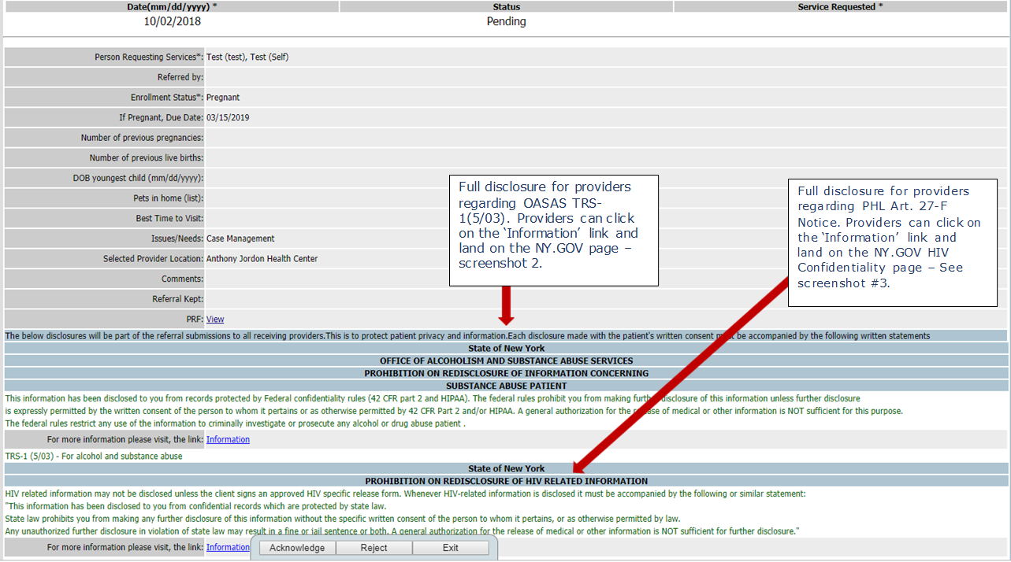
Disclosures–OASAS TRS-1(5/03) & PHL Art. 27-F Notices

Slide 19
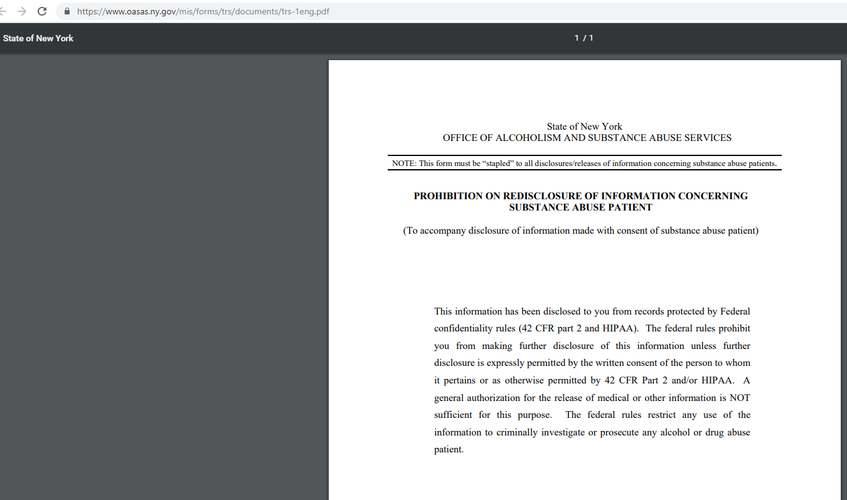
DOH Disclosures – OASAS TRS-1(5/03) Form
After clicking on the ‘Information’ weblink

Slide 20
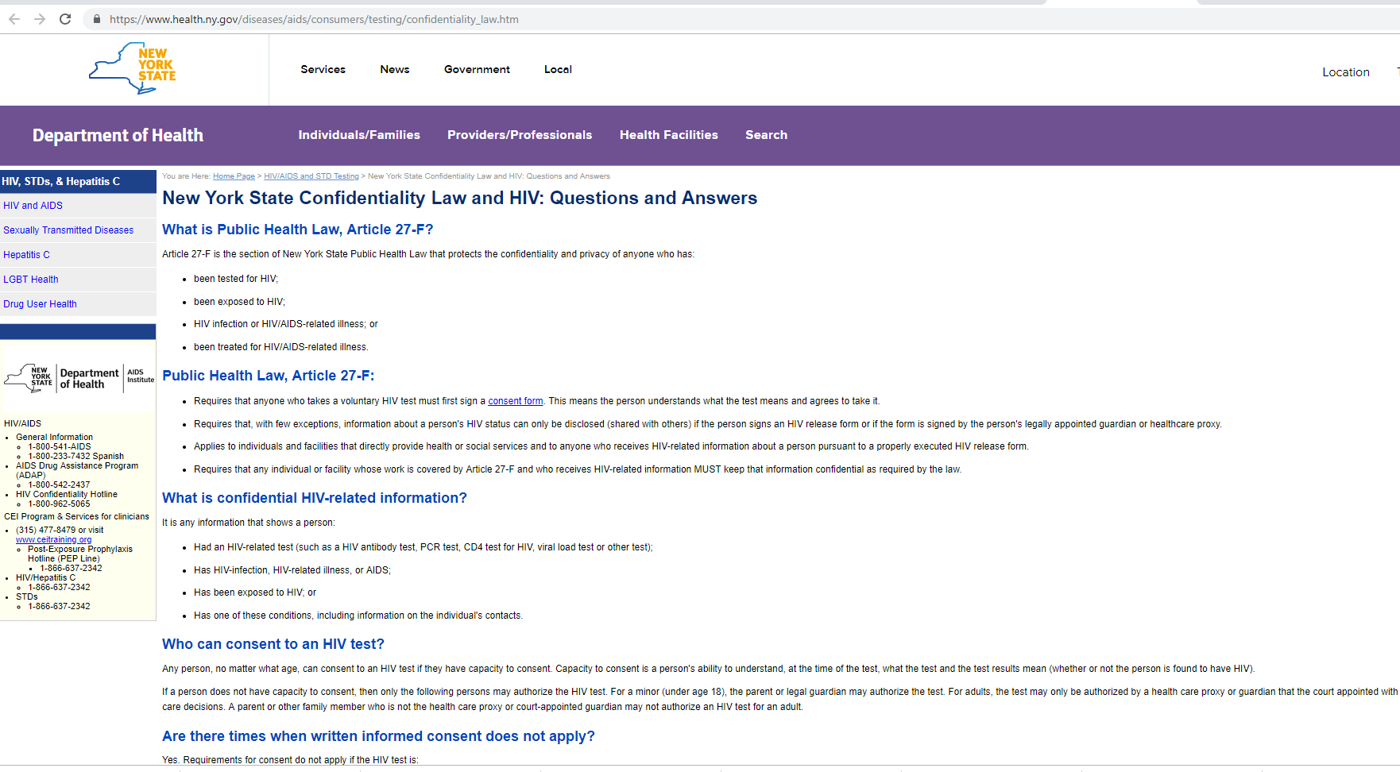
DOH Disclosures - PHL Art. 27-F
After clicking on the ‘Information’ weblink

Slide 21
Who sees what?
# | Electronic DOH Risk Form Sections | Information Displayed for Receiving Provider
 |  | Limited Version User | Full Version User
1 | Eligibility Screening | Yes | Yes
2 | Referral Details | Yes | Yes
3 | Additional PRF Demographics – Height, Weight, BMI, Due date, EDC etc. | Yes | Yes
4 | Social risks | Yes | Yes
5 | Medical Risks and Pregnancy Risks | No | Yes
6 | Confidential risks (two new sections) | Yes, with client consent to a specific provider. | Yes, with client consent to a specific provider.
7 | Consent #1 & #2 (Mandatory) | Yes | Yes
8 | Consent #3 for Confidential risks’ (Optional) | Yes, if client has confidential risks. | Yes, if client has confidential risks.
9 | Disclosures (HIV/AIDS, Substance Abuse) | Yes | Yes

Slide 22
DOH Reports Summary
Data summarized in brief highlight report and 33 detailed aggregations
# of clients screened
# of referrals processed and appointments made
Timeliness of referrals
# of care summaries transferred to RHIOs’
Provider mix summary
Client demographics:
- Race/ethnicity - Marital status
- Age group - Primary language
- Medical insurance - Trimester
38 DOH Approved Services Types, including 15 in #5007 form

Slide 23
Network of Providers
Provider Type | OCHD | BPN | HBN
Total | 63 | 7 | 11
Prenatal Care Providers | 13 | 1 | 6
FQHC's and Prenatal Care Providers | 1 |  | 1
FQHC’s other than Prenatal Care Providers | 1
Medical Centers, other than Prenatal Care Providers | 2
Hospitals, other than Prenatal Care Providers | 11
Home Visiting Programs | 5 | 1 | 3
Public Social Service Agencies | 3
CBOs that are not Home Visiting programs | 8 | 5 | 1
Public Health Departments – Including OCHD | 5
MMCO's | 2
Behavioral/Mental Health | 12
Medical Centers, Hospitals
13
CBOs, Social Services & Home Visiting
26
2
MMCO’s
Prenatal Care Providers (PCPs)
20
5
Public Health Depts.
Behavioral / Mental Health
12
All FQHCs, and PCPs other than FQHCs
3
Period - 12/02/2018 to 2/28/2019

Slide 24
HIT Systems Walkthrough
Pitching Provider
Logging in and searching an existing client or creating one, if no results found.
Conducting risk assessment using online Prenatal Risk Form
Search providers and refer, based on client consent.
Receiving Provider
Review their client referrals queue, accept/reject them
If accepted, contact the client, set up appointment and update system
Provide needed services on the date of appointment and update system by closing the referral.

Slide 25
Challenges Onboarding New Providers
Duplicate data entry in multiple systems
Subscription to existing EHR systems
Competition from similar systems E.g. Healthify, NowPow
Costs of maintenance and sustainability
Finding & connecting to the decision-maker in an organization

Slide 26
DOH - Next Steps
Analyze data from the quarterly reports submission
Make recommendations on effectiveness for risk identification and referrals
MRT HIT Projects - Next Steps
Quarterly reports submission
Continue HIT network expansion and provider enrollment including MMCOs
Continue efforts to expand, and integrate HIT systems with EMRs
Maintain HIT systems and RHIO connections
Implement sustainability plan

Slide 27
Questions and answers

