Slide 1
Understanding and Addressing the Impact of Stalking on Young People
Presented by:
Lorien Castelle, Director of Prevention Nasim Sarbandi, Project Coordinator

Slide 2
ABOUT US
Statewide Membership Organization
Members:
Domestic violence service providers, allied agencies and community members
Mission:
Create and support the social change necessary to prevent and confront all forms of intimate partner violence
Work:
Training, technical assistance, public policy, systems advocacy, best practices, broad-based collaboration
Philosophy:
Anti-oppression, trauma informed, and survivor centered principles integrated into all of our work

Slide 3
IMPORTANT INFO
Identify the most common ways technology and
online spaces are misused in the context of intimate partner stalking among student populations
• Identify strategies survivors can use to increase privacy and securely access technology and online spaces
Stalking laws and remedies
• Learn strategies for helping survivors safety plan

Slide 4
Definition of Stalking
A pattern of behavior directed at a specific person that would cause a reasonable person to feel fear.*
A Pattern of Behavior… Not a single incident or “one off” event. Called a “course of conduct” in most stalking statutes
Context is Critical in Stalking Cases
* Slide’s information from SPARC

Slide 5
Stalking Facts
Prevalence across Lifetime: More than 1 in 6 women & more than 1 in 17 men. (Smith, S.G, et al (2018). The National Intimate Partner and Sexual Violence Survey (NISVS) 2015 Data Brief. Atlanta, GA: National Center for Injury Prevention and Control, Centers for Disease Control and Prevention)
Women are more likely than men to experience stalking. (The National Intimate Partner and Sexual Violence Survey (NISVS): 2010 Summary Report, Center for Disease Control (2011)
18-24 year olds experience the highest rates of stalking. (The National Intimate Partner and Sexual Violence Survey (NISVS): 2010 Summary Report, Center for Disease Control (2011)
Most stalkers are male. (The National Intimate Partner and Sexual Violence Survey (NISVS): 2010 Summary Report, Center for Disease Control (2011))
The majority of the time, the victim knows the perpetrator. (The National Intimate Partner and Sexual Violence Survey (NISVS): 2010 Summary Report, Center for Disease Control (2011))

Slide 6
Stalking facts
Does leaving = Safety?
Notes:
Women are 4 X more likely to be physically assaulted, sexually assaulted and stalked post separation.
Patricia Tjaden and Nancy Thoennes, NIJ
Stalking Victimization, Labeling, and Reporting: Findings From the NCVS Stalking Victimization Supplement
Kim S. Ménard, Amanda K. Cox
Helmer, Bureau of Justice Statistics Data User’s Workshop

Slide 7
Stalking Facts

Slide 8
Identifying a Pattern of Behavior

Slide 9
Identifying a Pattern of Behavior

Slide 10
Identifying a Pattern of Behavior

Slide 11
Understanding and Addressing the Impact of Stalking on Young People
Section 2: Technology Abuse, Safety Planning, Evidence Gathering, And Using Technology To Increase Safety
Tools Abusers Use To Stalk And Harass
Safety Planning With Survivors
Gathering Evidence Of Technology Abuse

Slide 12
TECHNOLOGY ABUSE
Simple Complex
Monitoring or changing functions or features
Manipulating features
Eavesdropping on calls
Spying on activity
Track location via phone app such as family location feature or find my phone

Slide 13
TECHNOLOGY ABUSE
Email & Messaging
Abusers can gain access to email accounts, phones, etc.
Delete messages
Send fraudulent messages to coworkers, family and friends
Intercept and monitor messages

Slide 14
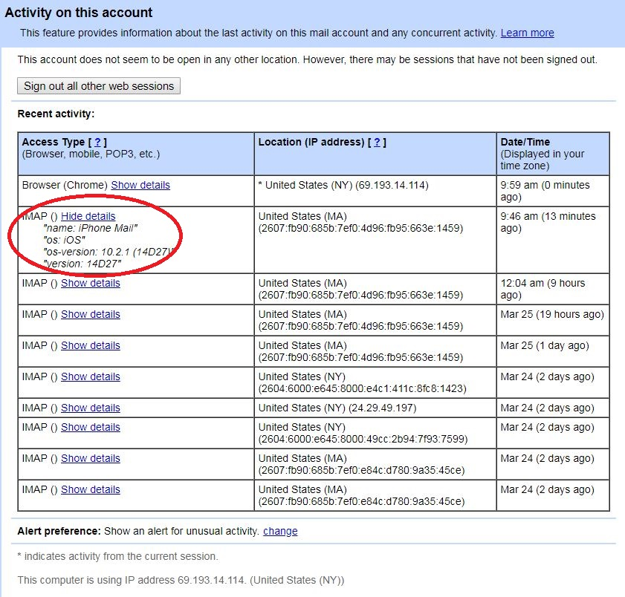
Active sessions on Gmail

Slide 15
TECHNOLOGY ABUSE
Text Messaging & Instant Messaging
Messages can be falsified, spoofed, or sent anonymously from the carrier’s website or other third party services
Apps and services can make evidence collection more difficult, e.g. Tiger Text, Snap Chat, etc.
Notes:
Go over terminology and tactics, such as “leashing”

Slide 16
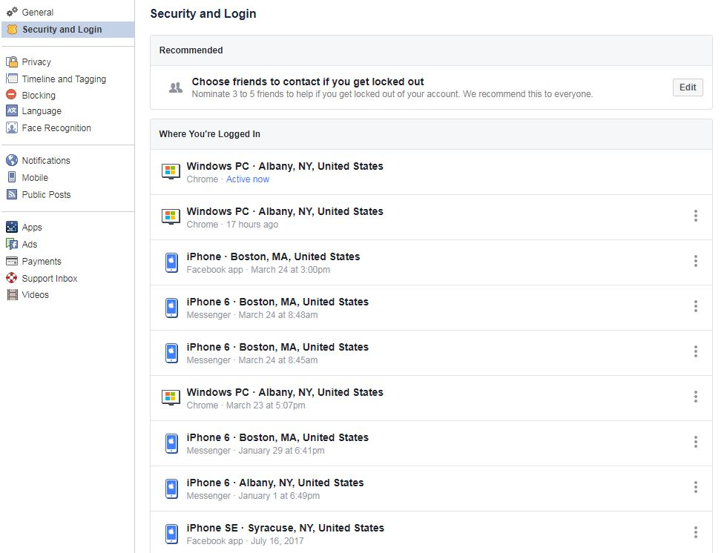
Active sessions on Facebook

Slide 17
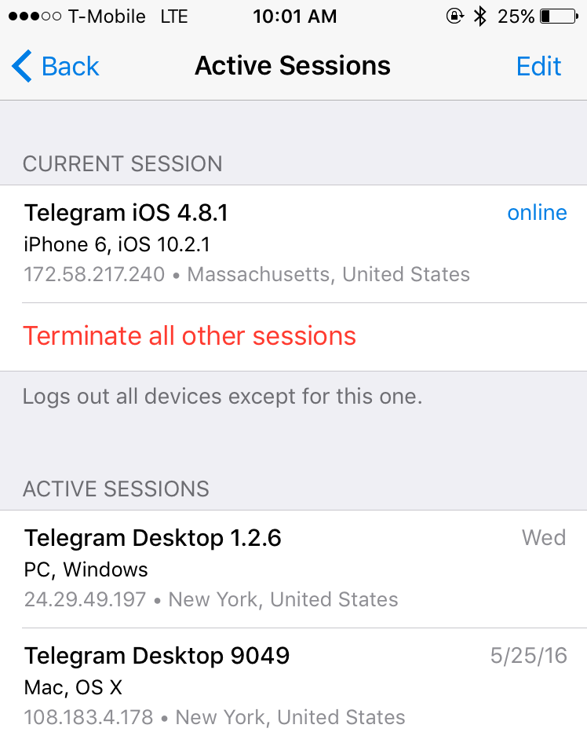
Active sessions on messaging apps

Slide 18
TECHNOLOGY ABUSE
Messaging, Phones & Evidence Collection
With a valid search warrant, a carrier might be able to retrieve deleted messages or document that messages were sent from one party to another
Using special software, law enforcement might be able to extract old backup files (e.g. iTunes / iPhone backups)
SIM cards, internal memory and MicroSD cards may contain evidence
Survivors can take screenshots, photographs or video of phone and message content, as well as the properties of a message (time & date stamp, contact info: name and number sent from)

Slide 19
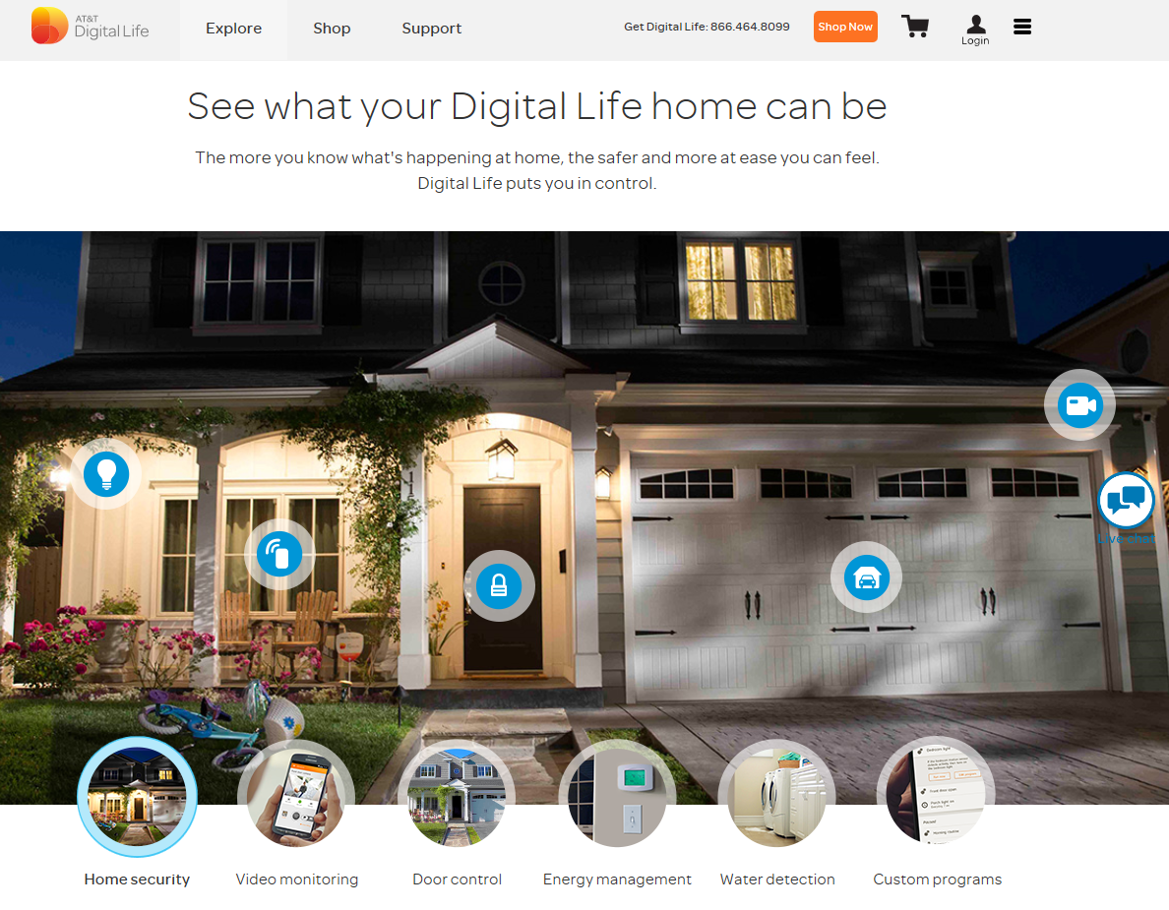
TECHNOLOGY ABUSE
Smartphones & Apps
Many companies now offer connecting your smartphone to your home security system (Ex. – AT&T Digital Life)
Notes:
TALKING POINTS:
(e.g. AT&T Digital Life) https://www.youtube.com/watch?v=7xx7jVTFTHE

Slide 20
TECHNOLOGY ABUSE
Smartphones & Apps
Receive text and video alerts of events at home
Arm or disarm the alarm, unlock, lock and open doors
Monitor indoor activity with contact sensors and cameras
Family Map / Family Locator Plans
Teen driving monitors
Apps can be renamed, or completely invisible
Photo apps that allow users to hide pictures, sometimes behind other pictures that require a password to be viewed

Slide 21
TECHNOLOGY ABUSE
Caller ID & Email Spoofing
Caller ID spoofing gives the caller the ability to show a different number on the caller ID display, change their voice, and record calls
Email spoofing is the creation of email messages with a fake email address, misleading the recipient about the origin of the message
Can you identify situations that these tools might be helpful for survivors?
Notes:
Insert spoof call demo video
https://www.youtube.com/watch?v=frSiBOrhgxI

Slide 22
SAFETY PLANNING
Spoofing, Safety Planning & Evidence
If survivor suspects a call has been spoofed, they can call the number that came in to check if a call was actually placed
Spoofed numbers do show up on the survivors bill, but the owner of that number will not show a call on their bill.
You can often identify the source of an email spoof by the IP address in the received line

Slide 23
SAFETY PLANNING
Truth In Caller ID Act of 2009
Signed into law December 2010 and enacted in June 2011, this law prohibits caller ID spoofing for purpose of defrauding or otherwise causing harm
The FCC now:
Prohibits any person or entity from transmitting misleading or inaccurate caller ID information with the intent to defraud, cause harm, or wrongfully obtain anything of value
Subjects violators to a penalty of up to $10,000 for each violation
Exempts authorized activities by law enforcement agencies and situations where courts have authorized caller ID manipulation to occur

Slide 24
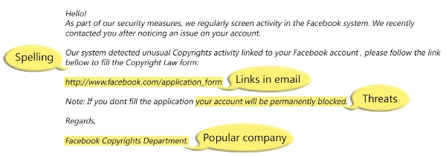
Technology abuse
Phishing
- Phishing is a method of trying to gather personal information using deceptive e-mails and websites.
- It uses social engineering methods to convince you to click or download something

Slide 25
TECHNOLOGY ABUSE
Cell Phone Spyware
Hardware example: SIM Card Spy – Transfer files on a cell phone SIM card to a computer for viewing, saving and editing
Software can be difficult to install without physical access, but also can be very difficult to detect

Slide 26
TECHNOLOGY ABUSE
Detecting Cell Phone Spyware
Unusual battery drain, or battery is warm when not in use
Unexplainable spikes in data usage
May take longer to shut down
Screen may light up when not using
May hear clicks or sounds when on calls
Additional incoming calls on the bill that user didn’t receive
Perpetrator knows things that could only be known with access to the phone
Perpetrator currently has or has had physical access

Slide 27
SAFETY PLANNING
Safety Planning For Phones
Ensure phone use is a part of every safety plan
Use passcodes – the more complex, the better
Use pay-as-you-go phones
Treat usual phone like a tracking device
Be wary of “gifts”
Always give location information to 911 in an emergency in case phone settings have been changed without your knowledge
Unmask blocked calls (TrapCall)

Slide 28
SAFETY PLANNING
Safety Planning For Phones
Educate and strategize about safe phone use and increased privacy
Document calls, text messages, photo & video messages (date, time, content, number / IP address)
Record if possible, particularly if it is threatening (apps are available)
Print out call logs and billing records that corroborate the documentation

Slide 29
TECHNOLOGY ABUSE
Computer Spyware
Can be used to record all:
Keystrokes
Websites visited
Emails and IMs
Windows and application details
Can take screen shots
Restart, shutdown & logoff computer
Control desktop and mouse remotely
Make computer talk

Slide 30
SAFETY PLANNING
Computer Spyware and Safety Planning
Clearing history is not enough
Identify safer computers (libraries, friends' houses, internet cafes, etc.) that can be used for sensitive web surfing
If a survivor’s computer (or phone) is being monitored, it may be important to continue using it, so as not to alert the abuser and risk escalation
Create separate safe email/IM accounts and don’t use your name

Slide 31
TECHNOLOGY ABUSE
GPS Technology
Track a person or object using satellite technology in real time
Vehicle navigation systems
Small and easily hidden
Affordable and readily available (ex. Tile)

Slide 32
SAFETY PLANNING
Safety Planning & GPS Technologies
Trust instincts
Do visual sweeps or ask law enforcement, mechanic or private investigator to do a sweep
If a device is located, strategize about the removal – remember it might be better to leave it where it is

Slide 33
TECHNOLOGY ABUSE
Social Media
Abusers can use social media to stalk and harass survivors
Abusers can gain access to a survivor’s profile without consent
Abusers can create false profiles

Slide 34
SAFETY PLANNING
Social Media & Privacy
Virtually every social media app has location based features that you opt into when you first set up the app
Posts and media are automatically time stamped and geo-tagged with the general or exact location
Privacy settings change regularly and can be very nuanced
Abusers can create false profiles on social media sites

Slide 35
SAFETY PLANNING
Social Media & Safety Planning
More than Facebook!
Keep profile settings as private as possible
Only login on trusted devices
Always logout!!
Remember that even when set to private, abusers can still access
Review: What are you sharing? Who do you want to see it?
Avoid tying accounts to optional personal information
Use print screen to track harassment, stalking, etc.

Slide 36
SAFETY PLANNING
Social Media, Online Privacy, & Safety Planning
Data brokers
Do a Google search of your name
Profile pictures
Post only what you want the public to see or know, even if you have your page set with privacy in mind – once it’s been shared online, it’s out of your control
Request that people not post personal information about you on social media (including tags and check-ins)
Blocking and un-friending
Temporary deactivation of accounts is often available

Slide 37
SAFETY PLANNING
You can report online abuse!
Most sites have rules about what is allowed on their site
Some content can be removed based on the site’s:
– Terms of Service, Content Policies, Community Guidelines/Standards
• Most sites will remove images or videos content if
the person who posted it doesn’t have copyright over the material*

Slide 38
TECHNOLOGY ABUSE
Video & Audio Monitoring
Hidden cameras cheap and easy to get
Very small, can be hidden anywhere and difficult to detect
Phones can be left in places and set to auto answer so that conversations can be monitored

Slide 39
SAFETY PLANNING
Safety Planning & Recording Devices
Trust instincts
Where does the victim feel like they are being watched/overheard?
Any new gifts or objects in the space they are being monitored?
Meet in secure locations that aren’t being monitored
If device is located, assess best next steps – will abuse escalate if device is found? Will it be tampering with evidence?
Obtain equipment to sweep for wireless signals

Slide 40
TECHNOLOGY ABUSE
Wi-Fi Routers
Unsecured routers can be used to hijack devices; email accounts can be taken over; can use the connection for malicious/illegal purposes
Wireless routers can be set to record all sites visited by any device connected to it
Access to websites can be blocked (firewall)

Slide 41
SAFETY PLANNING
Wi-Fi Routers
Don’t connect to public WiFi
Secure your wireless network (change the SSID and password protect)
Use WPA2-PSK {AES} security
Change default administrator passwords and usernames
Turn off when not in use for extended periods of time
Check for firmware updates

Slide 42
SAFETY PLANNING & EVIDENCE GATHERING
Tech Abuse Safety Planning & Evidence Gathering
Always do emotional safety planning first
Pay attention to the subtleties of a survivor’s story
Ask clarifying questions to identify the what, the how, the when and the where
Consider not just the survivor’s use of technology, but also those they are close with

Slide 43
SAFETY PLANNING & EVIDENCE GATHERING
Tech Abuse Safety Planning & Evidence Gathering
Don’t overwhelm survivors
Encourage them not to delete evidence
Blocking someone means you won’t know what they are posting
Educate about the use of the criminal justice system
Does the abuser’s behavior violate an Order of Protection (OP)? Can it help the survivor get an OP?
Consider using non-tech specific laws for prosecution

Slide 44
MORE ON EVIDENCE
Advocates should NOT collect or store evidence
Social media and email services have access logs that show where your account has been accessed from
Email headers contain IP address
“Download Your Information” tool on Facebook
Be aware that you can access some websites digital trails such as Facebook, Snapchat, Google, etc. but some other digital trails are only available to law enforcement and courts with Warrant/Subpoena
Warrant for account information from spoof company
Record conversations (New York is a one party consent state)

Slide 45
EVIDENCE & OPTIONS
Police engagement
Police collaboration with prosecution for evidence gathering
Demonstrate course of conduct
Email documentation to law enforcement for safe keeping / course of conduct demonstration
Defamation claims
Make sure orders of protection include social media and electronic communication

Slide 46
PROSECUTION & SURVIVOR BEHAVIOR
Survivor behavior can be confusing to some prosecutors
Sometimes seemingly benign behavior from an abuser can be terrifying to a victim
Bailiffs need to be trained to identify and respond to courtroom intimidation
Remember - only unsuccessful intimidation ever comes to the attention of police or prosecutors
Asking “what was going through your mind when…” can be a powerful question offering vital information – sometimes factual, sometimes contextual

Slide 47
Stalking Law
All 50 states
District of Columbia
US Territories
Federal
UCMJ
Some tribal codes*

Slide 48
Stalking Laws
New York State Laws and Provisions
Federal provisions
PL § 120.45. Stalking in the fourth degree
PL § 120.50. Stalking in the third degree
PL § 120.55. Stalking in the second degree
PL § 120.60. Stalking in the first degree

Slide 49
Safety Planning
Group Exercise

Slide 50
Passwords
At least eight characters long
Does not contain a complete word
Contains characters from each of these categories:
UPPERCASE LETTERS; lowercase letters; numbers(123); special characters (!@#$%^&*)
Does not contain your user name, real name, or company name
Is significantly different from previous passwords and other passwords currently in use
Two-step verification pass for emails, websites and apps

Slide 51
Computers
Maintain current antivirus/anti-malware/anti-spyware software and keep it updated
Update operating system
Be extremely cautious about connecting to unsecure public Wi-Fi
Use a virtual private network (VPN) for remote connection to office
Use complex passwords and change them every few months
Don’t use the same password across different sites
Don’t click on any links in emails, even if you know who sent it to you, without first:
–hovering over the link to see what the actual URL is (example: http://www.google.com/), or
–typing the text of the link into a browser

Slide 52
Smart Phones
Bluetooth: only turn on when you need it, then be sure to turn it off
Using public Wi-Fi puts you at risk of hacking, malware and monitoring
Cellular data connections are much more secure than Wi-Fi – be sure to use it if doing work on the phone
Use complex passcodes

Slide 53
Databases
Many programs are transitioning to new databases
Cloud vs. local
Remember that data entered can exist forever
Data can be used for secondary purposes
Risk of accidental deletion or alteration
Privacy & safety
Informed consent
Backups – use same security
SafetyNet & Confidentiality Institute Toolkit:
http://techsafety.org/selecting-a-database

Slide 54
Considerations in using technology
Social Media
Social media spaces do not have the privacy or safety mechanisms in place to be used as service provision forums
Have clear content guidelines (ex. NYSCADV Facebook Page)
Be thoughtful about what you post
Best use of social media: education
Plan how your agency will respond to negative or opposing views
Plan how your agency will handle survivor posts that reveal personal stories

Slide 55
SURVIVOR-CENTERED TECH SAFETY
Remember
Safety + Privacy + Technology = Possible!
Getting rid of technology is not the answer
Safety planning around technology should be individual and specific

Slide 56
SURVIVOR-CENTERED ADVOCACY
Key Concepts
Respect and maintain confidentiality
Offer support, information, safety options and advocacy unique to each survivor
Identify and reinforce strengths and current methods of survival
Do not offer personal opinions about what the survivor should do
Accept and reinforce the survivor’s right to make their own decisions

Slide 57
IN CLOSING
While it’s easy to get overwhelmed with all of the bad that can be done with technology, work hard to keep in mind how much these same technologies have helped survivors seek and find connection and safety.
SAFETY PLAN, SAFETY PLAN, SAFETY PLAN!

Slide 58
RESOURCES
NYSCADV: Nasim Sarabandi– nsarabandi@nyscadv.org 518-482-5465
NNEDV SafetyNet Project: https://nnedv.org/content/safety-net/
NNEDV Tech Safety Blog: http://techsafety.org/
TechSafety APP: https://techsafetyapp.org/
Stalking and Harassment Assessment and Risk Profile: http://www.cdar.uky.edu/CoerciveControl/sharp.html
The Stalking Prevention, Awareness, and Resource Center: https://www.stalkingawareness.org
Notes:
https://www.youtube.com/watch?v=t7DmsuDHLm0
https://nnalytics.azurewebsites.net/v1/media/download/636397103605238508.mp4

