Slide 1

It Takes a Village:
Integrating Preconception Wellness into Routine Services
“Meeting Women Where They Are”
Presentation to:
NYS DOH Bureau of Women, Infant and Adolescent Health
Provider Meeting
May 23, 2019
Cheryl Hunter-Grant
Executive Director
Lower Hudson Valley Perinatal Network
Notes:
Introduction

Slide 2

Objectives
Increase awareness of the importance of working with non-medical providers to reach a greater percentage of the Pre/Interconception population
Increase knowledge around incorporating Pre/Interconception wellness into routine services
Collaboratively brainstorm ideas for implementation with varied organizations to incorporate tactics into their routine services

Slide 3

Lower Hudson Valley Perinatal Network
The goal of the LHVPN (a program of Children’s Health & Research Foundation, Inc.) is to make sure all babies are born healthy. At the neighborhood level with we work to advocate for and educate consumers and professionals about maternal, child and family health.
We aim to improve maternal and infant health outcomes for high-need women and to reduce racial, ethnic and economic disparities in those outcomes.

Slide 4
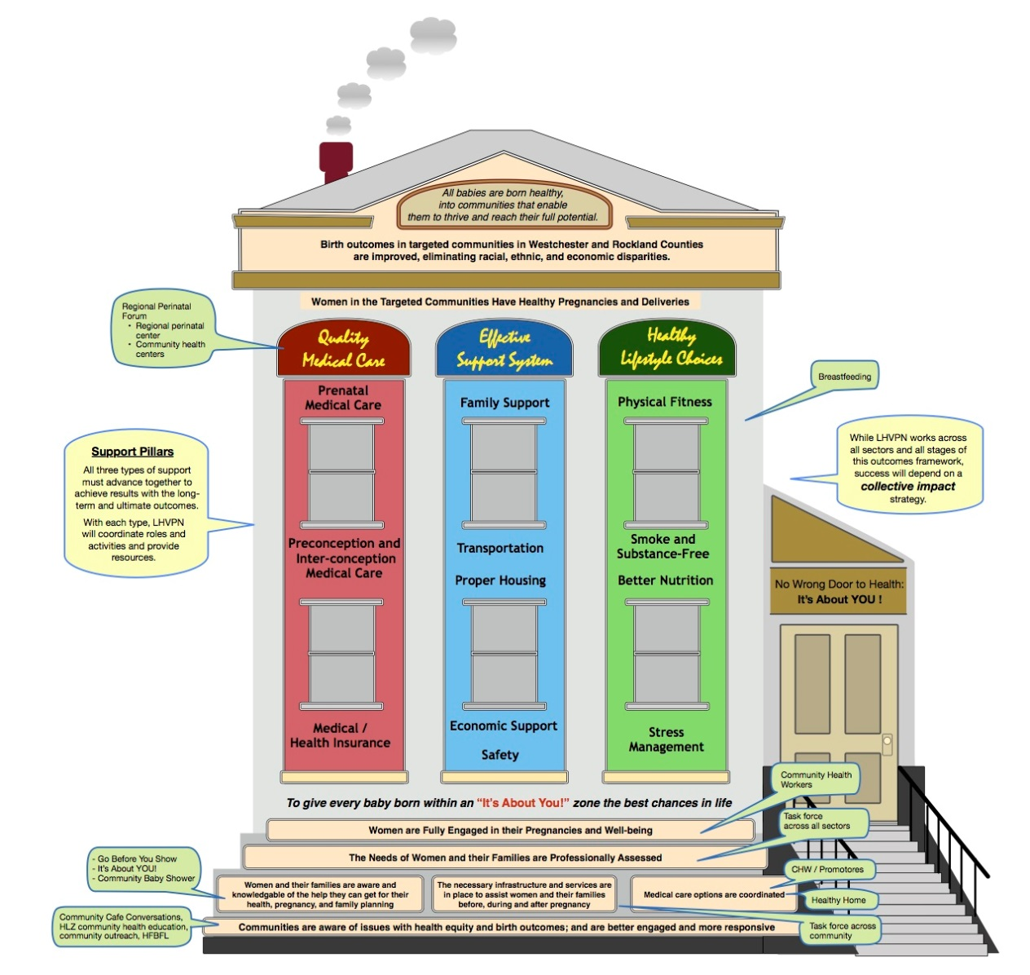

LHVPN Theory of Change
Strategic Framework

Slide 5
New Perspective on Care
“If we are serious about improving birth outcomes and reducing disparities, we’ve got to start taking care of women before pregnancy…when she’s a baby inside her mother’s womb, an infant, and then a child, an adolescent and really taking care of women and families across their life course.”
Michael Lu, MD
Geffen School of Medicine, UCLA

Slide 6
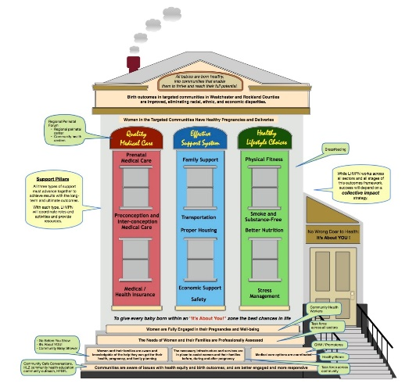
LHVPN’s Theory of Change Focus
Integrating preconception and interconception care into routine services* for all women** of reproductive age
* outpatient care, human services, etc.
  Assessing & addressing pregnancy planning and prevention (**men of reproductive age will also be a focus)
Focus on women who have serious chronic conditions/risk factors, including but not limited to:
  Diabetes (pre, gestational, Type 2)
  Hypertension
  Heart disease
  Obesity
  Tobacco, Alcohol, Drug use
  Prior preterm birth
  Domestic Violence
  Depression
  Poverty/Economic Insecurity
Instituting systems and protocols for early identification and management of high-risk women, including when pregnant.

Slide 7


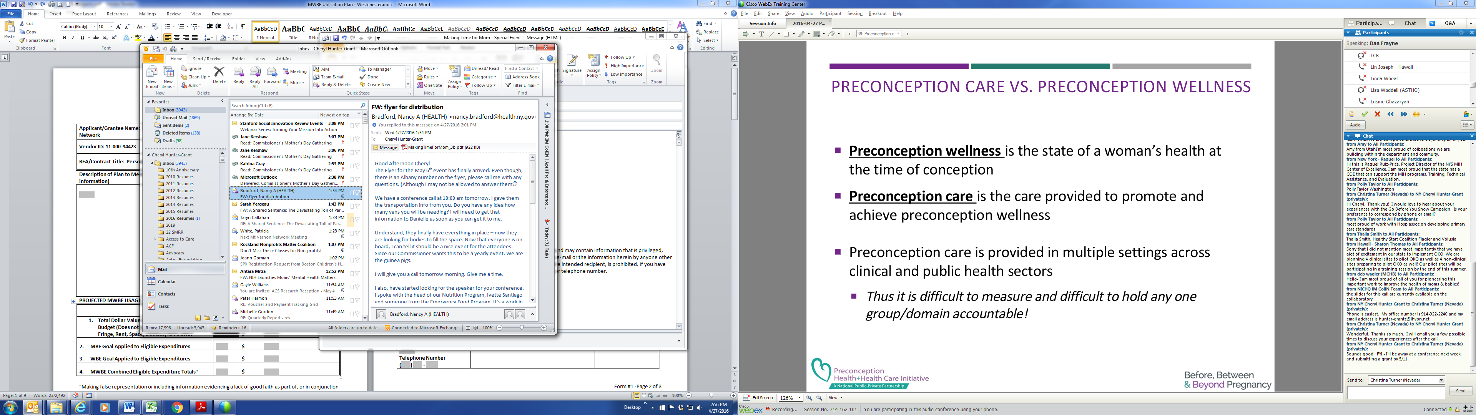
Definitions
Preconception - Before Pregnancy
Interconception – period between end of one pregnancy and conception of next
CDC 2006 Recommendations to improve preconception health and health care*
Notes:
The National Preconception Health and Health Care (PCHHC) is a public-private partnership of over 70 organizations focused on improving the health of young women and men and any children they may choose to have. The vision is that all women and men of reproductive age will achieve optimal health and wellness, fostering a healthy life course for them and any children they may have.
The Initiative’s Goals are to…
Improve the knowledge, attitudes and behaviors of men and women related to preconception health
All pregnancies are intended and planned
Build health equity and eliminate disparities in birth outcomes
Ensure that all women and men of reproductive age receive quality services that enable them to achieve high levels of wellness, minimize risks and enter any pregnancy they might have in optimal health
Reduce risks among women who have had a prior adverse maternal, fetal or infant outcome through interventions during the postpartum / interconception period
PCHHC is coordinated by the Center for Maternal and Infant Health, housed within the School of Medicine at UNC at Chapel Hill. Support for the Initiative’s core operations is provided by the Centers for Disease Control and Prevention. Currently, the Initiative also has support from the W.K. Kellogg Foundation. As the Initiative seeks to expand its work, additional funding partners are needed.

Slide 8
Preconception Care vs Preconception Wellness
Preconception care is provision of health promotion, screening, and interventions for women of reproductive age to reduce risk factors that might affect future pregnancies*
Preconception care is the care provided to promote and achieve preconception wellness
Preconception wellness is the state of a woman’s health at the time of conception
CDC 2006 Recommendations to improve preconception health and health care*
Notes:
The National Preconception Health and Health Care (PCHHC) is a public-private partnership of over 70 organizations focused on improving the health of young women and men and any children they may choose to have. The vision is that all women and men of reproductive age will achieve optimal health and wellness, fostering a healthy life course for them and any children they may have.
The Initiative’s Goals are to…
Improve the knowledge, attitudes and behaviors of men and women related to preconception health
All pregnancies are intended and planned
Build health equity and eliminate disparities in birth outcomes
Ensure that all women and men of reproductive age receive quality services that enable them to achieve high levels of wellness, minimize risks and enter any pregnancy they might have in optimal health
Reduce risks among women who have had a prior adverse maternal, fetal or infant outcome through interventions during the postpartum / interconception period
PCHHC is coordinated by the Center for Maternal and Infant Health, housed within the School of Medicine at UNC at Chapel Hill. Support for the Initiative’s core operations is provided by the Centers for Disease Control and Prevention. Currently, the Initiative also has support from the W.K. Kellogg Foundation. As the Initiative seeks to expand its work, additional funding partners are needed.

Slide 9
Recommendations to Improve
Preconception Health & Health Care
Recommendation 1. Individual Responsibility Across the Lifespan
  Each woman, man, and couple should be encouraged to have a reproductive life plan
Recommendation 2. Consumer Awareness
  Increase public awareness of the importance of preconception health behaviors and preconception care services by using information and tools appropriate across various ages; literacy, including health literacy; and cultural/linguistic contexts.
Recommendation 3. Preventive Visits
  As a part of primary care visits, provide risk assessment and educational and health promotion counseling to all women of childbearing age to reduce reproductive risks and improve pregnancy outcomes.
Centers for Disease Control and Prevention. Recommendations to improve preconception health and health care — United States: a report of the CDC/ATSDR Preconception Care Work Group and the Select Panel on Preconception Care. MMWR 2006;55

Slide 10
Recommendations to Improve
Preconception Health & Health Care
Recommendation 4. Interventions for Identified Risks
  Increase the proportion of women who receive interventions as follow-up to preconception risk screening, focusing on high priority interventions (i.e., those with evidence of effectiveness and greatest potential impact).
Recommendation 5. Interconception Care
  Use the interconception period to provide additional intensive interventions to women who have had a previous pregnancy that ended in an adverse outcome (i.e., infant death, fetal loss, birth defects, low birthweight, or preterm birth)
Centers for Disease Control and Prevention. Recommendations to improve preconception health and health care — United States: a report of the CDC/ATSDR Preconception Care Work Group and the Select Panel on Preconception Care. MMWR 2006;55

Slide 11
Recommendations to Improve
Preconception Health & Health Care
Recommendation 6. Prepregnancy Checkup
  Offer, as a component of maternity care, one prepregnancy visit for couples and persons planning pregnancy.
Recommendation 7. Health Insurance Coverage for Women with Low Incomes
  Increase public and private health insurance coverage for women with low incomes to improve access to preventive women’s health and preconception and interconception care.
Recommendation 8. Public Health Programs and Strategies
  Integrate components of preconception health into existing local public health and related programs, including emphasis on interconception interventions for women with previous adverse outcomes.
Centers for Disease Control and Prevention. Recommendations to improve preconception health and health care — United States: a report of the CDC/ATSDR Preconception Care Work Group and the Select Panel on Preconception Care. MMWR 2006;55

Slide 12
Recommendations to Improve
Preconception Health & Health Care
Recommendation 9. Research
  Increase the evidence base and promote the use of the evidence to improve preconception health.
Recommendation 10. Monitoring Improvements
  Maximize public health surveillance and related research mechanisms to monitor preconception health.
Centers for Disease Control and Prevention. Recommendations to improve preconception health and health care — United States: a report of the CDC/ATSDR Preconception Care Work Group and the Select Panel on Preconception Care. MMWR 2006;55

Slide 13
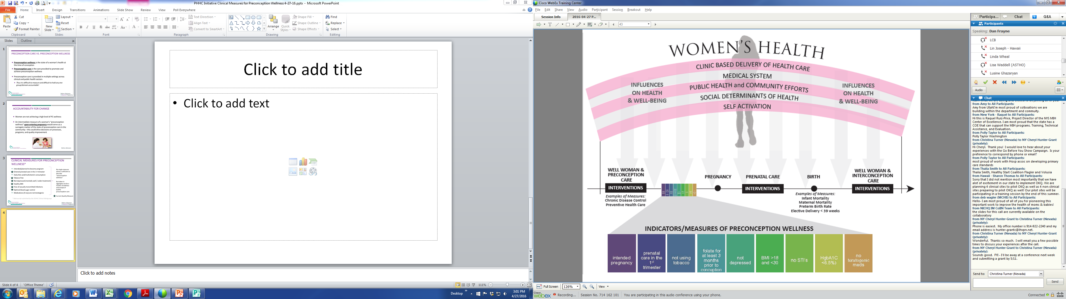


Slide 14
Accountability for Change
Women are not achieving a high level of Preconception Wellness
An intermediate measure of a woman’s “preconception wellness” upon entering pregnancy would serve as a surrogate marker of the state of preconception care in the community – this could drive decisions on processes, programs, and quality improvement

Slide 15
Clinical Measures for Preconception Wellness*
Intended/planned to become pregnant
Entered prenatal care in the 1st trimester
Daily folic acid/multivitamin consumption
Tobacco free
Not depressed (mentally well/under treatment
Healthy BMI
Free of sexually transmitted infections
Optimal blood sugar control
Medications (if any) are not teratogenic
No single measure alone is sufficient to describe “preconception wellness”
But taken in aggregate can be a marker of wellness and receipt of quality preconception care
*Frayne, D.J., Verbeist, S, et. al (2016) Health care system measures to advance preconception wellness. Consensus recommendations of the Clinical Workgroup of the National Preconception Health and Health Care Initiative. Obstetrics and Gynecology, 127(5), 863-872

Slide 16
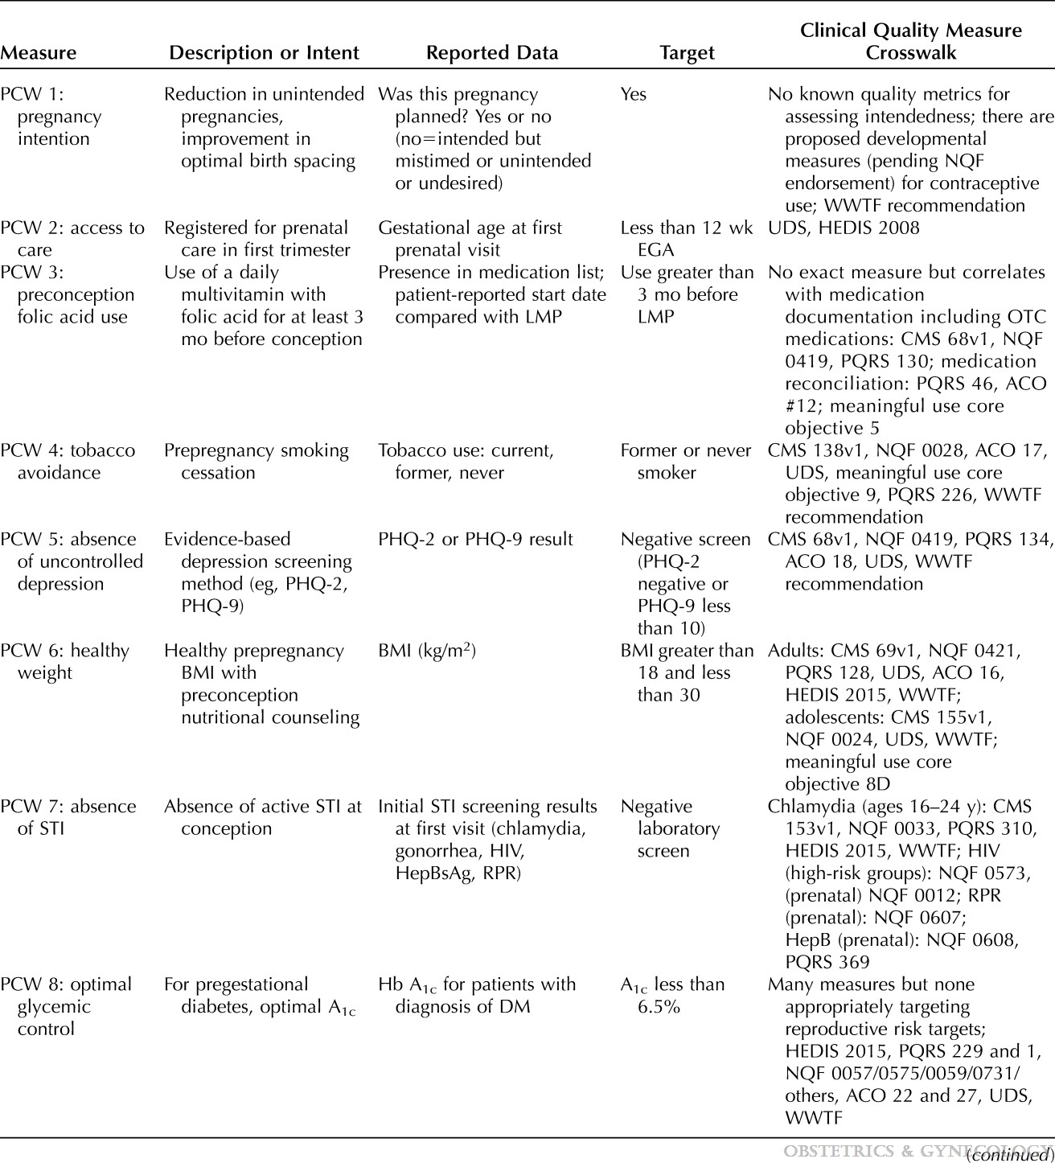
Clinical Measures for Preconception Wellness
Preconception Wellness Measures at Completion of First Prenatal Assessment
Health Care System Measures to Advance Preconception Wellness: Consensus Recommendations of the Clinical Workgroup of the National Preconception Health and Health Care Initiative
Frayne, Daniel J.; Verbiest, Sarah; Chelmow, David; Clarke, Heather; Dunlop, Anne; Hosmer, Jennifer; Menard, M. Kathryn; Moos, Merry-K.; Ramos, Diana; Stuebe, Alison; Zephyrin, Laurie
Obstetrics & Gynecology127(5):863-872, May 2016.
doi: 10.1097/AOG.0000000000001379

Slide 17
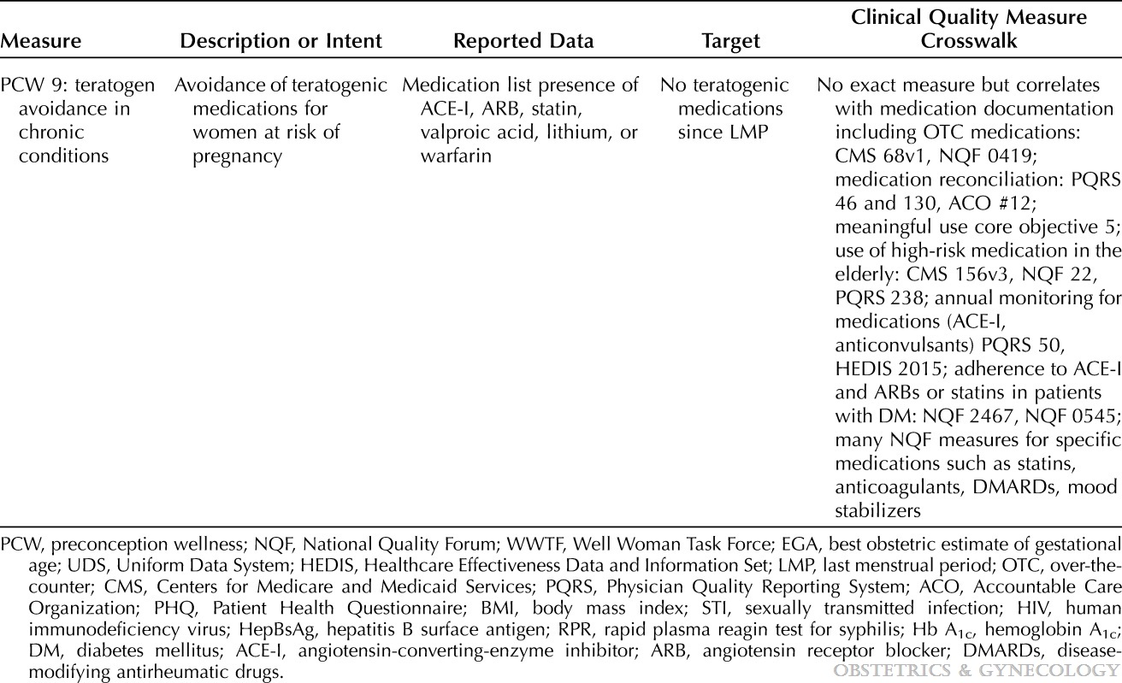
Clinical Measures for Preconception Wellness
Preconception Wellness Measures at Completion of First Prenatal Assessment
Health Care System Measures to Advance Preconception Wellness: Consensus Recommendations of the Clinical Workgroup of the National Preconception Health and Health Care Initiative
Frayne, Daniel J.; Verbiest, Sarah; Chelmow, David; Clarke, Heather; Dunlop, Anne; Hosmer, Jennifer; Menard, M. Kathryn; Moos, Merry-K.; Ramos, Diana; Stuebe, Alison; Zephyrin, Laurie
Obstetrics & Gynecology127(5):863-872, May 2016.
doi: 10.1097/AOG.0000000000001379

Slide 18

Almost 50% of pregnancies in the US are unintended
(mistimed or unwanted)
Finer & Zolna, 2016

Slide 19
Every Woman Every Time
Every service provider serving women of reproductive age play an important role
Every participant encounter is an opportunity to discuss pregnancy intendedness and current health
Well woman care is important for all, but crucial for those with chronic conditions who would like to become pregnant

Slide 20

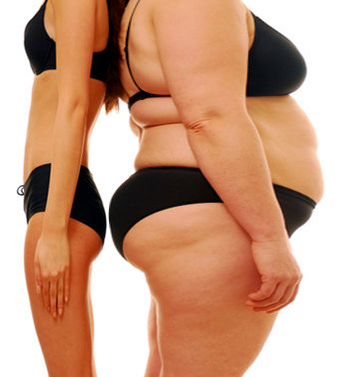







Risk factors for preterm birth and low birth weight
Violence / Abuse
Stress
Diabetes
Financial Instability
Smoking
High Blood Pressure
Alcohol Use
Drug Use
Obesity
Underweight
Notes:
What puts people at risk for poor birth outcomes?
UTI, STD, High Blood Pressure, Underweight/Obesity, Diabetes, Blood clotting problems, Vaginal infections, Abnormal development in the fetus, Smoking, Alcohol/Drug use, Violence/abuse (physical, sexual, emotional, verbal), Lack of social support/resources, Stress, being without access to quality Health Care, etc.

Slide 21
LHVPN Theory of Change
Strategic Framework
Phase 1 Focus
Integrating preconception and interconception care into routine services for all women of reproductive age

Slide 22
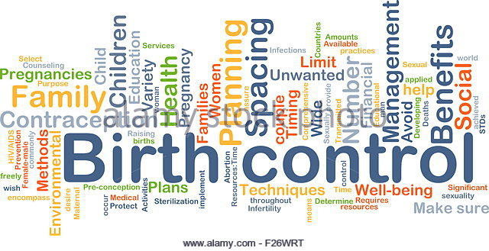

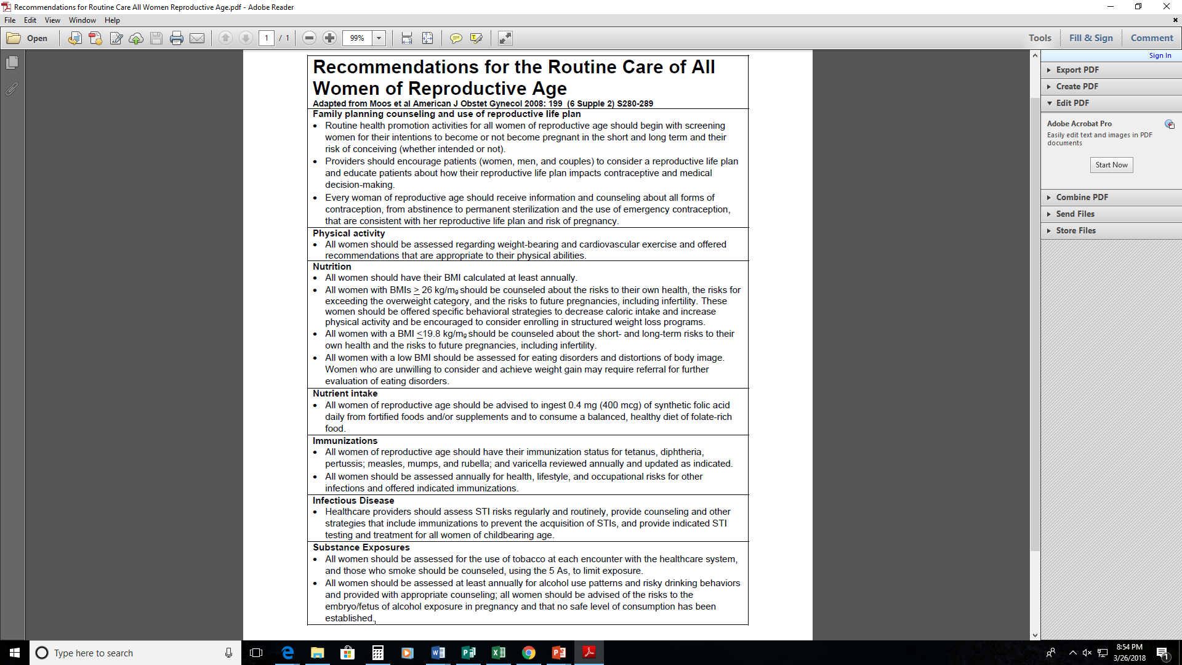

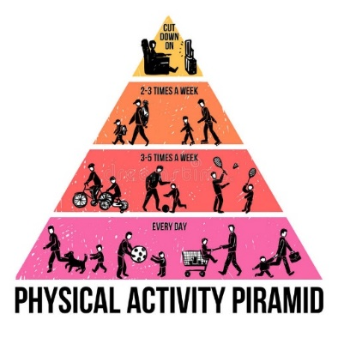


Recommendations for the Routine Care of All Women of Reproductive Age*
*Adapted from Moos et al American J Obstet Gynecol 2008: 199 (6 Supple 2) S280-289

Slide 23




Recommendations for the Routine Care of All Women of Reproductive Age
*Adapted from Moos et al American J Obstet Gynecol 2008: 199 (6 Supple 2) S280-289

Slide 24


Risk factors for preterm birth and low birth weight
Violence / Abuse
Stress
Diabetes
Financial Instability
Smoking
High Blood Pressure
Alcohol Use
Drug Use
Obesity
Underweight
Notes:
What puts people at risk for poor birth outcomes?
UTI, STD, High Blood Pressure, Underweight/Obesity, Diabetes, Blood clotting problems, Vaginal infections, Abnormal development in the fetus, Smoking, Alcohol/Drug use, Violence/abuse (physical, sexual, emotional, verbal), Lack of social support/resources, Stress, being without access to quality Health Care, etc.

Slide 25


Life Planning

Slide 26
One Key Question®
One Key Question® supports women’s power to decide by helping to transform their health care experience. The notion behind One Key Question® is simple: It asks all health providers and champions who support women to routinely ask, “Would you like to become pregnant in the next year?” From there, the provider or champion takes the conversation in the direction the woman herself indicates is the right one, whether that is family planning, preconception health, prenatal care, or other needs.
http://www.orfrh.org/patient-and-provider-resources/

Slide 27
One Key Question®
Yes – Desires Pregnancy
  “Your health before you become pregnant is critical for a healthy pregnancy and baby. If you want to get pregnant soon…”
  “It’s best for your body and the health of your next baby to wait about 18 months after giving birth to become pregnant again. Talk with your partner about your goals for pregnancy and what steps you can take to be as healthy as possible.”
No – Does Not Desire Pregnancy
  “If you want to prevent pregnancy, there are many safe and effective birth control options.”
Unsure/At Risk
  “Whether or not you want to become pregnant talk to your health care provider today. Learn how to prepare for a healthy pregnancy and how to prevent pregnancy until you are ready.”
http://www.orfrh.org/patient-and-provider-resources/
Notes:
Yes – Desires Pregnancy
Your health before you become pregnant is critical for a healthy pregnancy and baby. If you want to get pregnant soon, a few things to consider are:
• Start taking folic acid or a prenatal vitamin daily
• Make sure any health conditions, such as asthma or diabetes, are being managed
• Ask if the medications you are taking are safe during pregnancy
It’s best for your body and the health of your next baby to wait about 18 months after giving birth to become pregnant again. Talk with your partner about your goals for pregnancy and what steps you can take to be as healthy as possible.
No – Does Not Desire Pregnancy
If you want to prevent pregnancy, there are many safe and effective birth control options. It’s important to learn about all birth control options so you can find the best method for your life and your body. Ask directions for how to use it and what to do if a mistake happens
Unsure/At Risk
“Whether or not you want to become pregnant talk to your health care provider today. Learn how to prepare for a healthy pregnancy and how to prevent pregnancy until you are ready.”

Slide 28




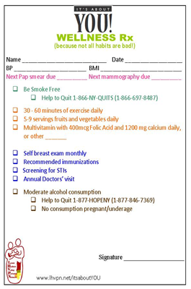



Opportunities for Action
Carry this
booklet
with you!
Remember that
It’s About YOU!
Lower Hudson Valley
Perinatal Network
22 Saw Mill River Road
3rd Floor, Mailbox 19
Hawthorne, NY 10532
(914) 922-2240 • www.lhvpn.net
A program of the Children’s Health
and Research Foundation
Produced with funding from the New York State
Department of Health, Division of Family Health
Notes:
What can we do together to help increase the rates of healthy birth outcomes?
Our program “It’s About You,” provides tools that may help incorporate interconception care into your (Head Start’s) regular routine. These tools will help individuals set goals and create a healthy lifestyle. If you take a look in your folders, you will see the different handouts we have; such as, goal setting booklets for adults and teens, “wellness” prescriptions, and on-the-go information regarding healthy food choices.
As we have taken a look at the FSW “Child Health Record Intake Packet,” we have highlighted the places where we’ve noticed a handful of already implemented questions regarding preconception/interconception health and care. These questions can open up conversation between primary care providers and clients. We encourage that all individuals converse with their primary care provider about past, current, and/or future pregnancies.
Within the packet in your folders, we have provided an outline of research and information regarding how and why we should work together to make certain that all individuals are given an opportunity to receive care during the interconception period – especially throughout White Plains and Westchester County. From this outline packet, we hope to create a toolkit to serve as a resource for the individuals you work with in the future.

Slide 29
Interactive Activity

Slide 30
PRECONCEPTION/INTERCONCEPTION QUICK REFERENCE GUIDE

Slide 31
PRECONCEPTION/INTERCONCEPTION QUICK REFERENCE GUIDE

Slide 32
PRECONCEPTION/INTERCONCEPTION QUICK REFERENCE GUIDE

Slide 33
PRECONCEPTION/INTERCONCEPTION QUICK REFERENCE GUIDE

Slide 34
Interconception Scenario
CHW met with Kim at the ABC office to go over the forms she had previously submitted. She brought her 5 year old son and 3 year old daughter with her because she was having difficulty finding a babysitter. The CHW stated to Kim, that after having reviewed the forms noticed that she had identified herself as having diabetes in response to (question 6) Please put a check mark to indicate which family member has the following chronic disease. She also said no to (question 4A) Is the mother currently pregnant? and yes to (question 4C) “Would you like to become pregnant in the next 12 months?”
What messages would you give Kim?

Slide 35
Prenatal Scenario
CHW visited Maria at her home for her first home visit. She is 4 months pregnant and this is her first pregnancy. The CHW prior to this visit, and after having reviewed her forms noticed she answered yes to (question 4A) Are you currently pregnant? , yes to (question 4B) Is this mother receiving prenatal care? and yes to (question 5) Does anyone living in the house smoke?
What messages would you give Maria?

Slide 36
Postpartum Scenario
You are visiting Devon, mother of a 3 week old baby girl, at her home. She is concerned that the baby is not getting enough breastmilk and is considering supplementing with formula. Remind the client about the importance of that 8 week postpartum check up. The client answered breastfeeding to (question 32) Which feeding method did you use or are currently using? Breastfeeding, bottle feeding, or both. She also answered yes to (question 7) Did the mother experience feelings of depression (mental health issues) anytime during or following the birth?
What messages would you give Devon?

Slide 37
Empowering Referrals
Obstetrician, Family Practitioner, Midwife – Post Partum Visit
Primary Care
Smoking Cessation
Family Planning
Diabetes Self Management Program
Diabetes Prevention Program
YMCA
Support Circles
Baby Cafés
Psycho Social Support
….and more

Slide 38



Preconception Resources
On-line Training – “Understanding Preconception Health: A Course for Community Health Workers”
https://phtc-online.org/catalog/pch/
Preconception Health - https://www.womenshealth.gov/pregnancy/you-get-pregnant/preconception-health
Show Your Love - National preconception consumer resource and campaign
http://showyourlovetoday.com/

Slide 39
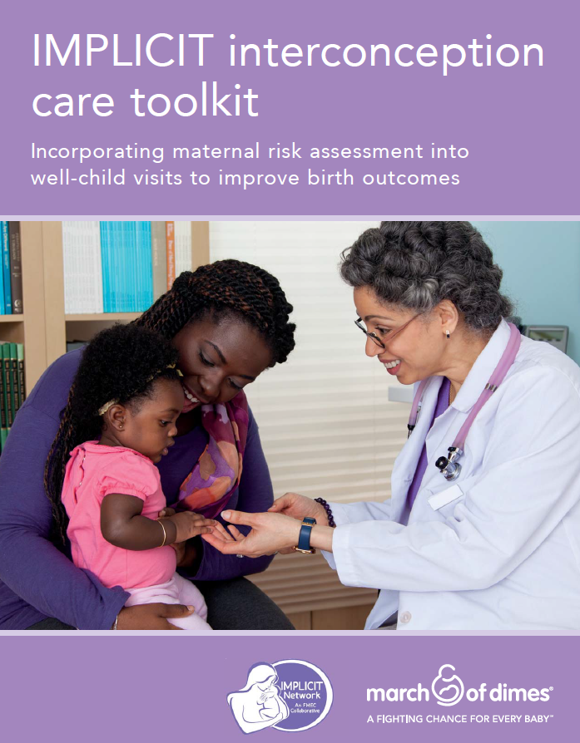
Health Provider Resources
Interventions to Minimize Preterm and Low birth weight Infants using Continuous quality Improvement Techniques (IMPLICIT)
https://www.prematurityprevention.org/Home

Slide 40
Health Provider Resources
National Preconception Health and Health Care (PCHHC)
https://beforeandbeyond.org/
  Resource Guide for Clinicians
  Toolkits
  Educational Modules

Slide 41


Women’s Wellness Affirmation
I am beautiful both inside and out.
I am mentally and emotionally strong. No other individual can break me.
I am NOT perfect and that is OKAY!
I have value to myself and others. I am confident.
Above all else, I can do anything I put my mind to.

Slide 42

It Takes a Village!
To ensure all women and men of reproductive age will achieve optimal health and wellness, fostering a healthy life course for them and any children they may have.*
* National Preconception Health and Health Care (PCHHC) Vision

Slide 43


Slide 44

It Takes a Village
For more information, please feel free to contact:
Lower Hudson Valley Perinatal Network
(914) 922-2240 phone
(914) 922-2254 fax
Cheryl Hunter-Grant
hunter-grantc@lhvpn.net
www.lhvpn.net

