Slide 1
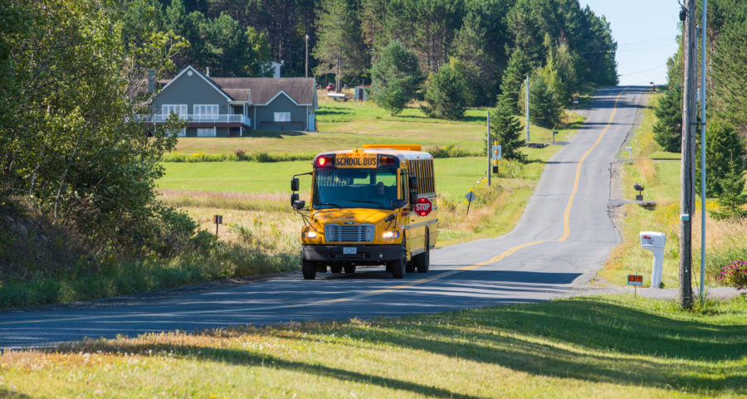
The ABCD Approach to Working with Rural Communities
Jutta Dotterweich, ACT for Youth,
Cornell University
BWIAH Provider Meeting – Albany, May 2019

Slide 2
Objectives
Identify core concepts of asset-based community development
Explore the power of individual assets and associations
How can we apply ABCD principles to our work?

Slide 3
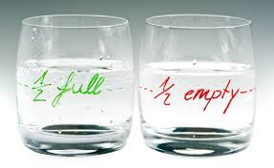
How do you see Rural Communities?

Slide 4
NEEDS | ASSETS
Focuses on deficiencies | Focuses on effectiveness
Results in fragmentation of responses to local needs | Builds interdependencies
Makes people consumer of services; builds dependence | Identifies ways that people can give their talents
Residents have little voices in deciding how to address local concerns | Seeks to empower people

Slide 5
COMMUNITY NEEDS MAP
Dilapidated
Housing
Unemployment
Gangs
Single Parent
Families
Illiteracy
Teen Pregnancy
Child
Abuse
Mental
Disability
Crime
Alcohol &
Drug
Abuse
Domestic
Abuse
Juvenile Delinquency
Poverty
Homelessness
Suicide & Depression

Slide 6
Consequences of the power of the needs map
Internalization of “deficiency” identity by local residents
Destruction of “local” relationships
Reinforcement of narrow categorical funding flows
Direction of funds towards professional helpers, not residents
Focuses on “leaders” who magnify deficiencies
Rewards failure, promotes dependency
Creates hopelessness

Slide 7
ABCD principles & goals
Everyone has gifts
For ABCD to work, everyone must give gifts
Identifies and mobilizes the assets of individuals, especially those who are marginalized
Builds relationships among community members, especially those that are mutually supportive
Gives community members more roles and power in local institutions; citizens lead efforts

Slide 8
COMMUNITY ASSETS MAP
Local Institutions
GOVERNMENT
HOSPITALS
Citizens’ Associations
BUSINESS
CHURCHES
BLOCK CLUBS
SCHOOLS
Gifts of
Individuals
INCOME
SKILLS
ELDERLY
DIFFERENTLY
ABLED PEOPLE
YOUTH
PARKS
COLLEGES
CULTURAL CLUBS
HUMAN SERVICE AGENCIES
LIBRARIES

Slide 9
Five types of assets to connect
Talent and skills of our people
Associations and our network of relationships
Institutions and professional entities
Physical assets
Land
Property
Buildings
Economic assets
Productive work of individuals
Consumer spending power
Local business assets

Slide 10
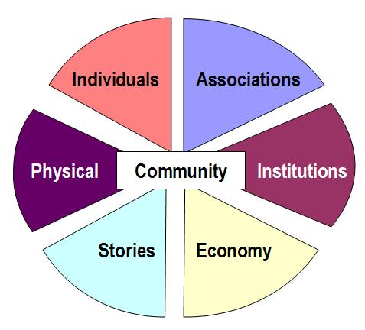
Wheel: Stories
Stories
Background & Personal History
Like to Do
Realizing & Engaging Skills
Community Development
Economic Growth
Addressing Racism
Including Those Who Are Marginalized

Slide 11
Activity
Individual Gifts or Assets
Knowledge/Skills
Passions/Interests
Social Networks
HandOuts/personal assets.ppt

Slide 12
Types of Associations
Artistic Groups Business Professional Associations Charitable Associations Church Groups Civic Groups Collectors Groups Community Support Groups Elderly Groups Ethnic and Cultural Groups Health & Fitness Groups Special Interest Groups Media and Communications Groups | Self Help Groups Neighborhood Councils Block Watch Associations Outdoors Groups Political Organizations School Groups (PTA’s etc.) Service Clubs Alumni Associations Sports Leagues Study Groups Survivors Groups Veterans Groups Women’s Groups Youth Groups

Slide 13
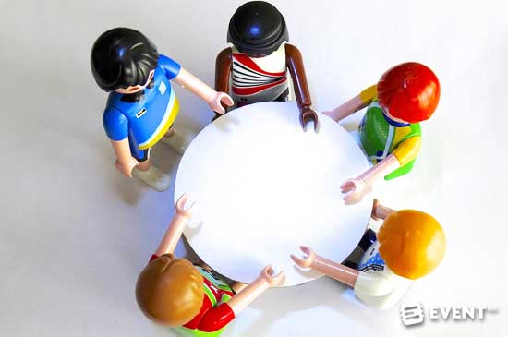
Small groups: What are associations in your community?

Slide 14
Social capital questions
How does your work foster communication and relationship-building among the people you serve and residents in your community?
What are the associations in your communities? What might they be able or willing to do to improve the community?

Slide 15
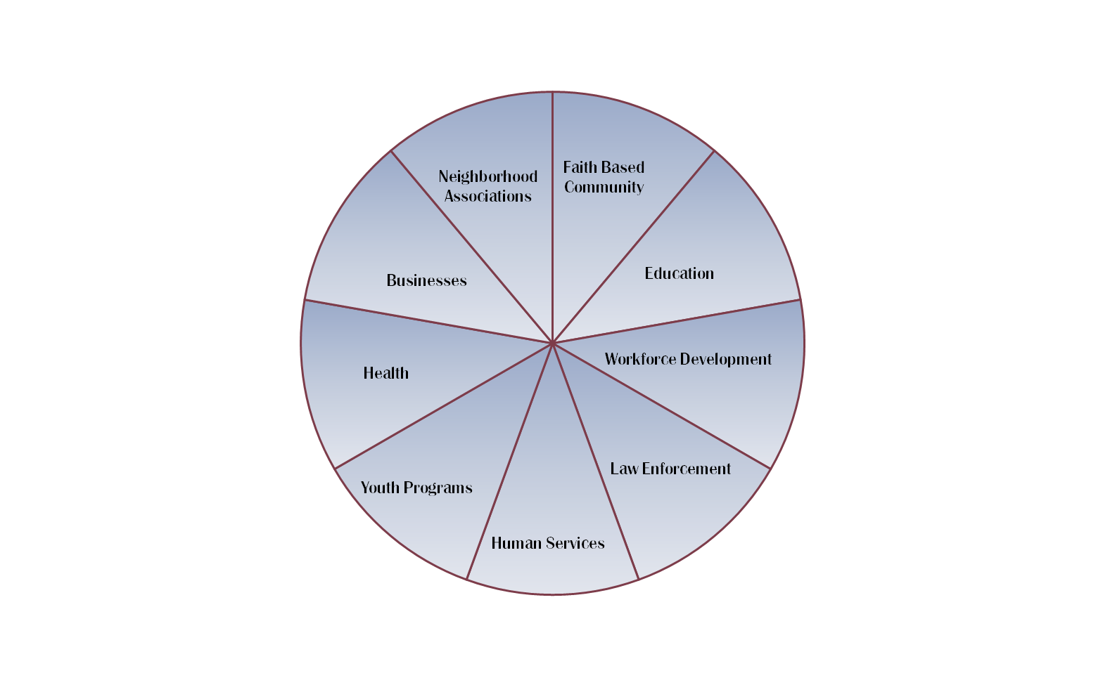
Think ABCD to Identify Resources

Slide 16
ASSETS OF ORGANIZATIONS
Personnel
Space and Facilities
Materials and Equipment
Expertise
Constituents
Economic Power
Networks of Connections

Slide 17
Health Care
Provider
Constituents
CCE
Equipment
Mental Health
Facilities
Expertise
Your Agency
Individual Assets
Connections
Social Services
BOCES

Slide 18
Start with a conversation
The problem – literacy.
Start with an answer…
Who would like to become a tutor or
Start with a conversation…
How do you see the problem of literacy?
What do people have to offer to address the issue?
What do people “want” to offer?
What is the real question you want to answer?

Slide 19
Discover what people care about
Conversations
More Connections
Meaningful
Action

Slide 20
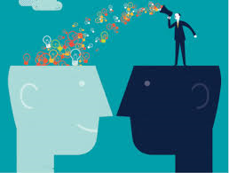
What are your takeaways?

Slide 21
Resources
ABCD Institute https://resources.depaul.edu/abcd-institute/Pages/default.aspx
ABCD Institute. 2005. Discovering Community Power: A Guide to Mobilizing Local Assets and Your Organization’s Capacity
https://resources.depaul.edu/abcd-institute/publications/publications-by-topic/Documents/kelloggabcd.pdf
ABCD Institute Workbook. 2001. The Organization of Hope: A Workbook for Rural Asset-Based Community Development. Chicago: ACTA Publications

Slide 22
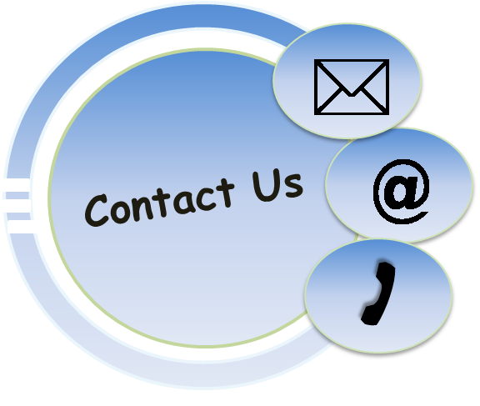
Jutta Dotterweich
Director of Training
ACT for Youth Center for Community Action
BCTR, Cornell University
www.actforyouth.net
jd81@cornell.edu
607-255-4108

