Slide 1
Using sticks & stones
As a Strategy to Build Creative Awareness Projects
Presented by: James Young, Jeff Gurkin-Young, & Geoff Peckman

Slide 2
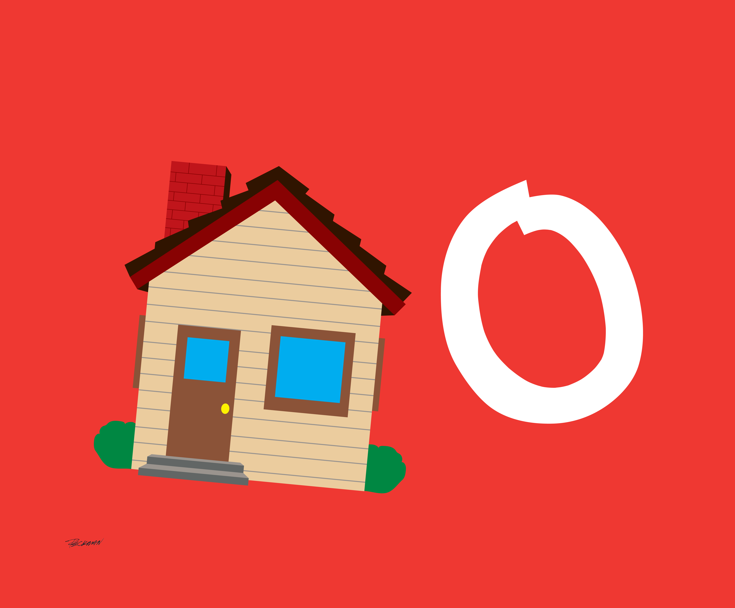
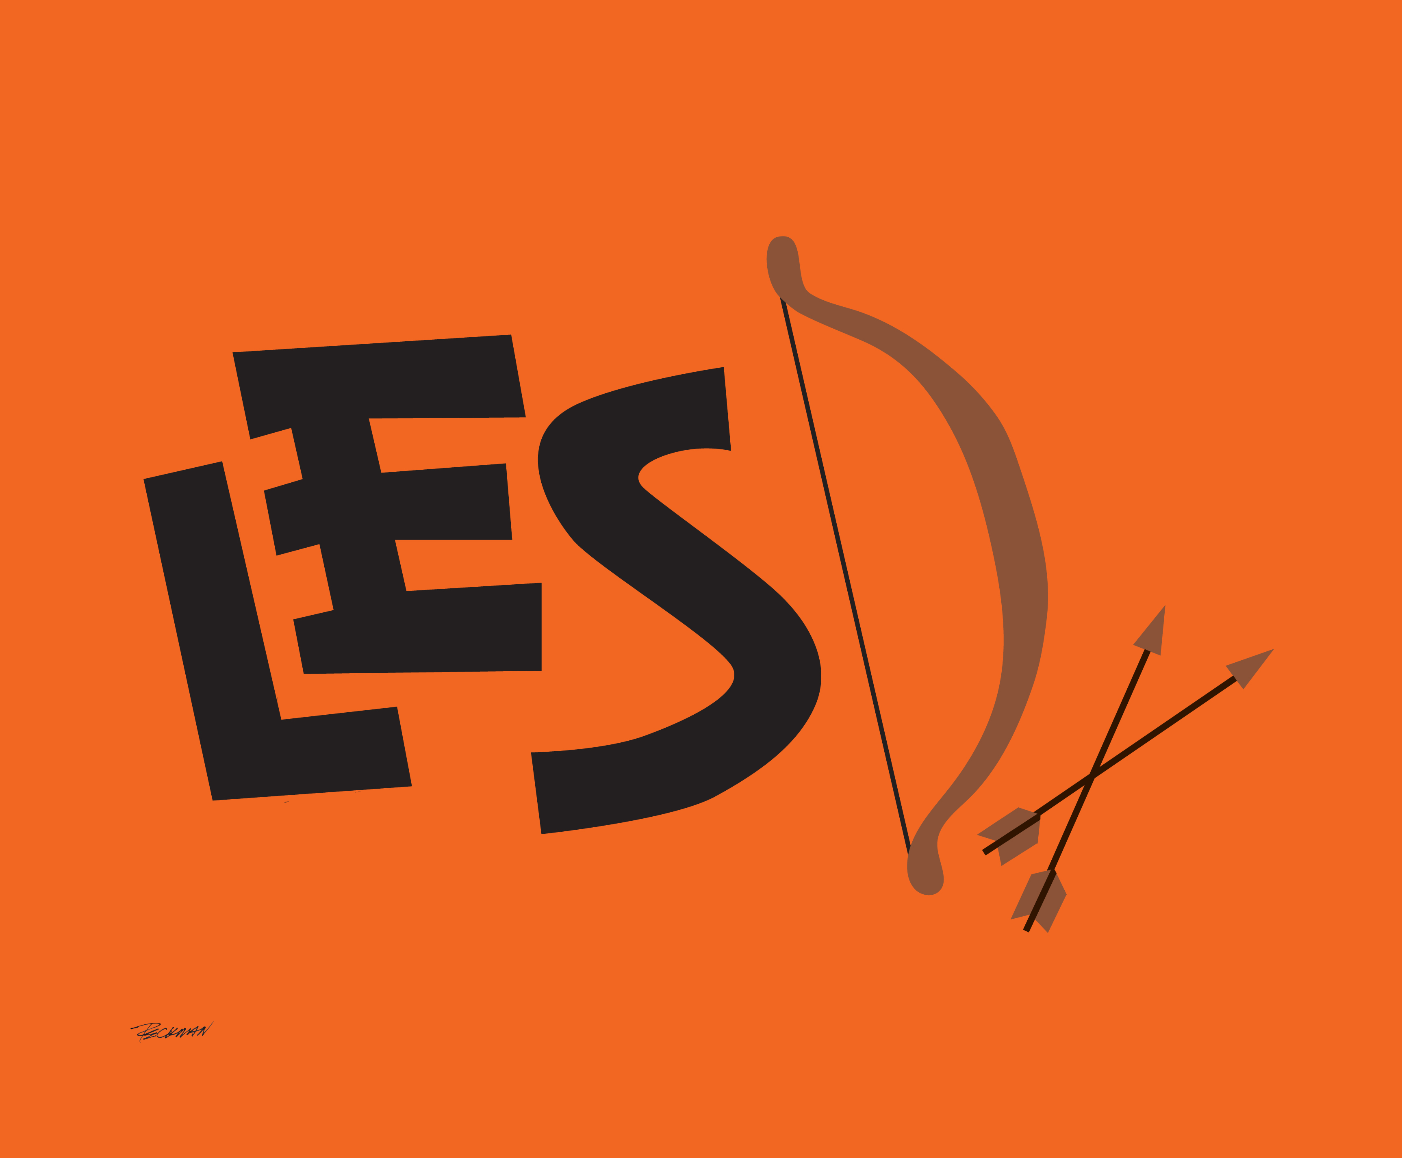
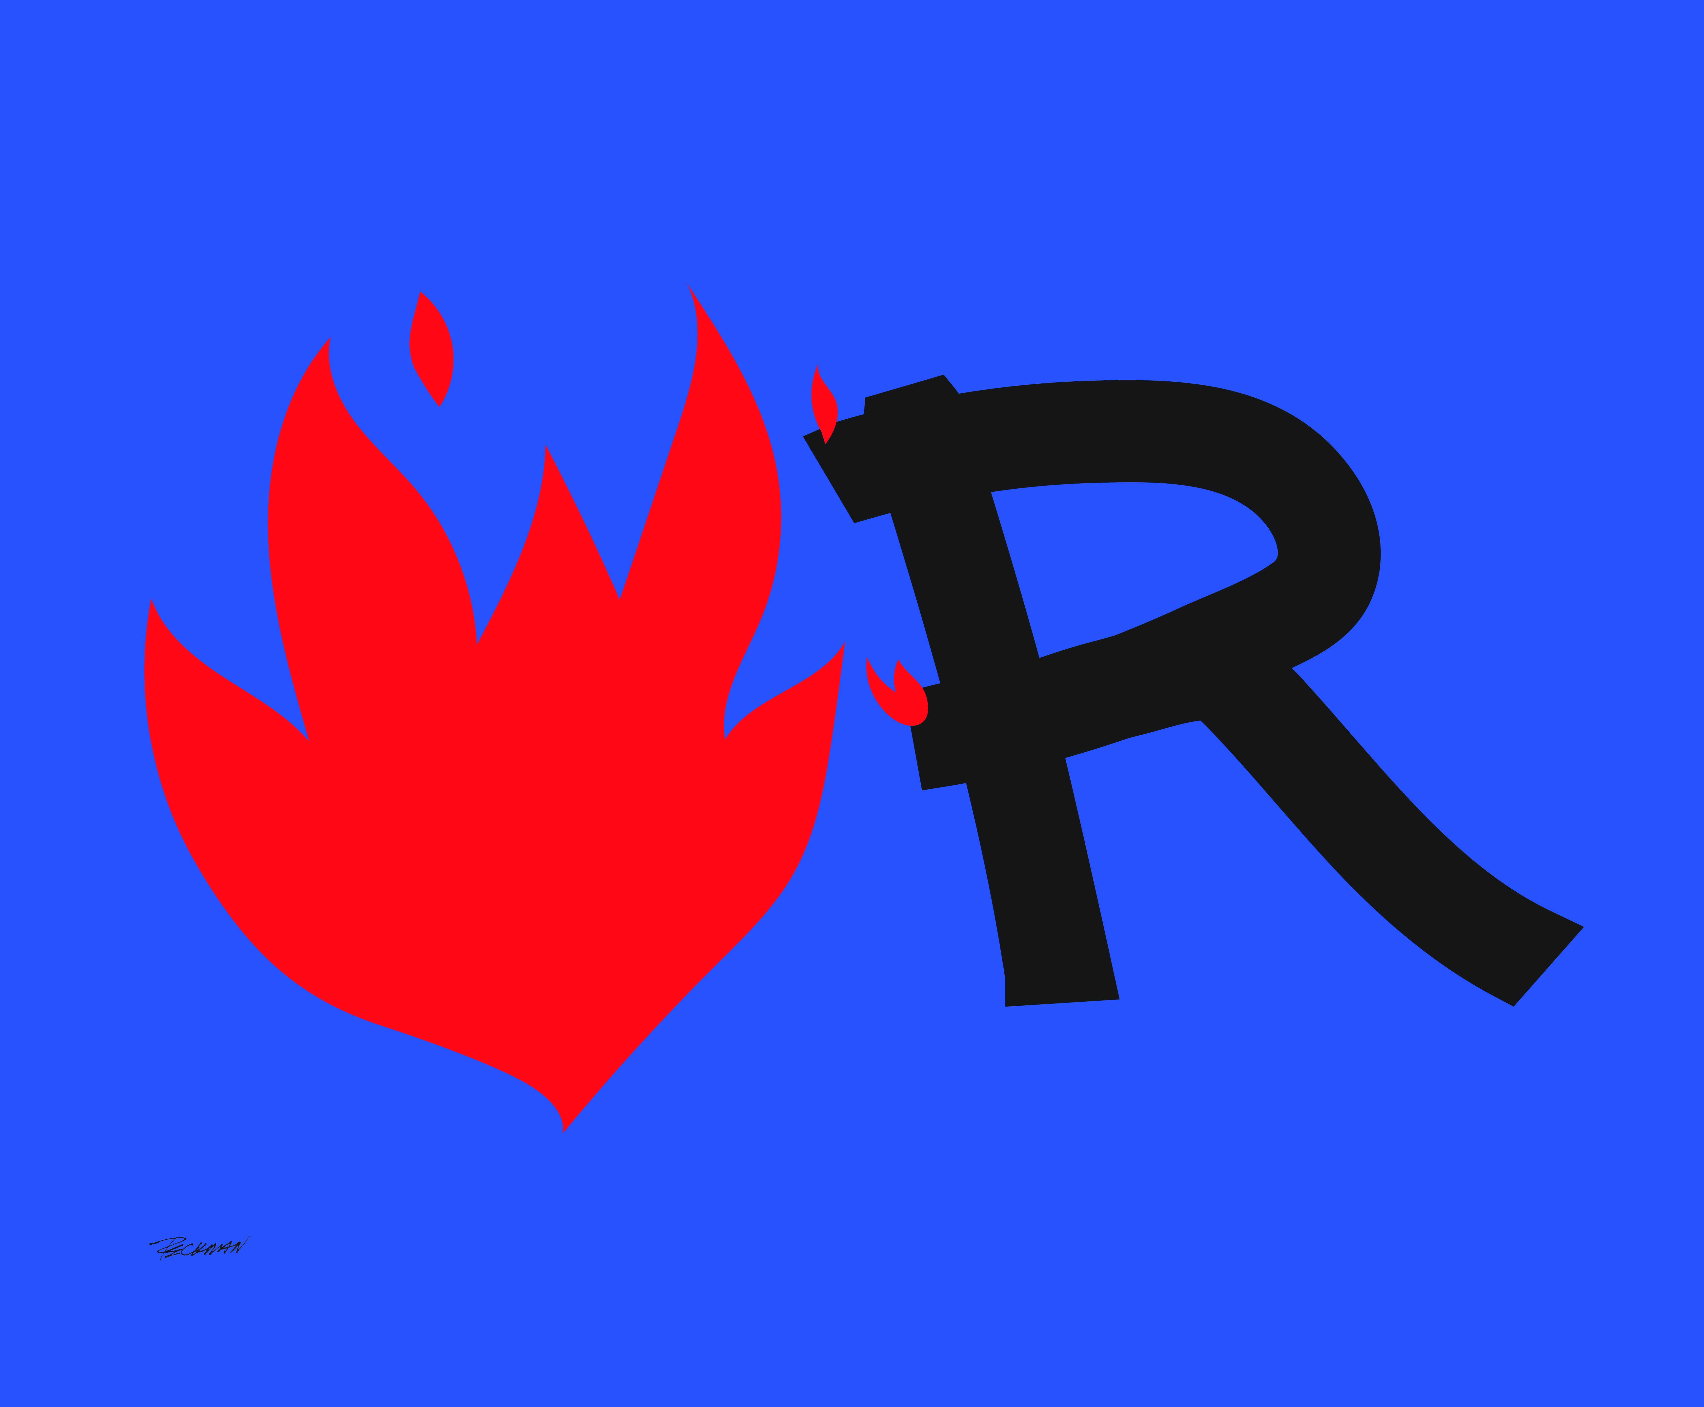
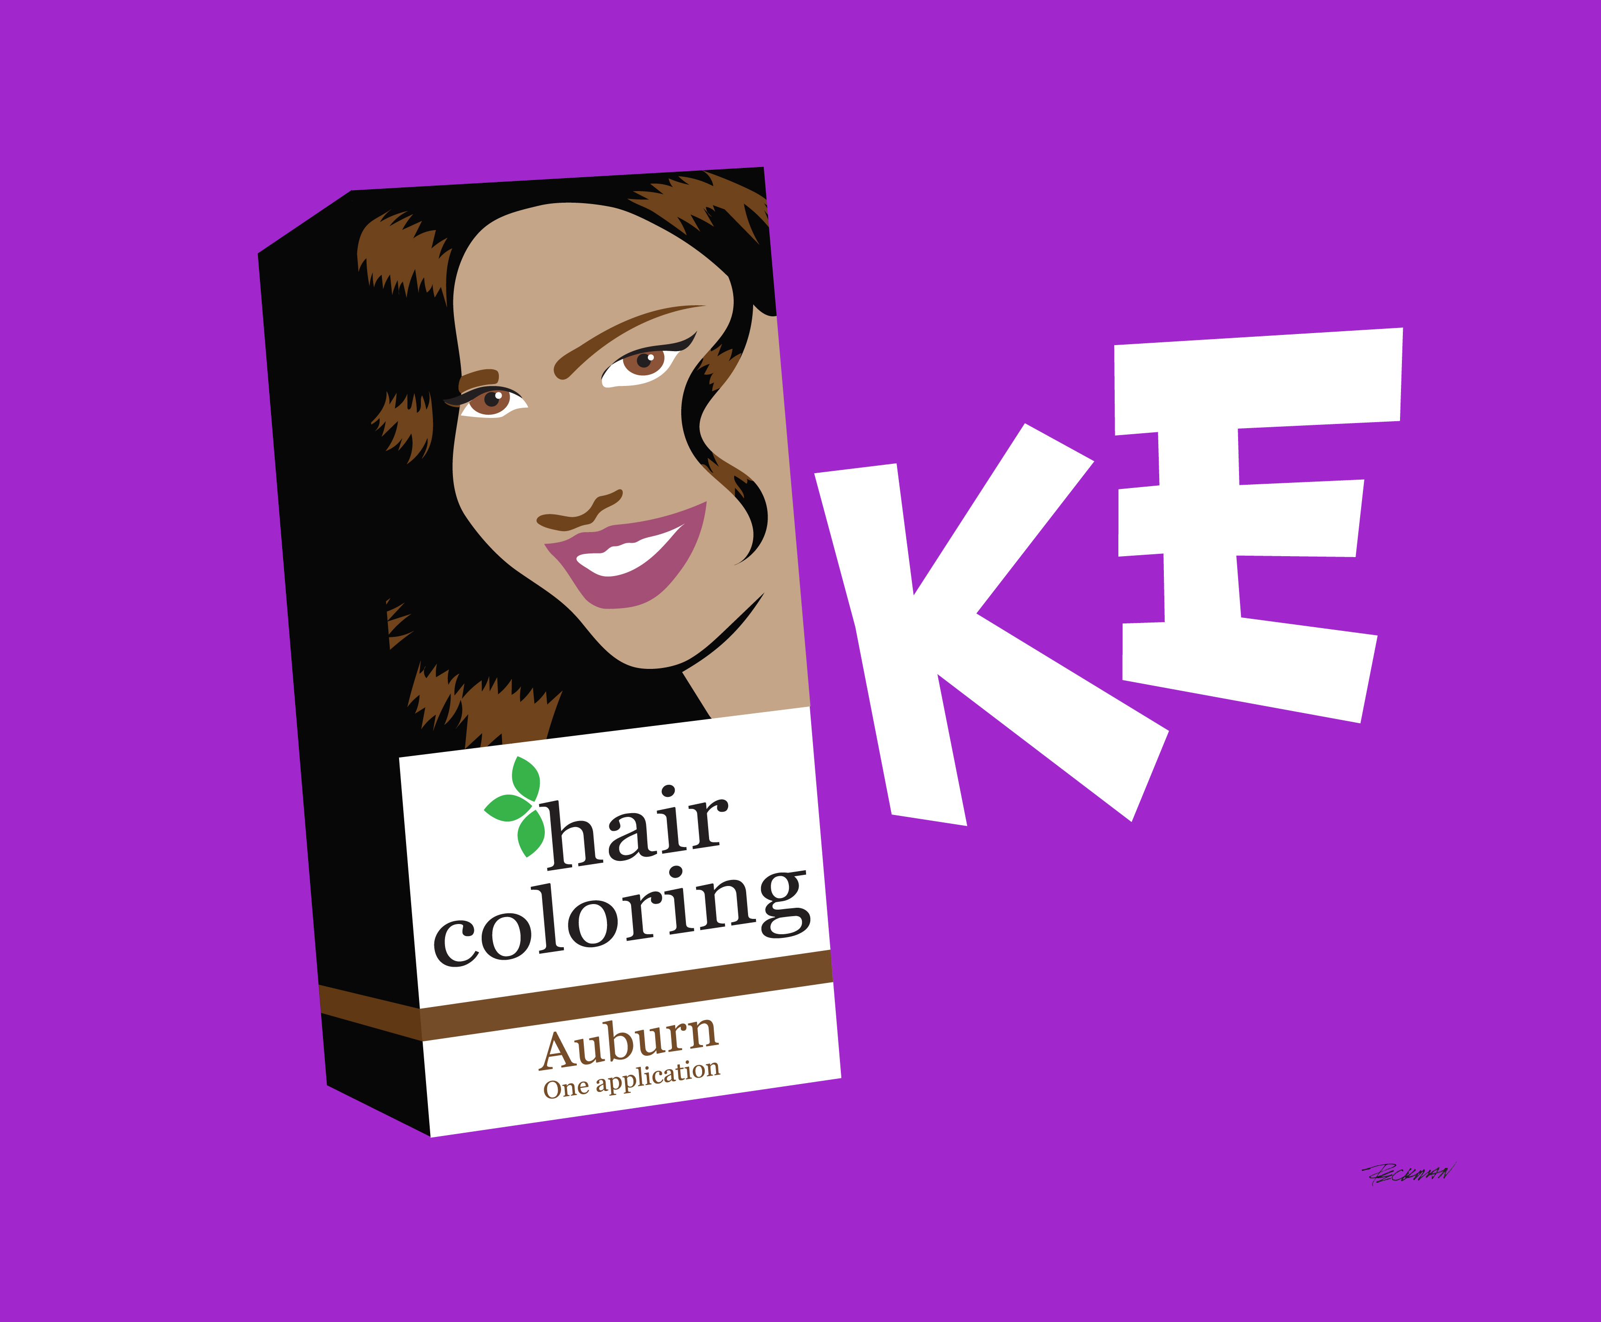
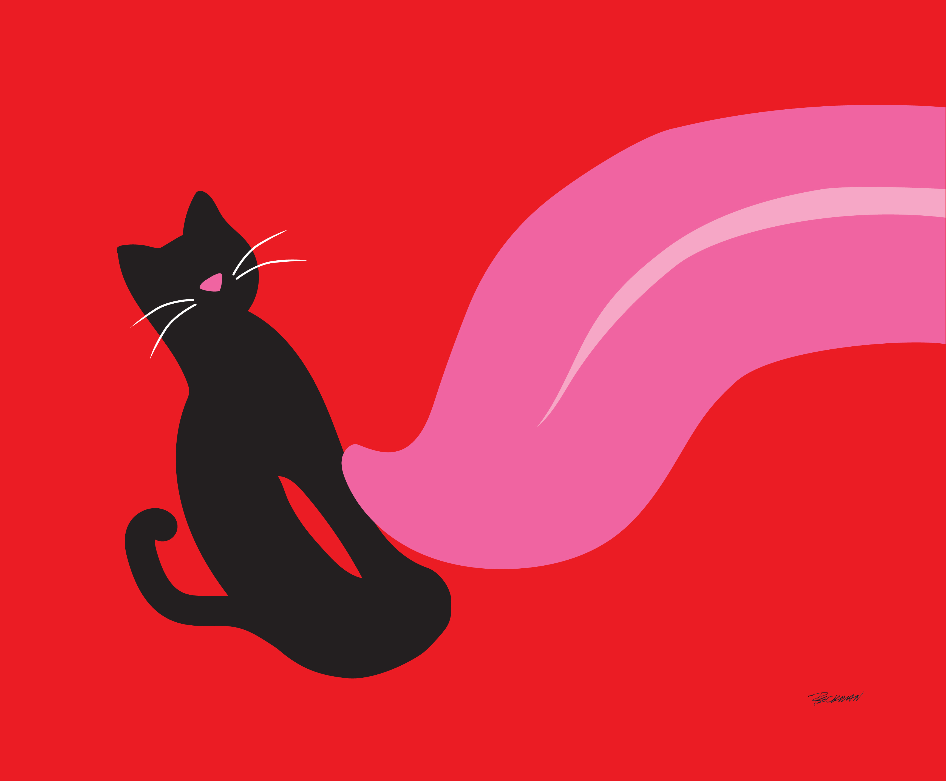
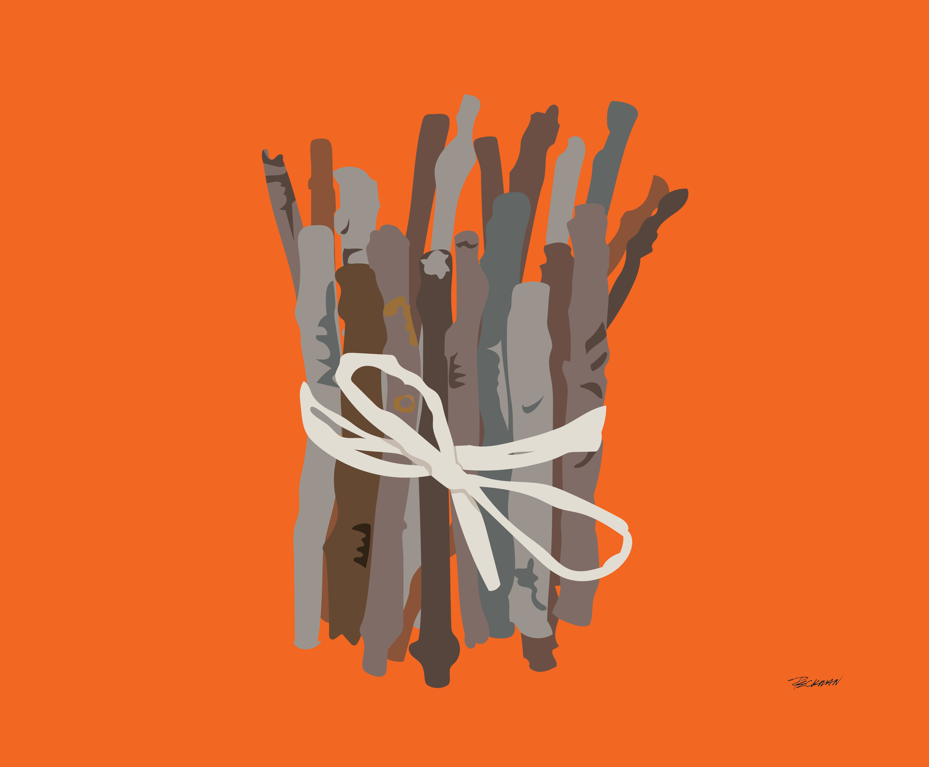
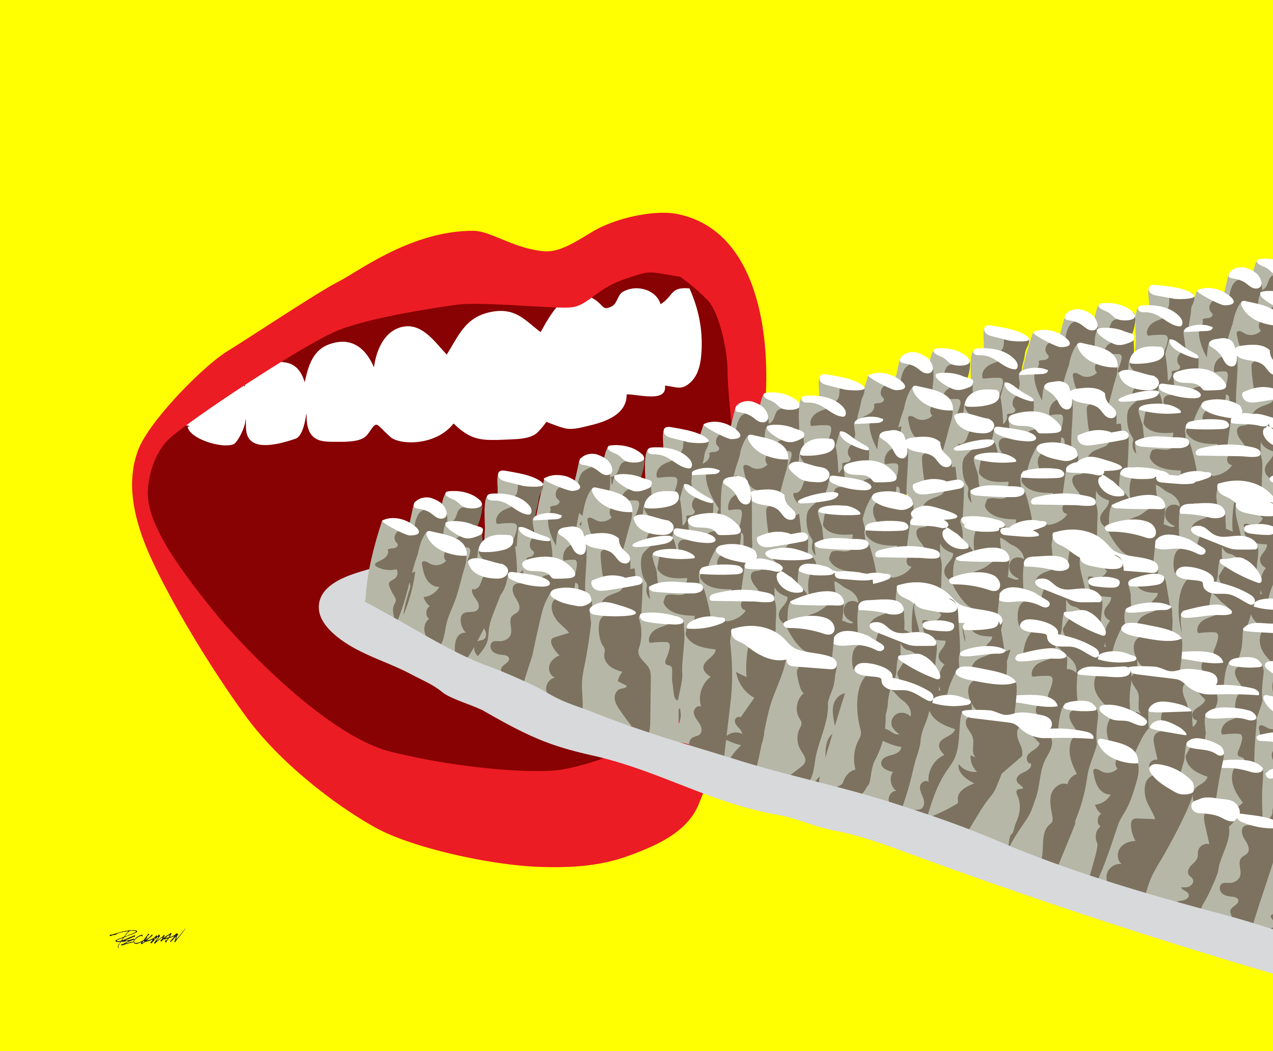
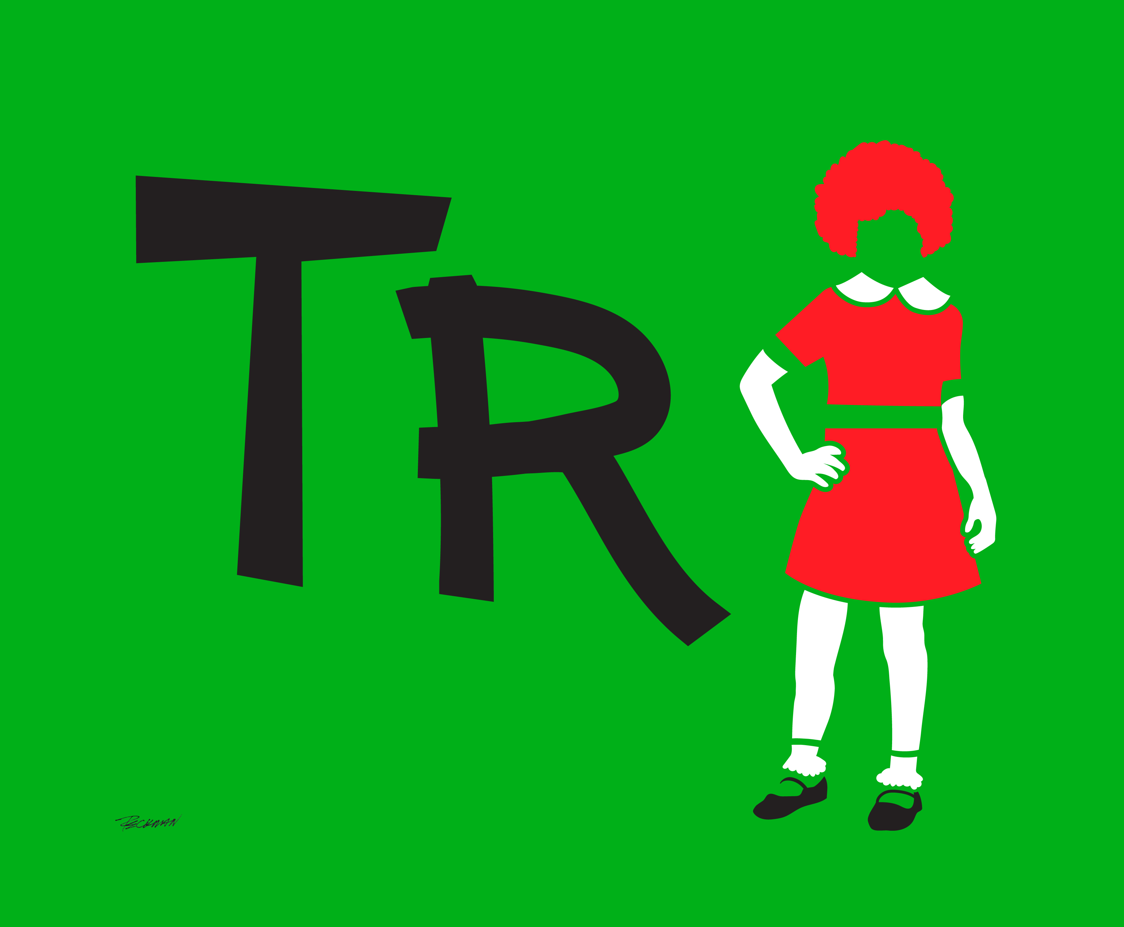
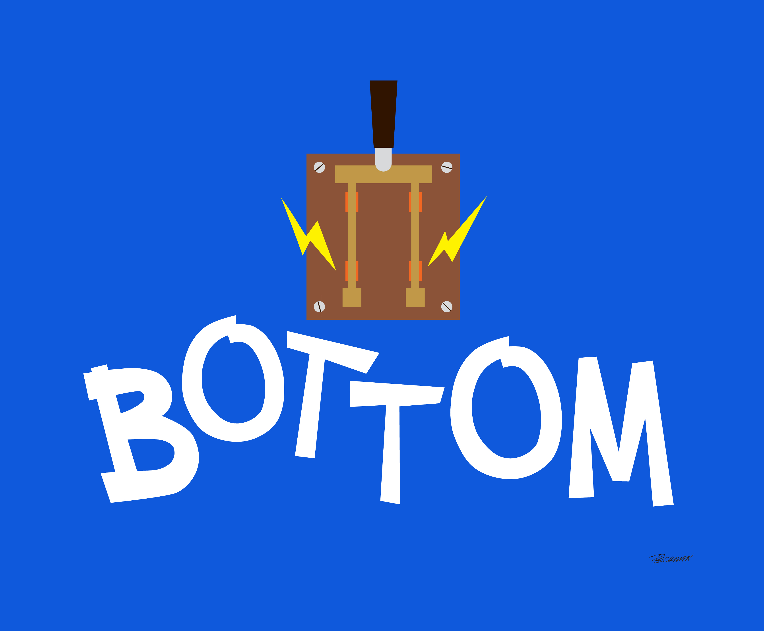
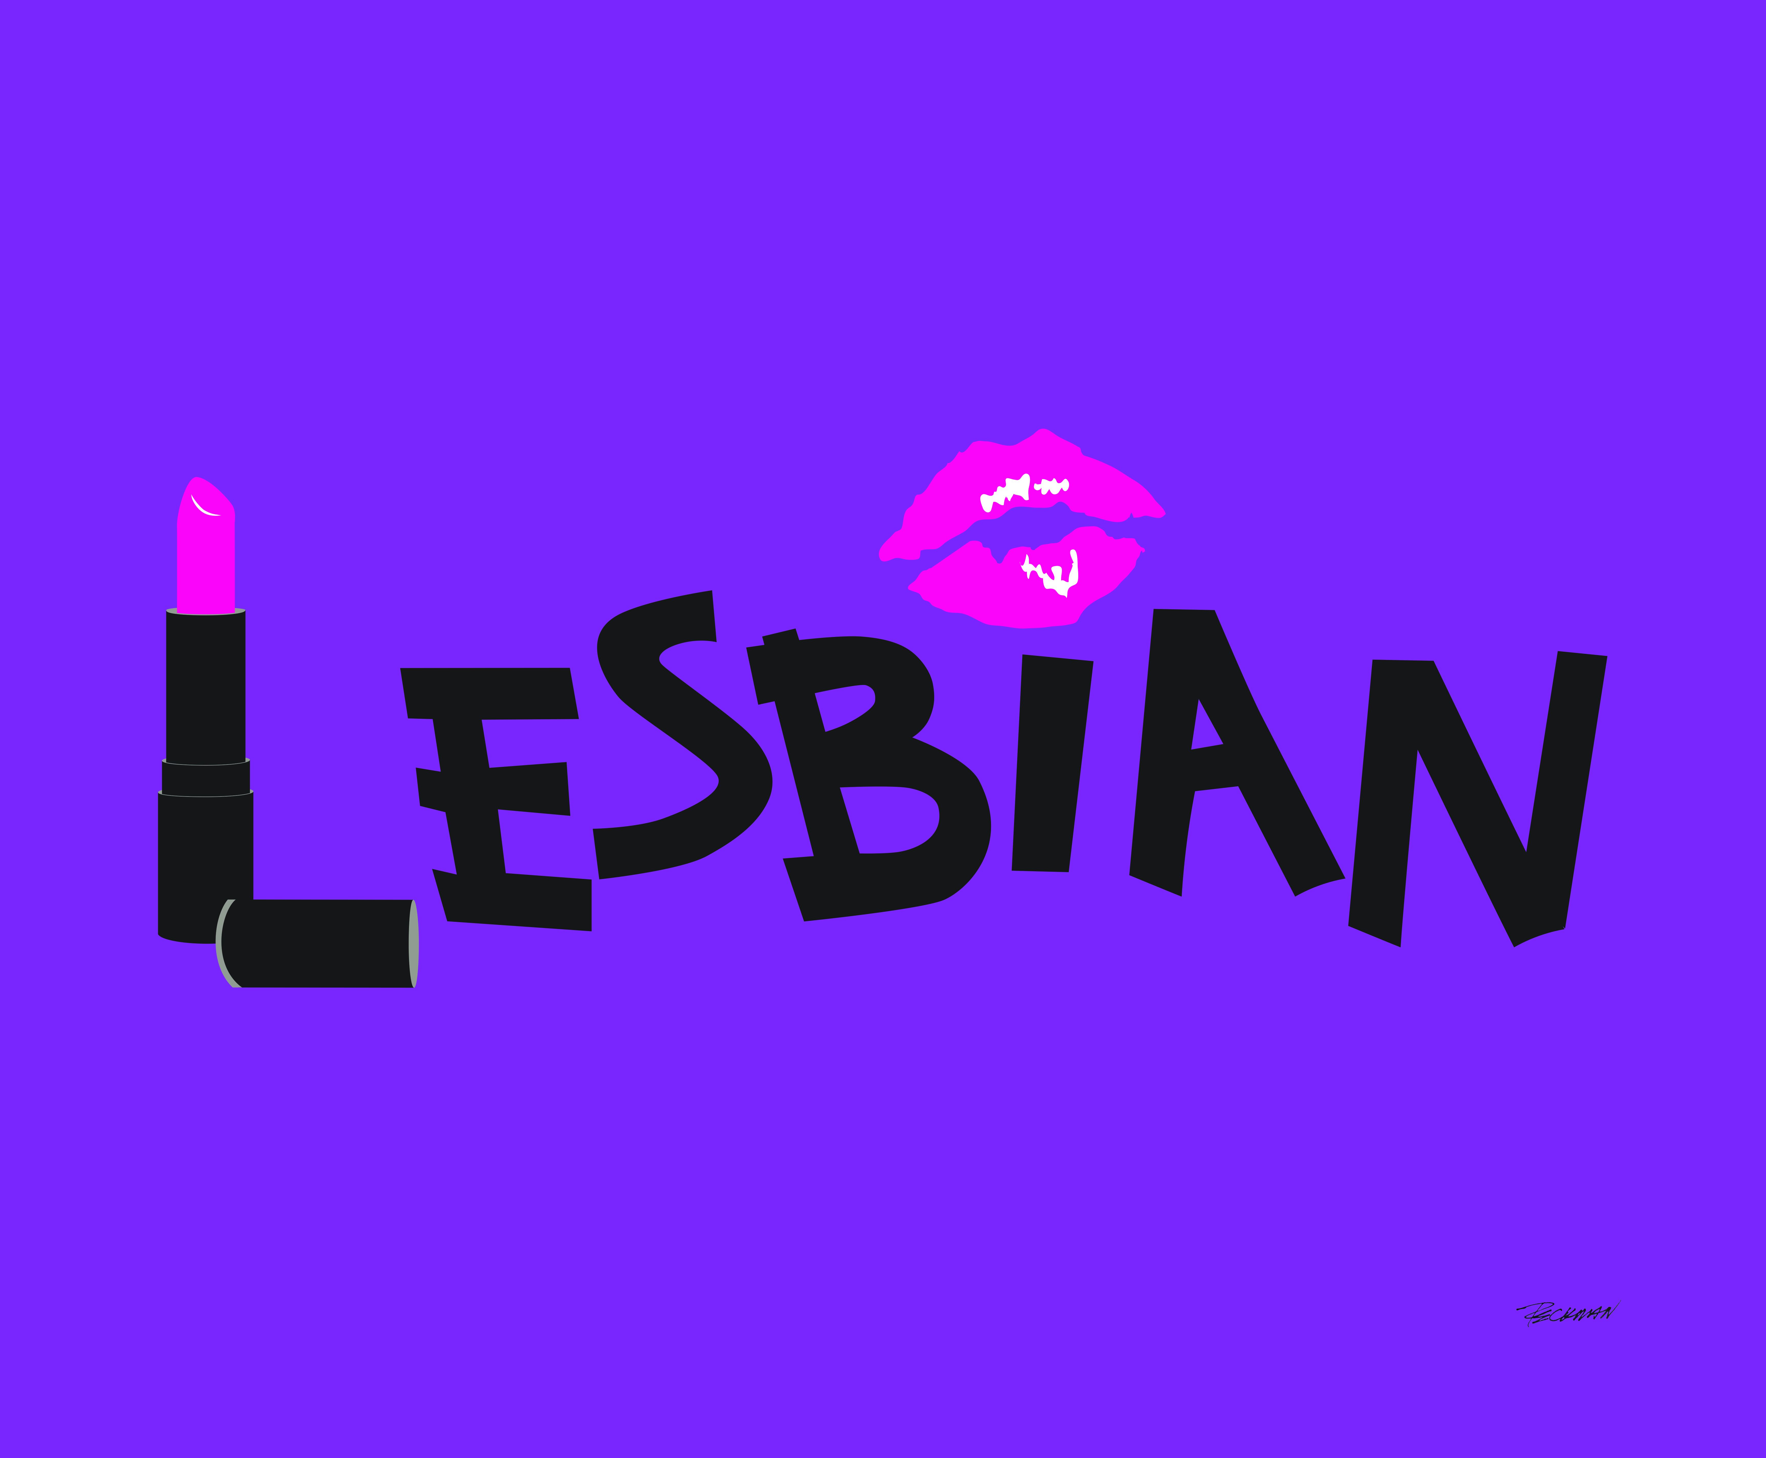
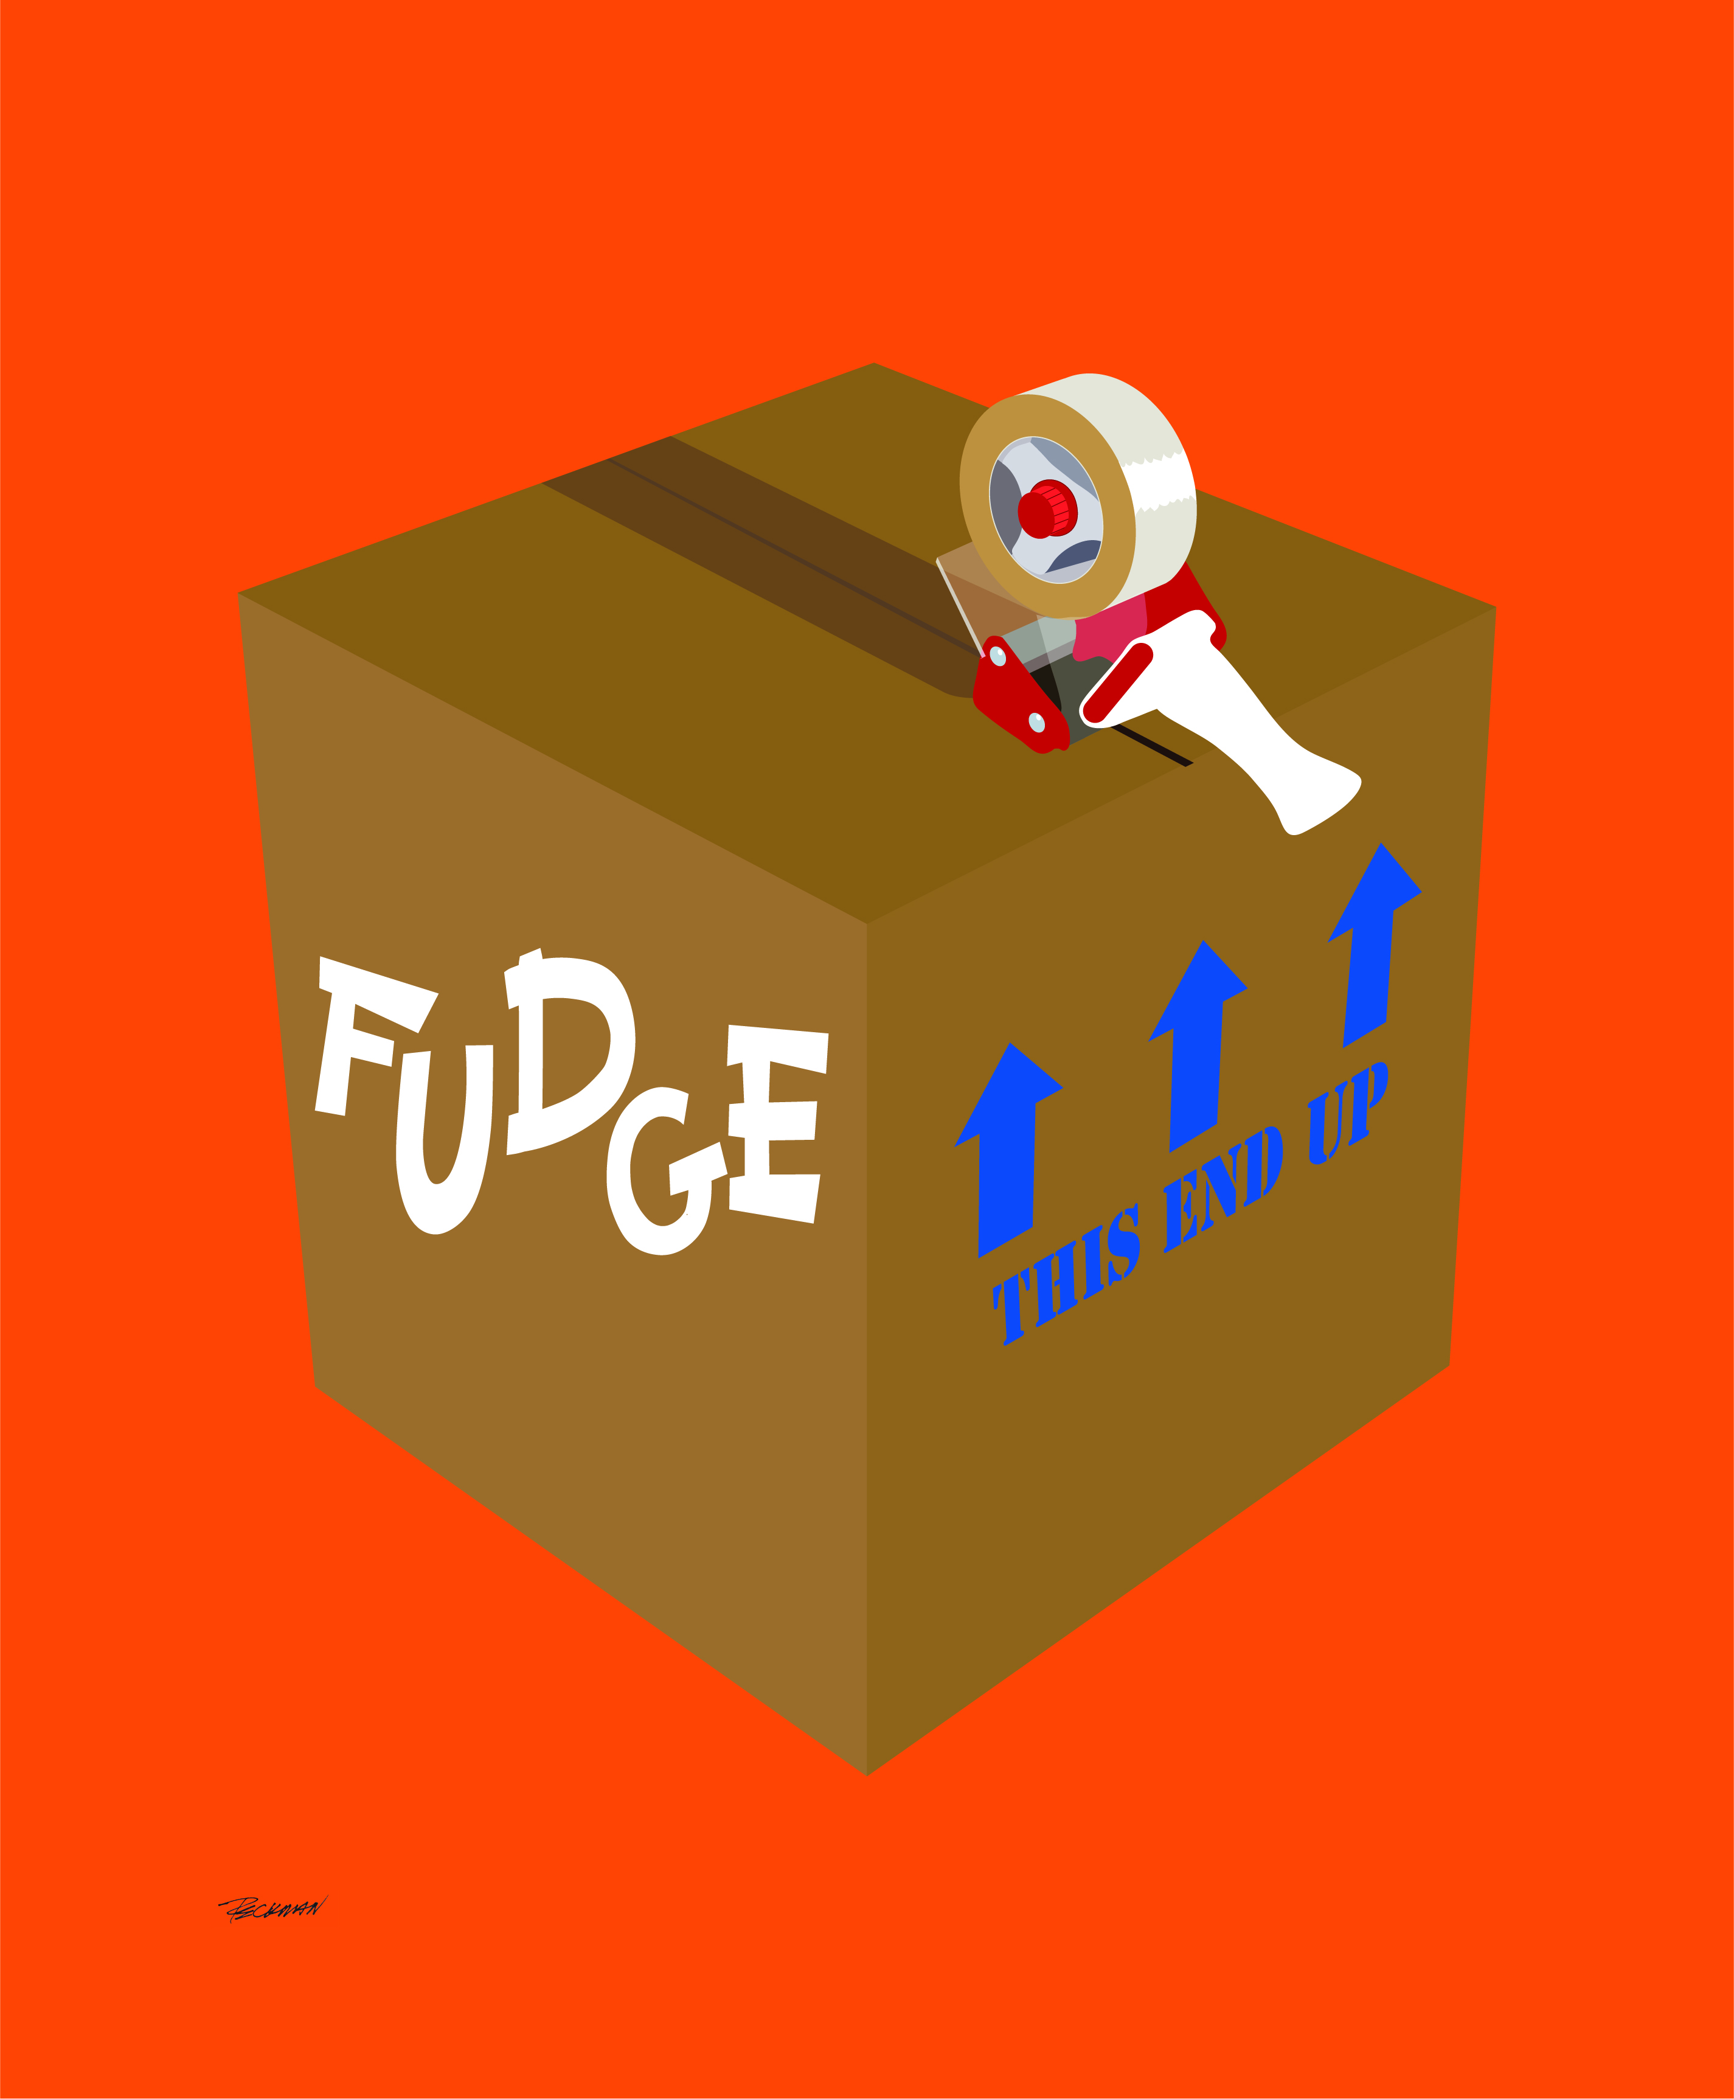
Art exhibit

Slide 3
Art exhibit Debrief
Facilitate Group Discussion (10 minutes)
How do you feel after seeing the art exhibit?
What were you feeling as you were looking at the art vs now?
What are your thoughts of the art exhibit?
What were you thinking as you were looking at the art vs now?

Slide 4
About queery

Slide 5
About queery

Slide 6
About queery

Slide 7
About queery

Slide 8
About queery

Slide 9
About queery

Slide 10
About queery

Slide 11
Engagement of lgbtq community in your program(s)
Facilitate Small Group Discussions (30 minutes)
Break into small groups by program
Complete worksheet focusing on engagement & awareness of LGBTQ around the mission and goals of the program

Slide 12
Sustainability

Slide 16
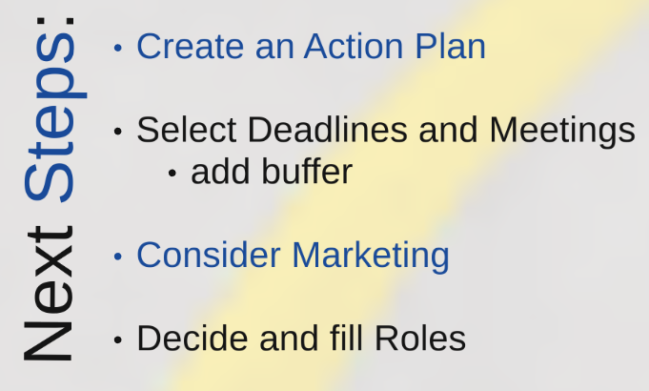

Slide 17
Closing

Slide 18
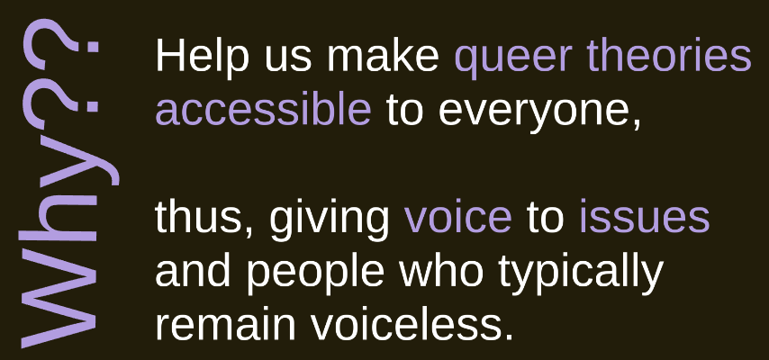

Slide 21
