Slide 1

Sex in the digital age

Slide 2
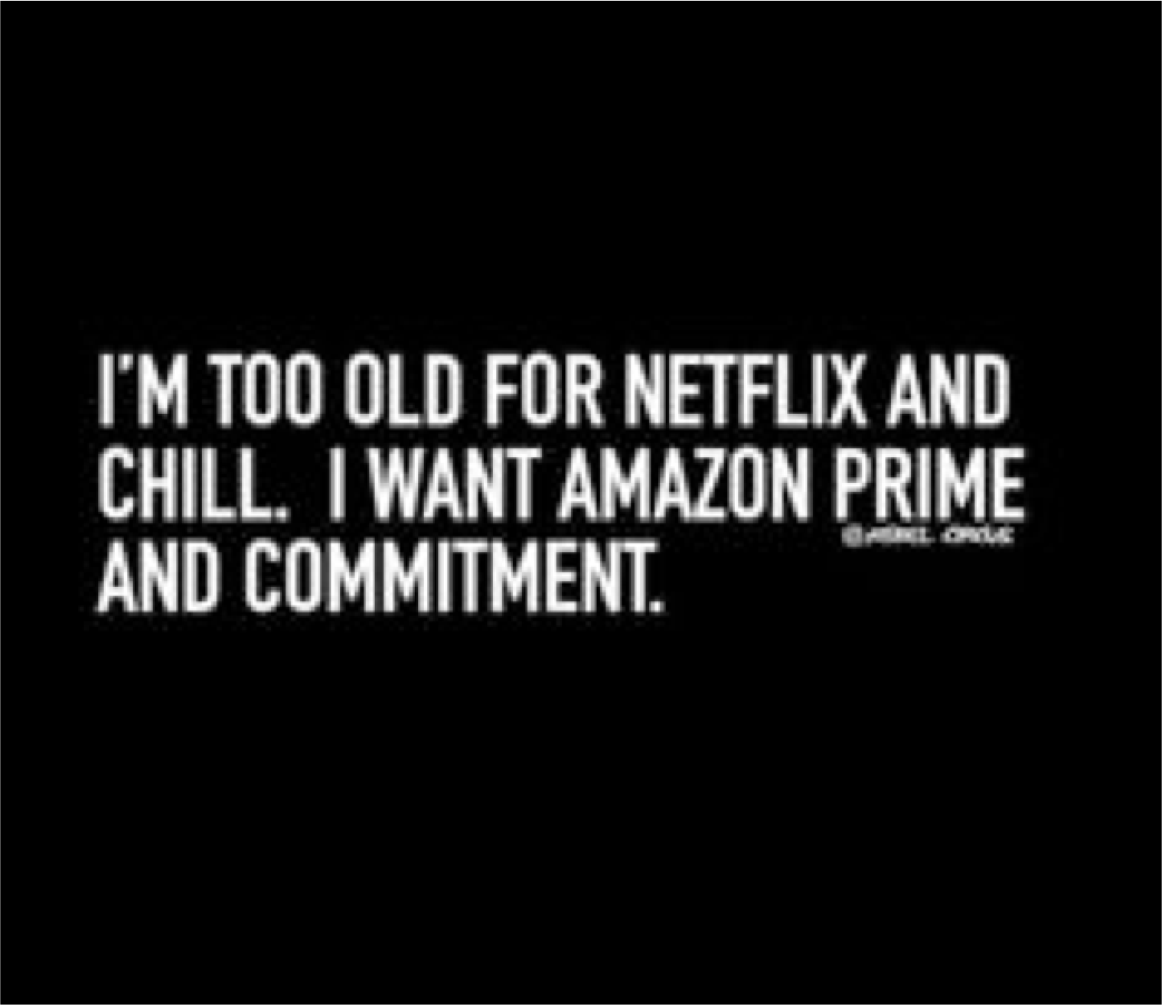
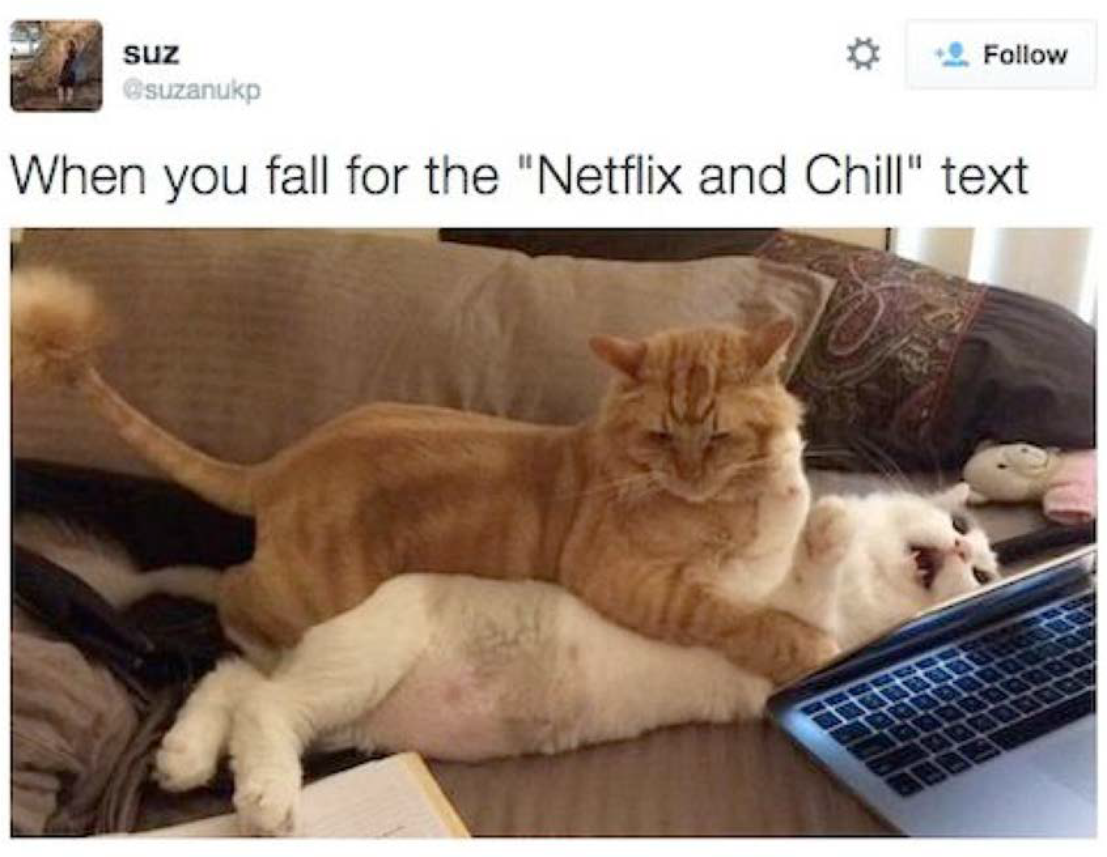
What’s your purreference?

Slide 3
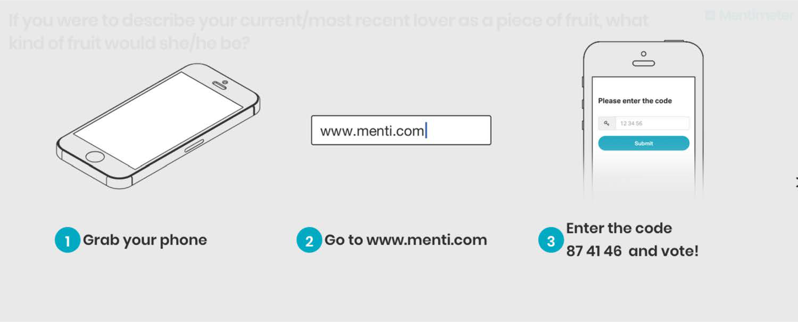
Live polling
Go to www.menti.com and use the code 81 47 12

Slide 4
Poll
If you were to describe your current/most recent lover as a piece of fruit, what kind of fruit would she/he/they be?

Slide 5
Poll
If your current/most recent lover describe you as a piece of fruit, what kind of fruit would you be?

Slide 6
The big picture

Slide 7

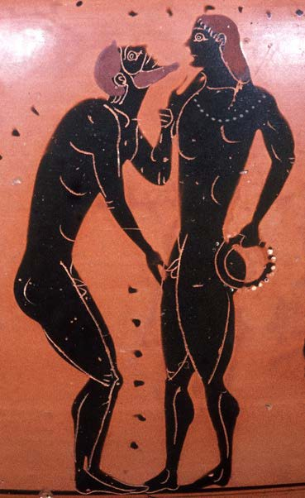
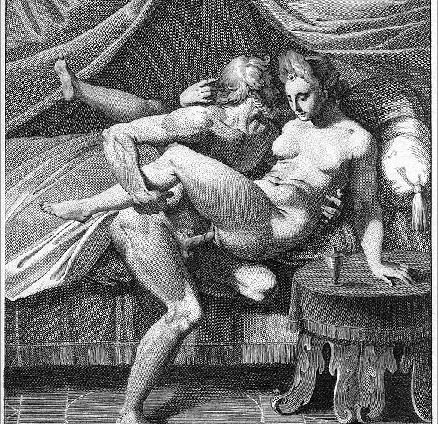


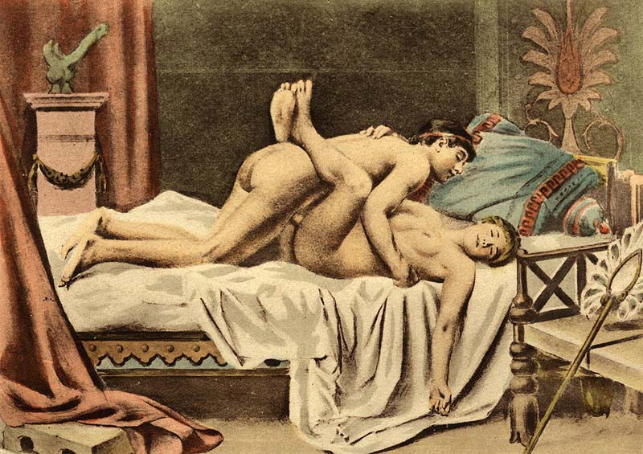

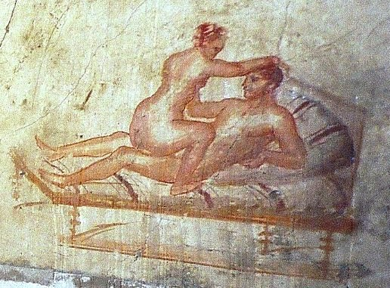
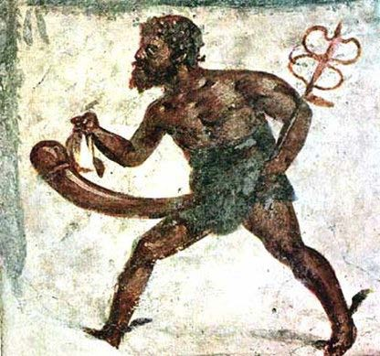
In the beginning…...

Slide 8
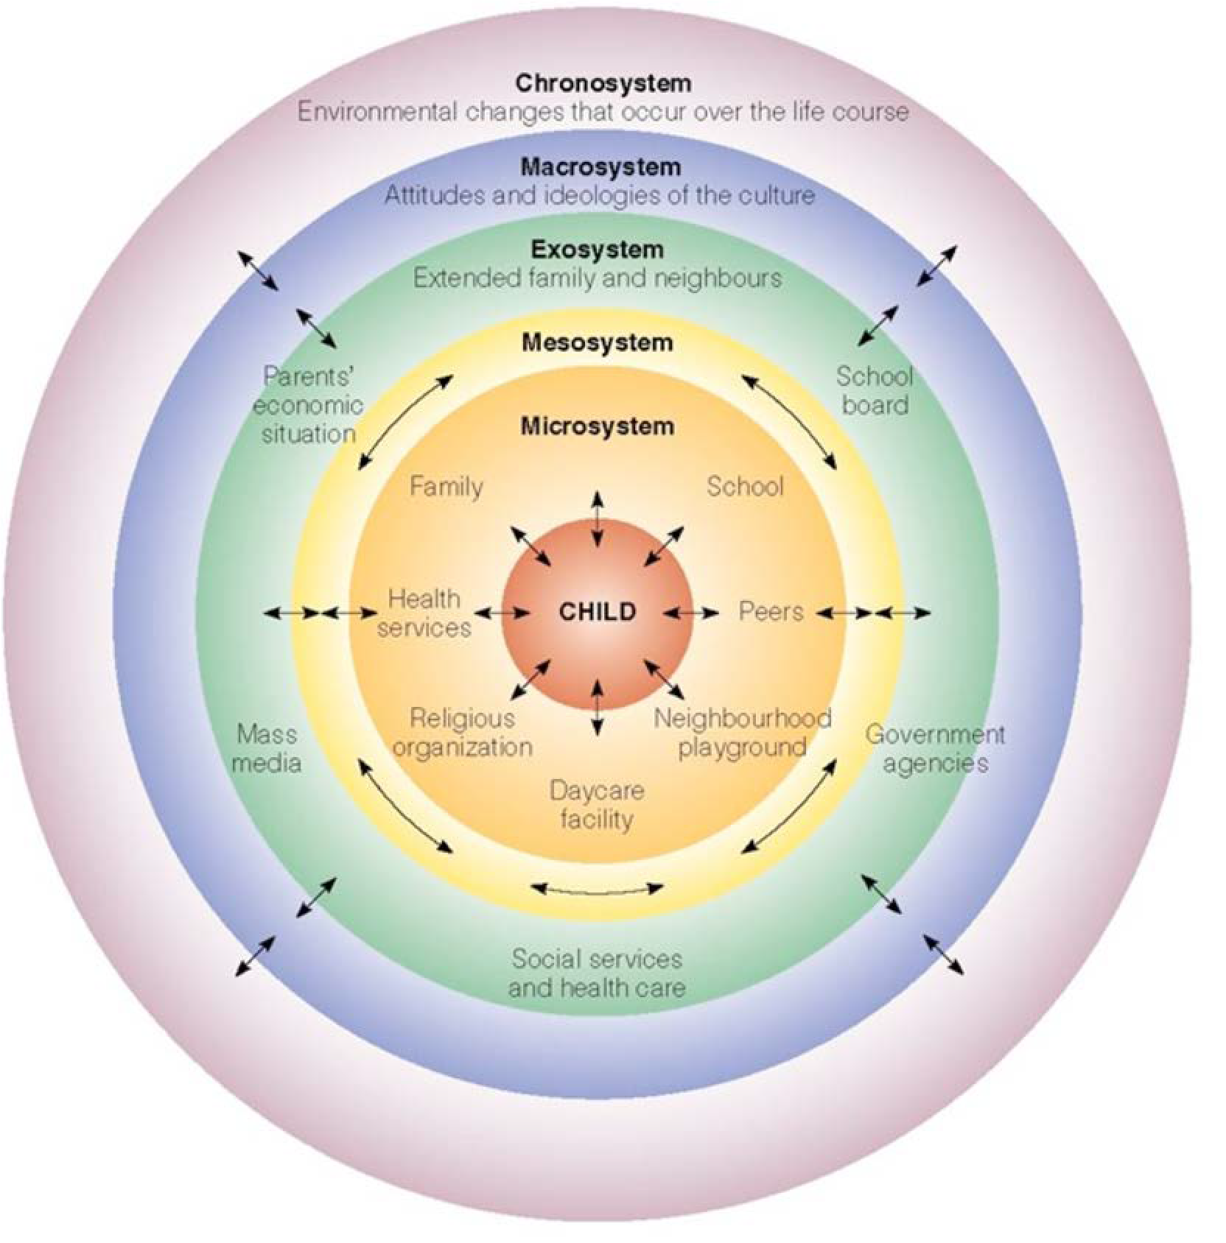
Disintegrating boundaries

Slide 9


Access is ubiquitous
92% of teens (13 to 17) go online daily; 24% go online “almost constantly”
87% of teens have access to a computer; cell phone (88%), smartphone (73%)
90% of teens with cell phones exchange text messages; typical teen sends 30 texts per day
Teens spend an average of 9 hours a day on digital media; 6 hours a day for tweens
(Lenhart, 2015; Common Sense Media, 2015)
9

Slide 10











71%
52%
41%
33%
The Digital Media Generation
92% of teens (13 to 17) go online daily; 24% go online “almost constantly”
87% of teens have access to a computer; cell phone (88%), smartphone (73%)
90% of teens with cell phones exchange text messages; typical teen sends 30 texts per day
Teens spend an average of 9 hours a day on digital media; 6 hours a day for tweens
(Lenhart, 2015; Common Sense Media, 2015)
33%
24%
14%
Lenhart, A. (2015) . Teens, Social Media & Technology Overview 2015. PEW Foundation
10

Slide 11









Intersections
Feminism / humanism / object / subject
Public/private
/ access & visibility
Privacy
Power
Representations in media and culture
Intimacy / longevity
Intimacy / relationships
Gender
Commodification of people / trafficking / market generation
Sexual desire
Human sexuality
Economics
Human development / physiological functioning
Porn as an industry
Sexual arousal & function
Influence of age on perception and participation
Body as chemical producing factory

Slide 12

Sex trafficking

Slide 13

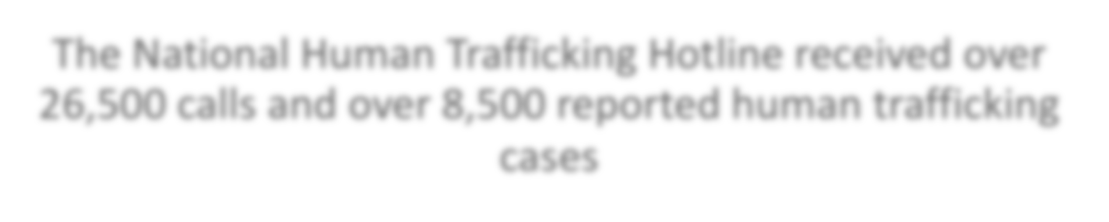



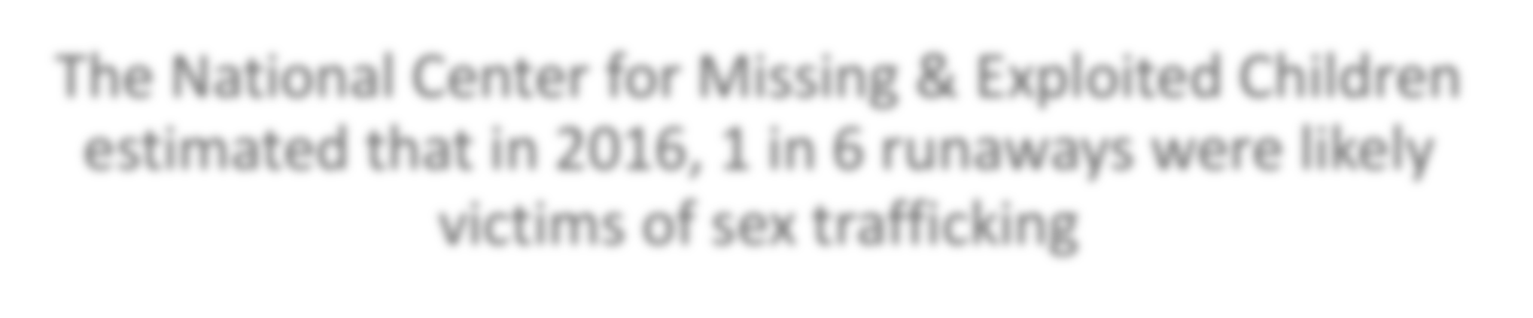
The National Human Trafficking Hotline received over 26,500 calls and over 8,500 reported human trafficking cases
About 6,000 of those cases were specifically sex trafficking and the majority were women
Just under 2,500 of those cases were minors
Most callers (about 8,000) were community members
Stats Overview for 2017
The National Center for Missing & Exploited Children estimated that in 2016, 1 in 6 runaways were likely victims of sex trafficking
Sources:
https://humantraffickinghotline.org/states
https://humantraffickinghotline.org/state/new-york
https://www.caclapeer.org/lapeercacblog/human-trafficking-the-internet

Slide 14
NYS had the 5th highest number of trafficking cases reported (333)
New York
State
238 were specifically sex trafficking
286 were women and 119 were minors
Most callers were either trafficking victims or community members

Slide 15




Trafficking, sexual services, and pornography businesses were some one the earliest adopters of internet use and internet marketing
Sex traffickers use the internet (both common sites like Craigslist and more “exclusive” sites and forums specifically for sex services) to market workers/victims to buyers
Trafficking and prostitution moving to the internet poses new and unique obstacles for law enforcement
The internet can be used by traffickers to lure but can also be used by anti-trafficking groups to find and stop traffickers
90% of prostitution moved online between 2009 and 2011
Laws like Prop 35 in CA have to navigate how to effectively handle those convicted of trafficking without violating constitutional rights
Sex Trafficking & The Internet

Slide 16
Pornography can be used as a form of control over trafficked women
Once an image is on the internet, it stays there
  Even if they are able to escape, their traffickers will hold images that are on the internet over their heads
Traffickers use pornography for greater financial gain
The porn industry is lucrative, and the younger girls are in an image/video, the more expensive the images are
Transactions for such images usually happen online, and images are used to attract more clients
Pornography can also be used a means of “advertisement” where sex buyers can view trafficked women for rent or sale
Sex buyers can remain anonymous on the internet
Pornography & Sex Trafficking

Slide 17
Social Media & Message Boards
Social media sites such as Facebook and Twitter can contain advertisements for sexual services
In 2011, 83% of prostitutes in NYC had a Facebook page (and could use them to friend others)
Facebook users as young as 13 (the minimum age to use Facebook) can post to anyone, not just friends, making them targets for marketers
Traffickers frequently friend or follow victims on social media, often becoming romantically involved with them before forcing or manipulating them into prostitution

Slide 18


While the Communications Decency Act protects Internet Service Providers from liability for some third party actions, websites are still responsible for taking action when they are warned about illegal content
In 2009, MySpace removed 90,000 sex offenders from their site after receiving pressure from the Attorney General
Users can alert each other about Law Enforcement watching the boards, and talk about “best practices” for anonymity
Users are able to rate women on these message boards, which can effectively coerce women to perform acts they otherwise would not, in order to receive a good rating
Message boards allow for direct, anonymous contact between buyers and sellers

Slide 19



These sites are not easily found by the general public, and sex traffickers often use these sites to advertise victims
Scientific American has reported that Google, Yahoo, and similar search engines really only bring up results from about 10% of the internet—the rest lives on what is called the “Dark Web” or the “Deep Web”
Some AI software is being used to investigate both open and dark web content to find traffickers and victims
DIG (Domain Insight Graph) is a technology being developed at the University of Southern California that can extract information from website and can be used by law enforcement agencies to find contact and location information for traffickers or trafficking rings
The Deep (Dark) Web

Slide 20
Porn

Slide 21

Triple A Engine (Cooper et al, 1999)
Accessibility
Affordability
Anonymity
Disembodiedness
Disinhibited behavior
High levels of self disclosure

Slide 22
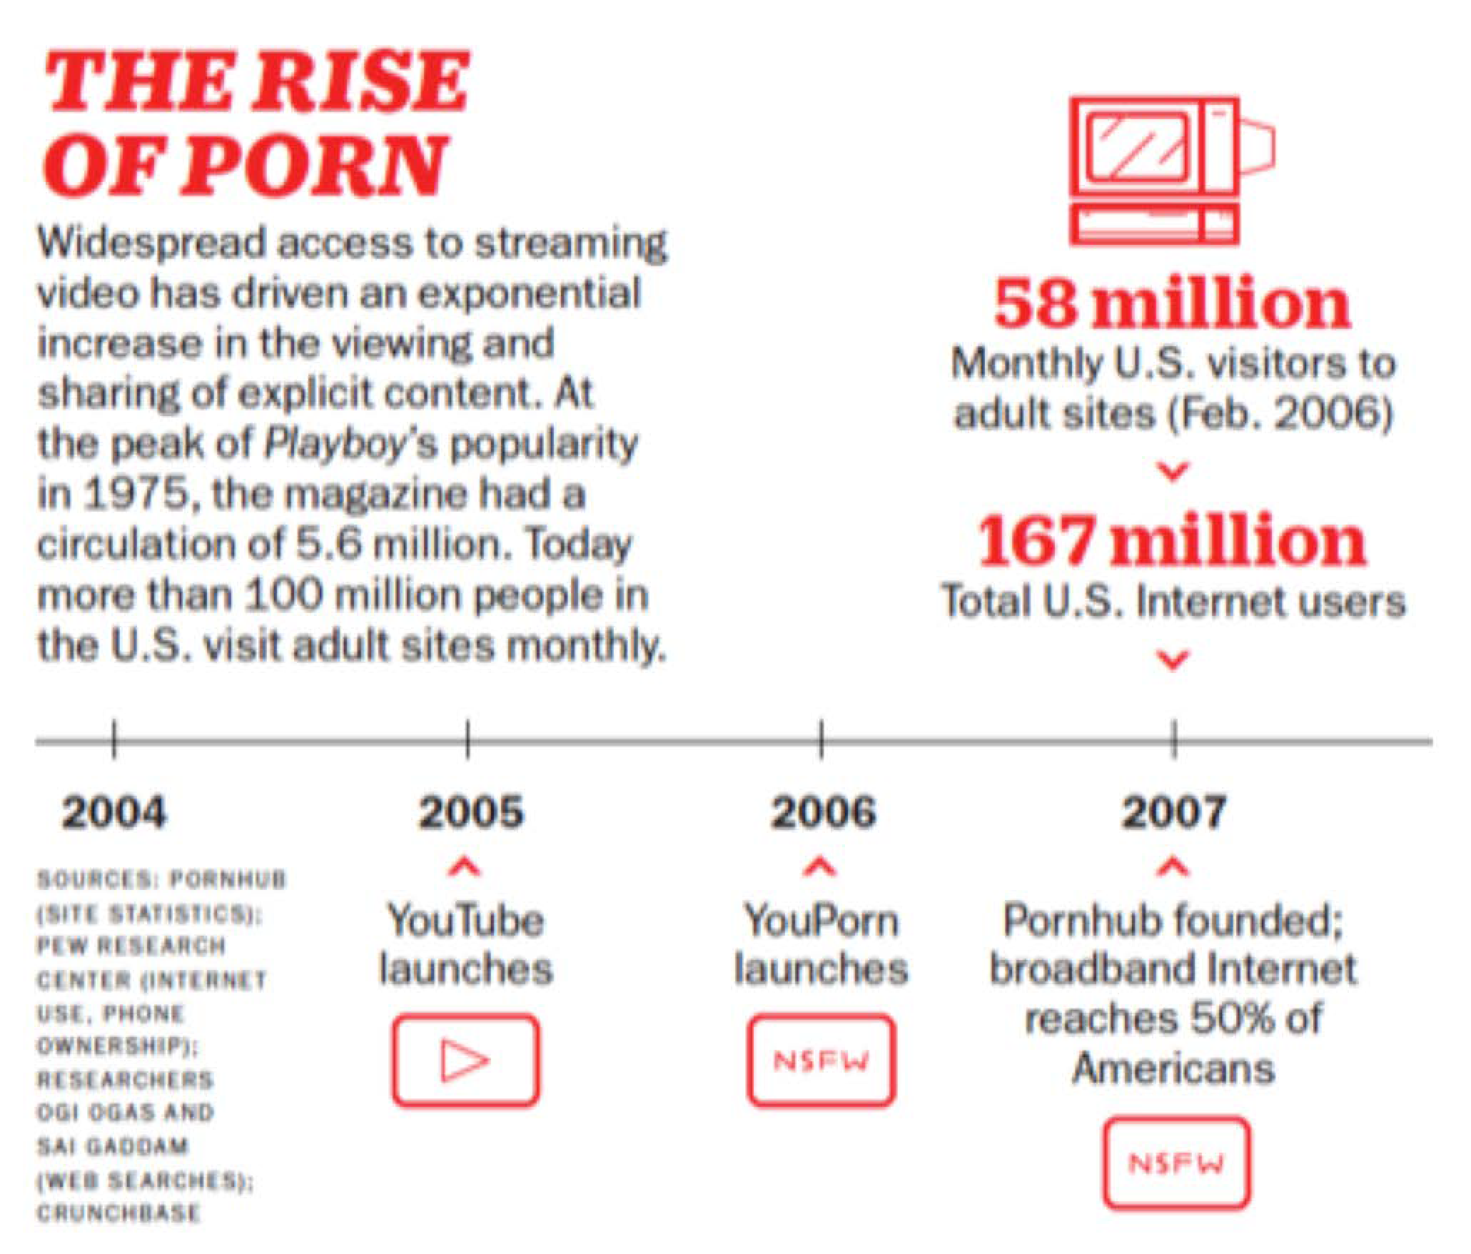

Slide 23
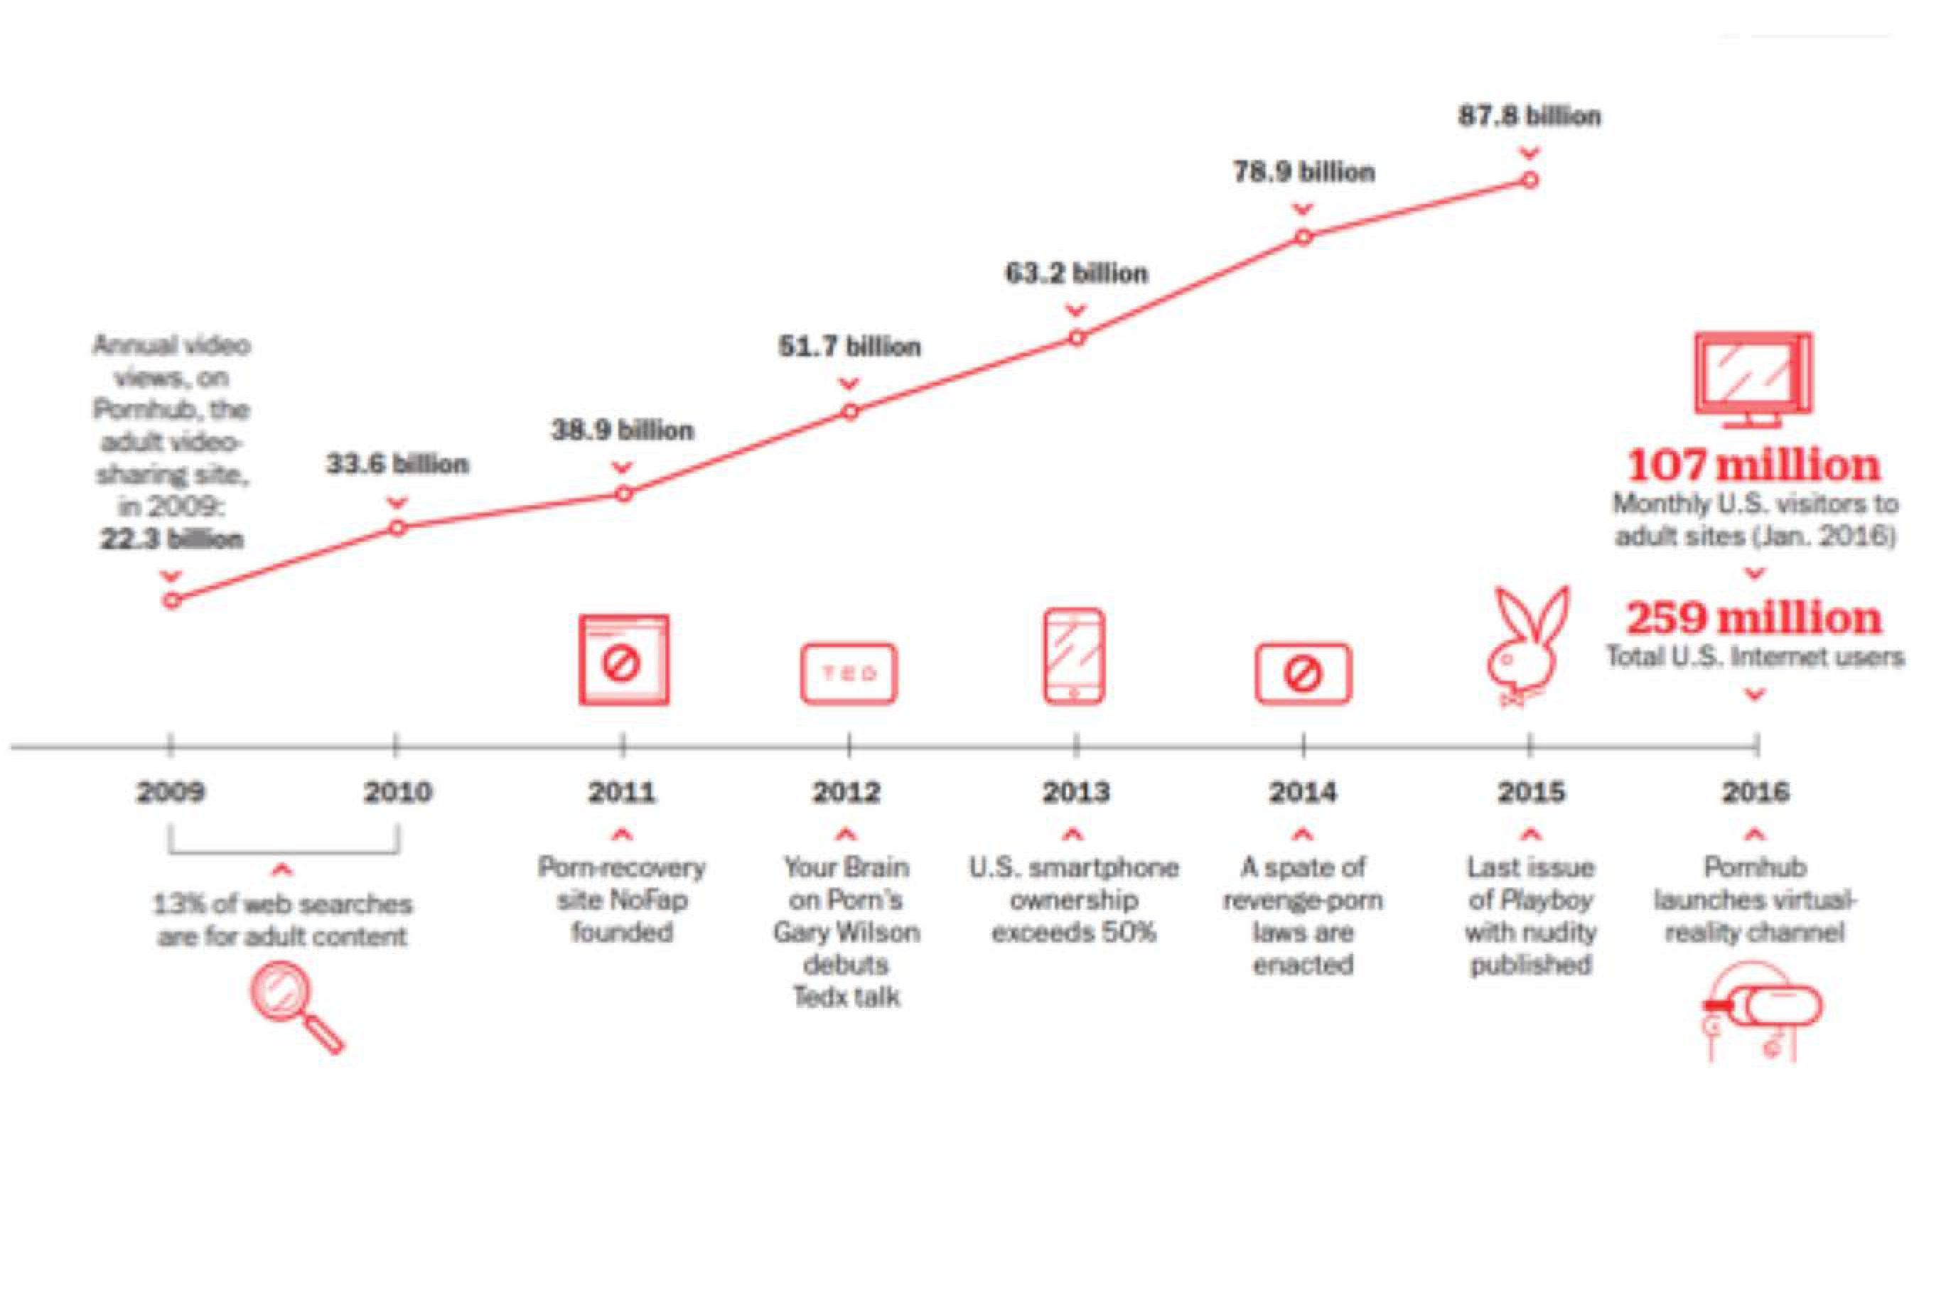

Slide 24

What did you take away?
Generally speaking:
Has been an increase in porn use over time by age cohort for both men and women, but larger for men
Cohort effect in acceptance for men – they become more conservative by cohort over time (younger more likely to think it should be illegal)
No cohort effect in acceptance for females (since 1945)
How much more XXX is generation X consuming?

Slide 25
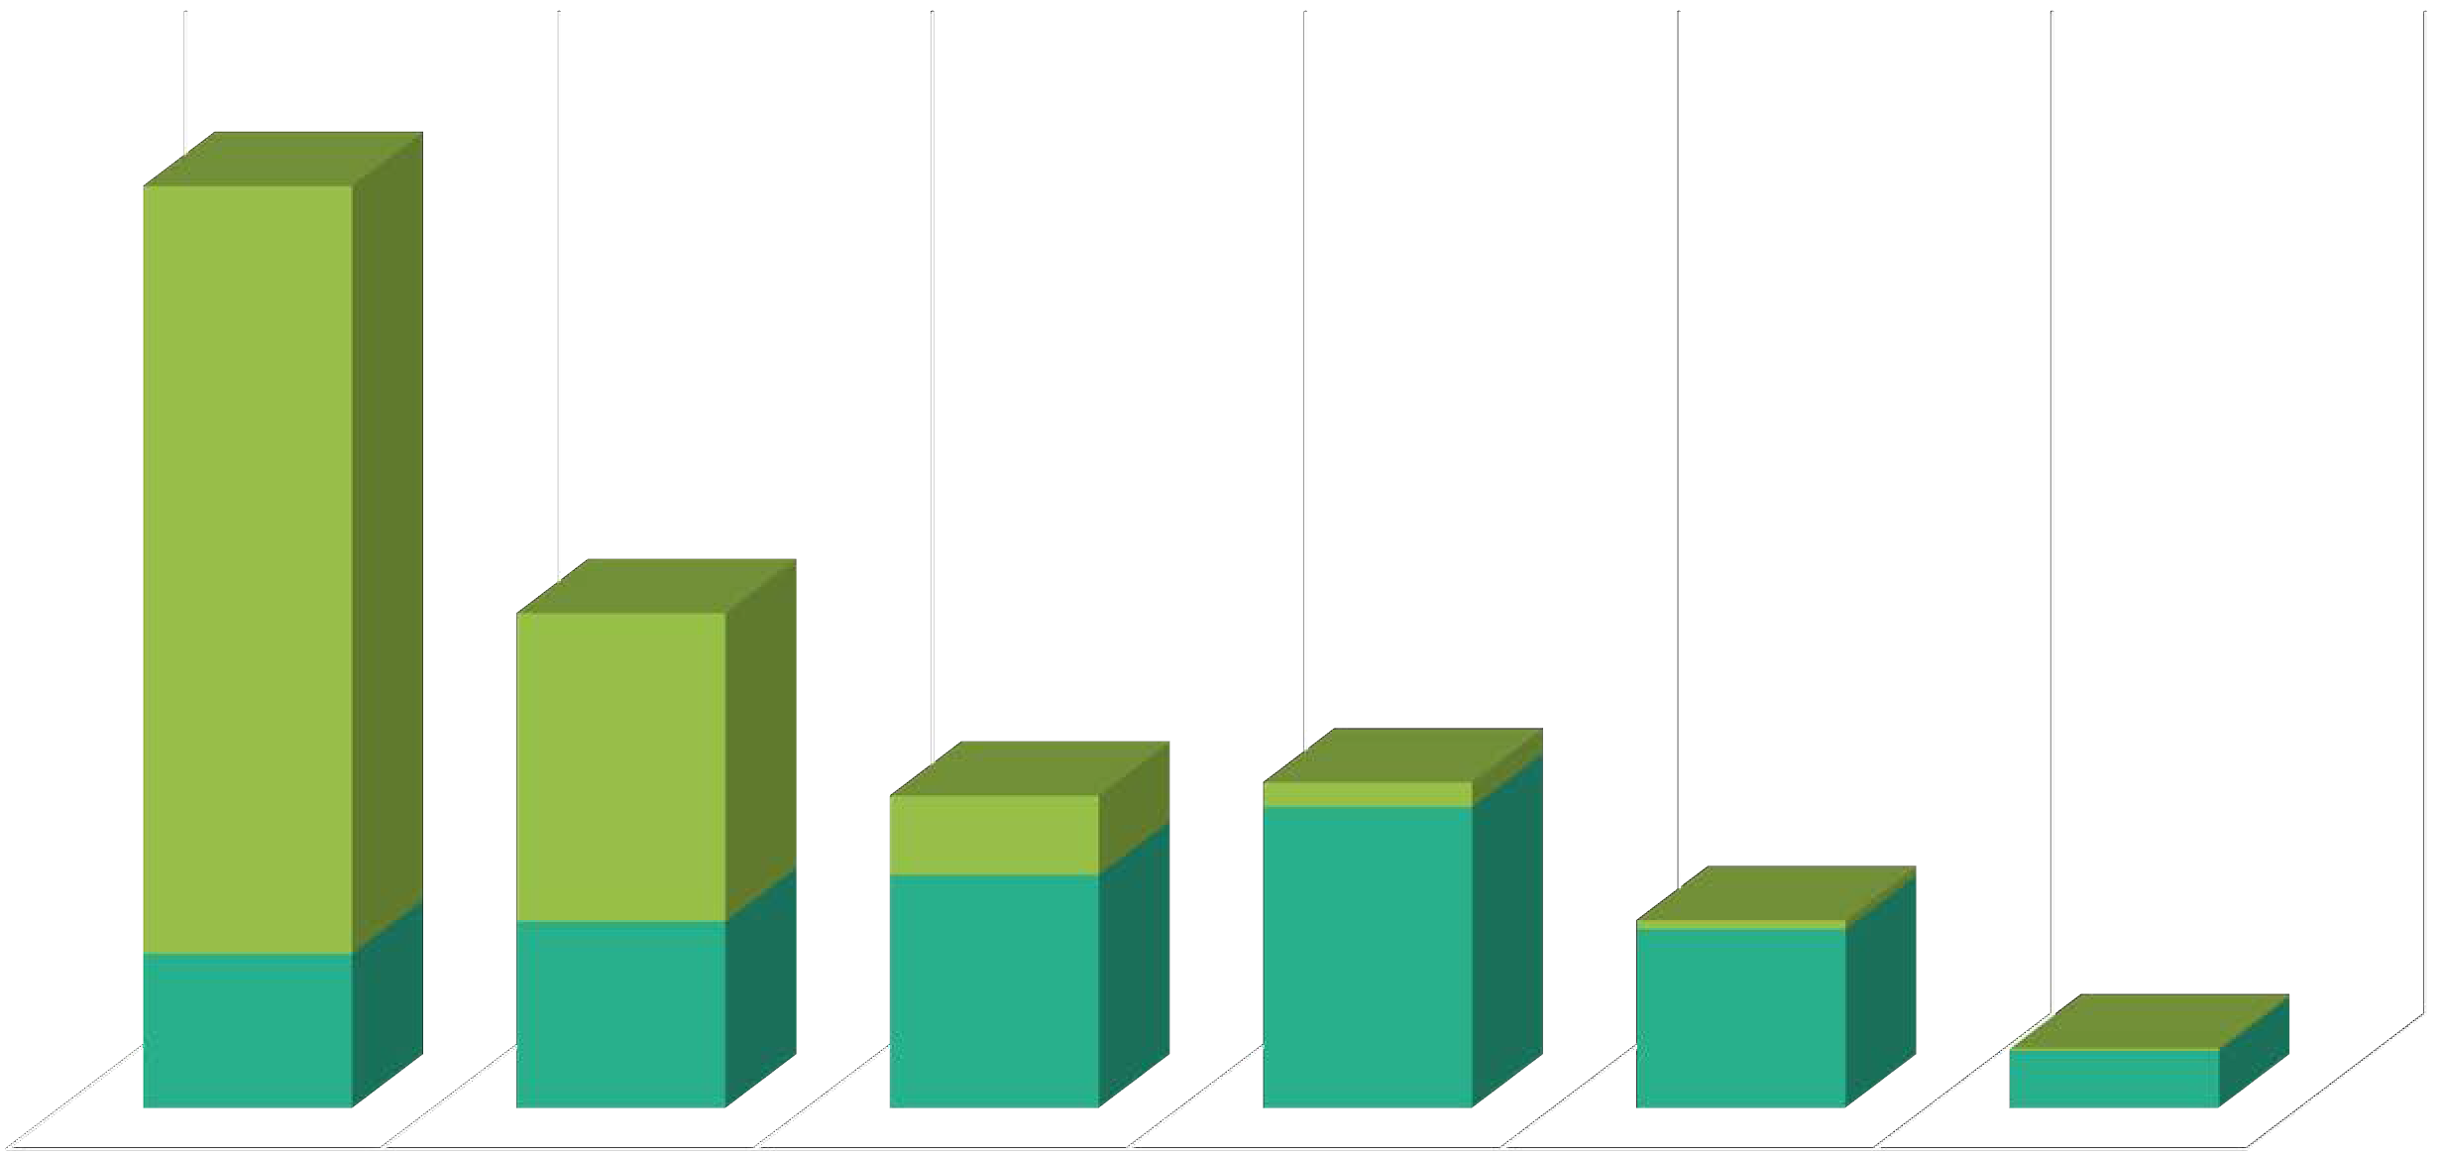
Porn use among college students by sex
males females
69
27.7
2.2
7.1
27.1
0.8
13.9
16.8
21
16.1
0.2
5.2
NEVER
1X MO OR LESS
2 - 3 DAYS/ MO
1 - 2 DAYS/ WK
3 - 5 DAYS/ WK
DAILY
87% of men and 31% of women reported using pornography in past 12 mos.
Carroll, J. S., Padilla-Walker, L. M., Nelson, L. J., Olson, C. D., McNamara Barry, C., & Madsen, S. D. (2008). Generation XXX: Pornography acceptance and use among emerging adults. Journal of adolescent research, 23(1), 6-30.

Slide 26
Attitudes toward porn use in college students by sex
50
45
40
35
30
25
20
15
10
5
0
very strongly acceptable
stongly acceptable
Acceptable
Unacceptable
strongly unaccpetable
very strongly unacceptable
males females
Carroll, J. S., Padilla-Walker, L. M., Nelson, L. J., Olson, C. D., McNamara Barry, C., & Madsen, S. D. (2008). Generation XXX: Pornography acceptance and use among emerging adults. Journal of adolescent research, 23(1), 6-30.

Slide 27

Middle School (78.5% 12yo) Peer to peer survey n=121
  Female: 47.11%
  Male: 47.93%
  Other: 4.96%
>75% use internet at least several times a day (23.7% almost constantly)
  76% owned at least one device of their own
  Everyone said that they used a mobile device to access Internet most often
Open Talk Project
Over 1.2 (52%) said that there are no parental blocks on any devices they use/own
  39.4% said some of them
45.5% indicated that their parent(s) do not see anything they do online
  46.6% said that their parents see some but not all

Slide 28
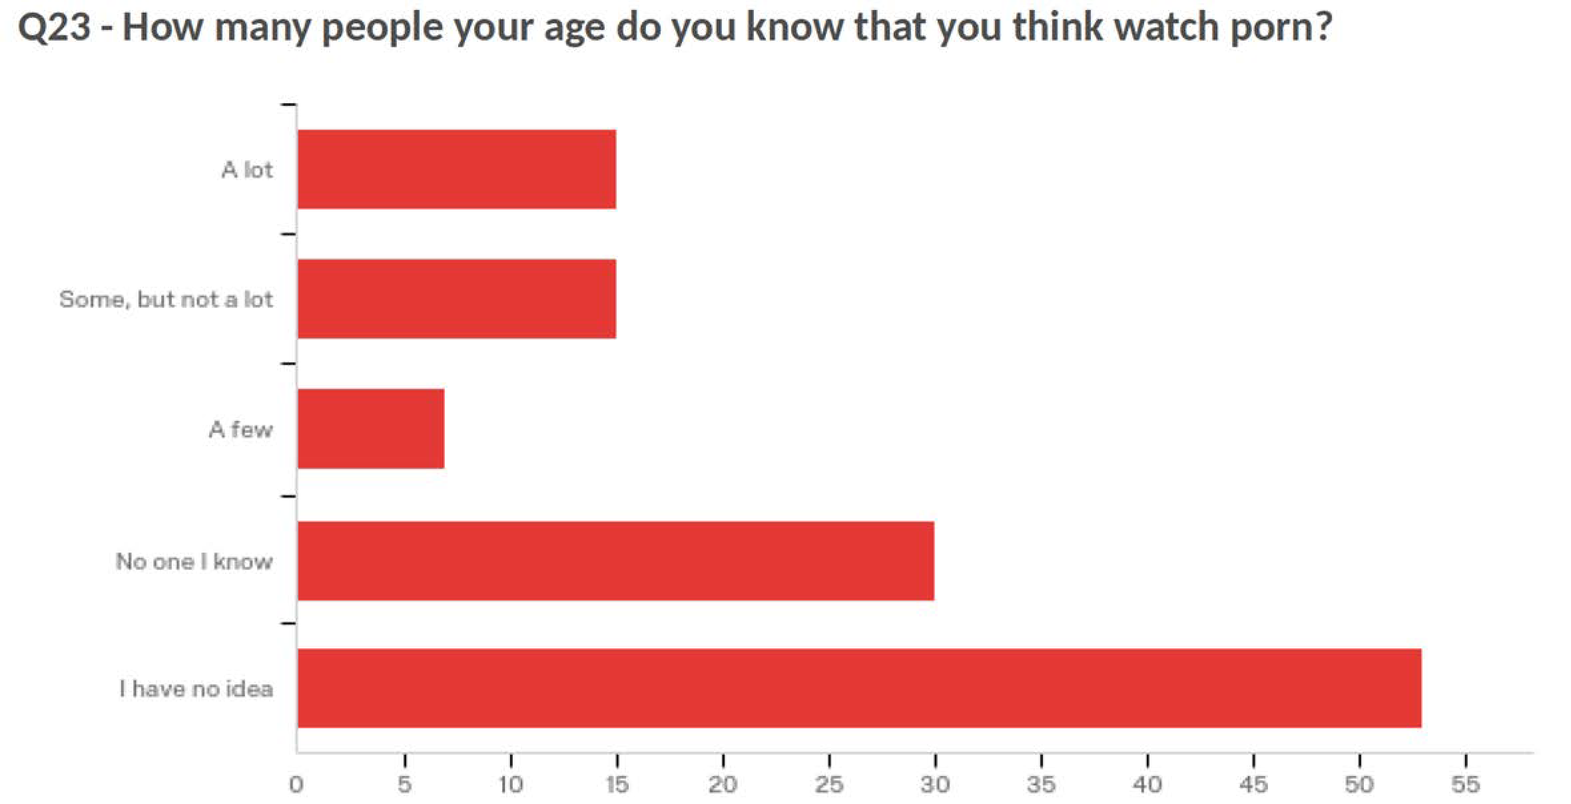
Perceived porn use by peers

Slide 29
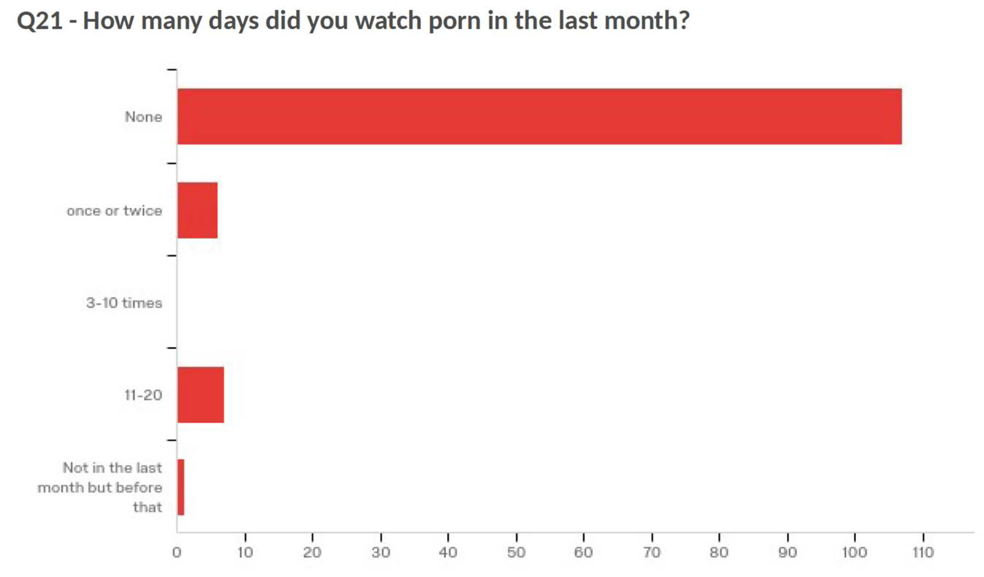
Let’s be Frank Project: Own porn use

Slide 30

Porn makes money
An estimated $10 - $14 billion annually
Porn is a bigger business than professional football, basketball, and baseball put together.
People pay more money for pornography in America in a year than they do on movie tickets or on all the performing arts combined.
Porn brings in more revenue than Microsoft, Google, Amazon, Ebay, Yahoo, Apple and Netflix combined

Slide 31

What is sexting?
Sexting is a term used to describe sending explicit photographs to another person via the Internet or a mobile device.
In some states, legal precedent has been established to criminalize sexting for teens

Slide 32
An estimated 20% - 28% of teens (14-18) admit to having sent a sext and approximately 40% have received one
25% forwarded it to someone else
23% of teens with dating experience have sent sexy or flirty pictures or videos to someone they were interested in, compared with just 2% of teens without dating experience.
How common is it?

Slide 33
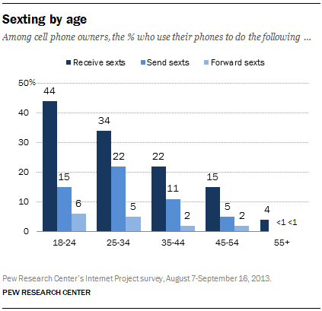
Sexting by age

Slide 34
They are already dating the person with whom they are sexting and it is a form of flirtation or connection,
One person is romantically interested in another and considers sexting a form of enticement or “relationship currency” (Lenhart, 2009).
Why?
Curiosity
Among couples, SM allows for enhanced emotions but can also lead to feelings of jealousy or uncertainty about the stability of their relationships.

Slide 35
Regardless of study, girls asked to send a sext (68%) more often than boys (42%)
Fully 35% of all teen girls have had to block or unfriend someone who was flirting in a way that made them uncomfortable, double the 16% of boys who have taken this step (PEW, 2015)
A few facts
Among couples, SM allows for enhanced emotions but can also lead to feelings of jealousy or uncertainty about the stability of their relationships.

Slide 36
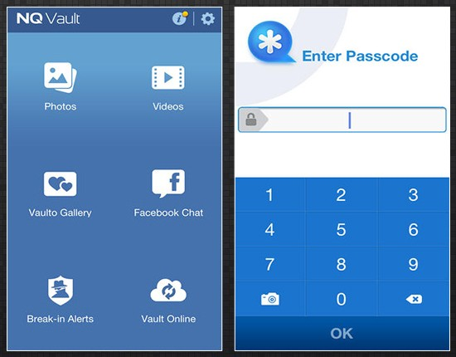
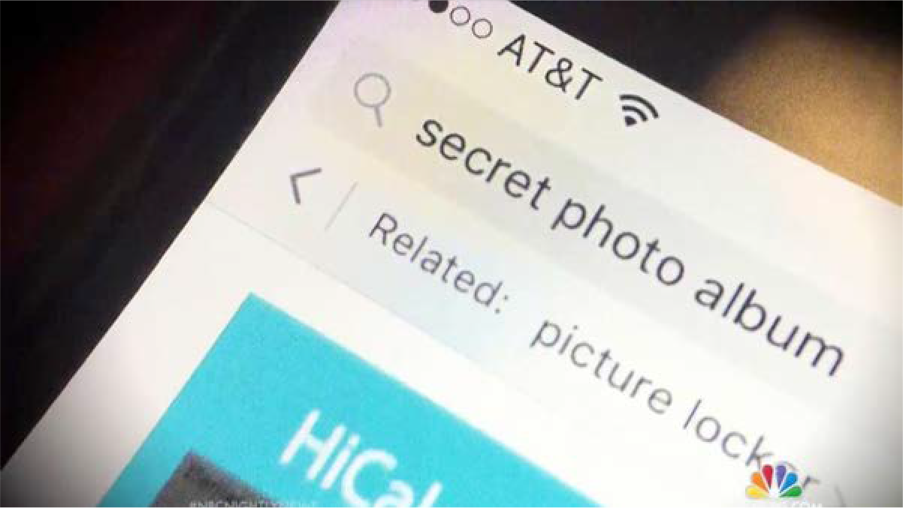
The Colorado case (Cañon City School District)
More than 100 students involved in massive sexting ring
Used vault apps to collect and store images
There were competitions to see who could collect the most
Charges could amount to a Class 3 felony unless the bill proposed making it a class 2 misdemeanor is passed

Slide 37
Legal ramifications
  Legal ramifications vary by state
  Complicated by the fact that it does not conform well to federal child pornography laws largely designed to protect minors from adults. Nevertheless, in many states teens can be charged if they send or receive a sext, with penalties that can be quite significant, especially if one of them is over 18 (Sacco et al., 2010).
“Exposing” (similar to revenge porn)
Normalizing the behavior
Long lasting
  Emotional effects of having images last and seen by unintended others
Effects of sexting

Slide 38
Kinsey Institute Survey
67% of all respondents has sexted
SMS text messaging most popular
Snapchat more popular for younger people
Sexting more likely in teens with higher extraversion, lower conscientiousness, and higher agreeableness
Sexting
In many states, teens and young adults can be charged with possession of child pornography for having nude pictures of their partners
19% of college freshman reported negative outcomes (embarrassment, bullying), 13% reported positive (improve relationship, confidence), 7% mixed

Slide 39
The number of young adults (age 18-24) who use mobile dating apps has increased dramatically from 5% in 2013 to 22% in 2015 (Smith, 2016).
Hook up apps
Little is known about the prevalence of use among minors
Tinder reported in 2016 that 7% of its users were between the ages of 13 and 17.
These findings prompted Tinder to institute a policy change prohibiting minors from using the app (Farber, 2016).
While most dating apps are restricted to those over the age of 17, processes for verifying age are limited and easily circumvented if desired.
Like online dating websites, dating apps have the potential to foster some sense of connection, particularly for individuals who feel marginalized or live in big cities.

Slide 40










Badoo
Trans
Hot or not
Bumble
KIK
Meet Me
Tinder
Grindr
Skout

Slide 41
The effects: What the literature says

Slide 42
People who consume pornography frequently and for longer durations are more likely to perceive positive impact (Hald & Malamuth, 2008; Mulya & Hald, 2014)
Can be very useful for people exploring sexual identity and orientation but who are otherwise isolated
Recent meta analysis of 50 studies collectively including more than 50,000 participants from 10 countries found (Wright et. al., 2017)
Porn use was not related to the intrapersonal satisfaction outcomes studied | Porn use was related to lower interpersonal satisfaction in all types of studies but this was true for men only

Slide 43
But also evidence that it reinforces stereotypical male attitudes toward women
Female users are less likely to intervene when seeing another woman being threatened or assaulted and are slower to recognize their own danger
May be contributing to youth erectile dysfunction: In 1992, about 5% of men experienced ED at age 40. By 2013, 26% of adult men seeking help for ED were under 40. And two studies of young adult men found 1/3 suffered from ED. (Milan etl. Al, 2012; Capogrosso et. al, 2013)
And…

Slide 44
On the whole, Americans who view pornography (either at all or more often) are more likely to experience depressive symptoms
Believing pornography use to be morally wrong is generally unassociated with depressive symptoms for all Americans, but
Among those who use pornography, being a “conflicted” user it is highly predictive of depressive symptoms.
Perry, S. L. (2017). Pornography use and depressive symptoms: Examining the role of moral incongruence. Society and Mental Health, 2156869317728373.

Slide 45

ED rates in YA have increased significantly in the past decade
Porn and erectile dysfunction
Rates in men 18-22 are 24% - 45% depending on the study.
Between 40% - 50% report low sexual satisfaction and arousal
A comprehensive review of the literature suggests that there may be a relationship between porn use and rising rates of ED.
Park, B. Y., Wilson, G., Berger, J., Christman, M., Reina, B., Bishop, F., ... & Doan, A. P. (2016). Is Internet pornography causing sexual dysfunctions? A review with clinical reports. Behavioral Sciences, 6(3), 17.

Slide 46
Decreases body confidence
Increase in hair removal, labiaplasty in women
Porn exposure correlated to increased physique anxiety for gay men
Emphasizes gender roles
Lastly..
More stereotyped gender beliefs in men who watch porn
More acceptance of rape myths
Enhances acceptance of marginalized gender identities or sexualities
More permissive sexual attitudes
More acceptance of same-sex marriage
Skews perception of the reality of sex
Adolescents structure their idea of what sex should be like based on porn

Slide 47
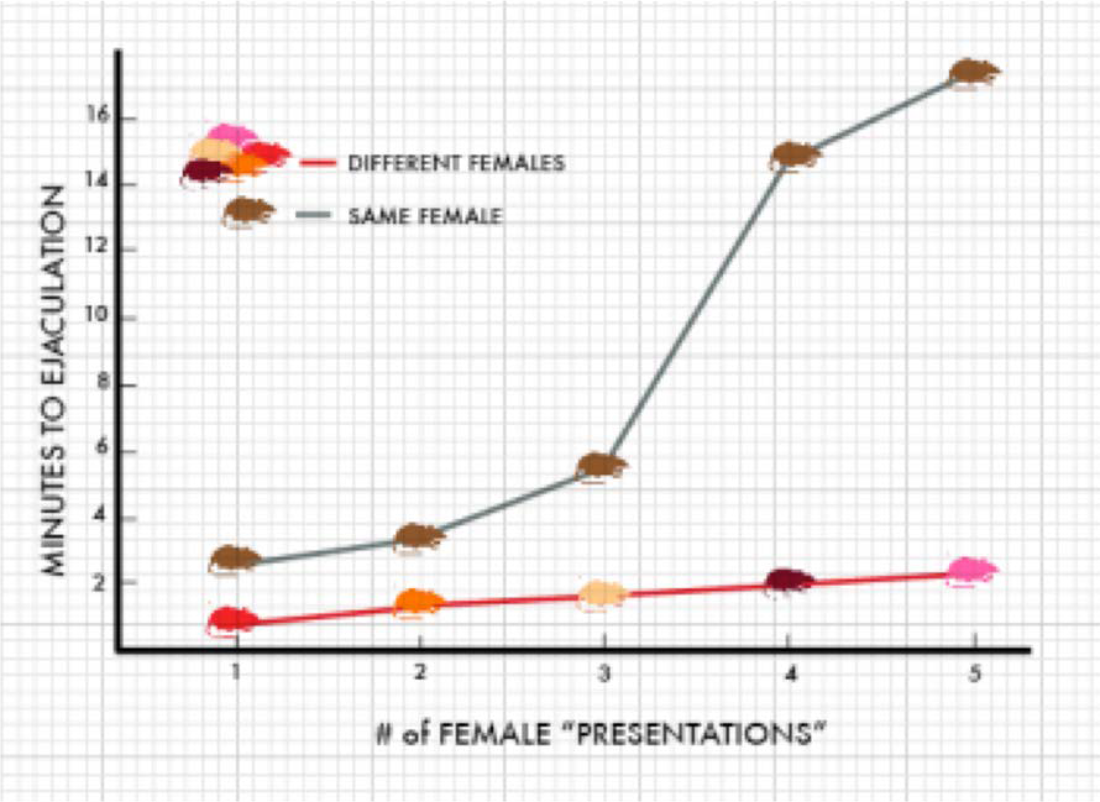
Why?
Leverages the reward system and is associated with a number of powerful neurotransmitters:
  Dopamine
  Adrenalin
  Oxytocin
Relies on the “coolidge effect”
Uses the DeltaFosB protein which, over time, accumulates with repeated use and leads to desensitization, need for more, and other traceable neurological changes

Slide 48
Effects of hook up apps
Correlations between Grindr and casual sex
Effective in promoting HIV testing, PrEP use
  Negatively correlated with loneliness for sexual-minority men
Correlation between Tinder use and higher odds of reporting nonconsenual sex, having 5+ partners
Tinder users reported lower levels of satisfaction with self, higher shame, surveillance, comparisons, internalizations
    Especially for males

Slide 49
The controversy

Slide 50
Behaviors prompting the most concerns about young adults + TMS use
Interacting with online partners (online or in person) Paying for services (online or in person)
Sexting
Using TMS to find information related to sexual health Looking at erotic photos or videos
Behaviors prompting the least concern
Limits to how youth educators can tackle TMS
“We’re only allowed to address it if students ask”
Youth serving professionals / parent perspective

Slide 51
Positive effects
Assists in exploring sexual identity, attraction and tips
Access to accurate information
Good for long distance relationships: allows people to have a connection
Can enhance pleasure
College student opinions

Slide 52
College student opinions
Negative effects
Sets unrealistic standards: relationships, partners, sex, expectations
Feelings of inadequacy, feel bad about their bodies
More pressure to move faster: skip to sex
Can lead to addiction and to violence toward others
TMS has reversed the cycle of relationships: Earlier days, relationships led to sex: now, sex leads to relationships

Slide 53
It seems to be a mixed bag. There are still important questions related to:
How do all of the new tech x sex affordances
affect development?
Capacity for intimacy and authentic relationships
Vulnerability to predatory or trafficking behavior
Developmental trajectories and vulnerabilities
Involvement with legal system
Expectations of self and other and of what relationships consist of and mean

Slide 54

Porn and the brain
fMRI evidence shows that problematic porn users have higher "wanting" activation than non-problematic porn users
Men and women show similar activation patterns across multiple brain regions involved in reward, but amygdala and hypothalamus are more strongly activated in men. In this context, the greater amygdala activation reflects a greater appetitive incentive value of visual sexual stimuli, either intrinsic or learned
There is a significant negative association between reported pornography hours per week and gray matter volume.
Much of brain response when viewing porn is identical to "disgust" response. Negative implicit associations towards porn actually predicted higher activation in women.

Slide 55
304 sex scenes in top selling porn movies were reviewed for physical verbal aggression:
  88% contained strong physical aggression (physical beating).
  49% contained verbal aggression (primarily extremely crude name-calling).
Does it support rape culture?
Male adolescent porn use predicted reports of sexually harassing someone 2 years later
Violent porn significantly increased likelihood (6 fold) of self- reported sexually aggressive behavior over time
  No association for nonviolent porn
  Number of modalities, not frequency of use, significant in prediction of sexually coercive behaviors
A recent study of Italian youth in 12th grade, 42% of males and 32% of women reported viewing porn features in which violence against women was featured (Romito & Beltramini, 2011).

Slide 56




The future

Slide 57
Discussion and implications

Slide 58

What do youth need to know?
Media literacy
  Skills to identify reputable sources
  Benefits of educational sites
  As young as possible!
Not reality
  Difference between porn and real, intimate, loving relationships
  Unrealistic or false expectations
Safety/risk/danger
  Perpetuity
  Future
Less common, but interesting responses: legal repercussions, potential for addiction

Slide 59
Do you find yourself spending considerably (more) amounts of time on-line? (More)
Are you intentionally or unintentionally neglecting your personal responsibilities that you, and your significant others, deem important for every day life? (Other)
Do you find it difficult and futile to reduce the amount of time that you spend online? (Unsuccessful)
You experiencing considerable relational problems with your significant others as a result of your Internet use? (Significant)
Are you overwhelmed with anxiety and preoccupied with unrealistic that’s when you’re online? (Excessive)
The MOUSE test

Slide 60

Resources

Slide 61
What can we do?
1
Figure out core messages and find ways to speak them clearly and consistently
2
Engage parents in understanding and responding in functional ways
3
Create environments that encourage candid conversation among adults and youth
4
Create alternatives to “porn as education”

Slide 62
The Truth About Pornography, a curriculum from Boston University’s School of Public Health that is currently being pilot tested
EducateEmpowerKids.org provides a “What is Pornography?” lesson for ages 8-11 as well as videos and resources
Programs & Approaches
The Porn Conversation is a website that offers tools for parents to teach their kids about porn
Teach kids that pornography differs from real sex
Discuss body types, consent, preparation (e.g. talking & foreplay), emotions, aggression etc.

Slide 63

Porn Literacy Checklist for Young People
From the book His Porn, Her Pain: Confronting America’s PornPanic With Honest Talk About Sex by Marty Klein
Questions include
  “I know the porn is fiction, not real”
  I understand that most people don’t have bodies like porn performers”
  “I understand that a lot of the arousal and orgasm I see in porn is pretend, not real”
Visit https://www.psychologytoday.com/blog/sexual- intelligence/201610/kids-need-porn-literacy for the full checklist

Slide 64
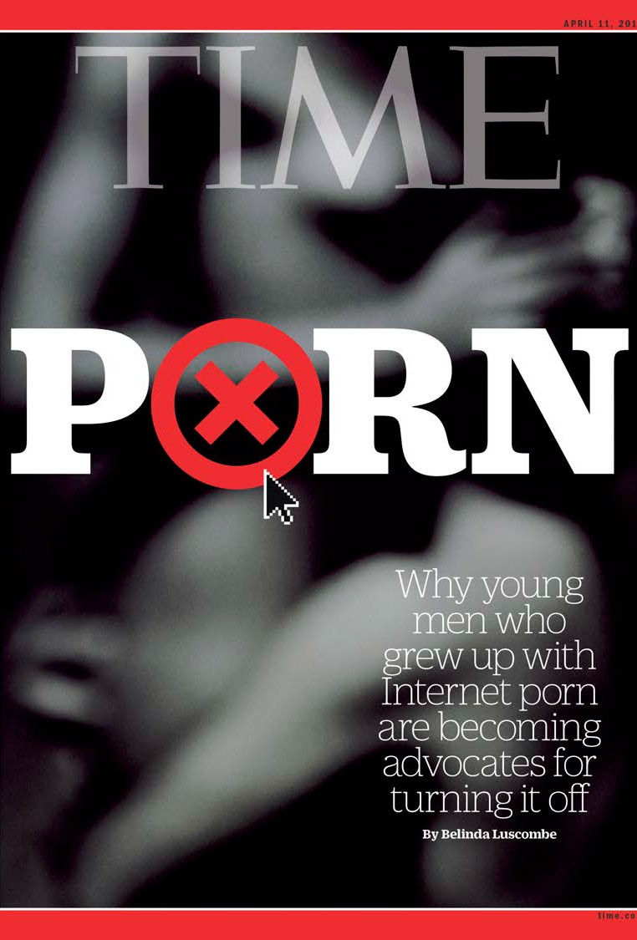
TIME magazine article and other resources
TIME Magazine: Porn and the threat to virility: http://time.com/4277510/porn-and-the-threat-to-virility/ Resources:
https://www.nofap.com/author/alexander/
http://www.rebootnation.org/
http://www.fightthenewdrug.org/
http://brickhousewebseries.com/
https://www.facebook.com/realterrycrews/videos (Terry Crews)
http://www.brainbuddyapp.com/

Slide 65
Janis Whitlock jlw43@cornell.edu
Contact information

