Slide 1
UNDERSTANDING restorative APPROACHES
PART I
NASTIA GORODILOVA
Nastia Gorodilova
NYC Alliance Against Sexual Assault
Senior Coordinator of Systems and Training
ngorodilova@svfreenyc.org| 212.229.0345 ext. 312

Slide 2
Where Are We Starting From?
Restorative Practices
Restorative Justice
Transformative Justice
Accountability

Slide 3
Accountability Processes
What values or goals guide your approach to the PROCESS of accountability?
What kinds of OUTCOMES do you want to see in an accountability process?
What CONCERNS or FEARS do you have about facilitating accountability processes?
Adapted from CREATIVE INTERVENTION’s Values to Guide Your Intervention; Guiding Questions

Slide 4
Responses To Harm
RETRIBUTIVE
DISTRIBUTIVE/THERAPEUTIC
RESTORATIVE
TRANSFORMATIVE
Adapted from CREATIVE INTERVENTION’s Values to Guide Your Intervention; Guiding Questions

Slide 5
What Is Restorative Justice?
“Restorative justice is a process to involve, to the extent possible, those who have a stake in a specific offense and to collectively identify and address harms, needs, and obligations, in order to heal and put things as right as possible.” - Howard Zehr

Slide 6
Roots of Restorative Justice Today

Slide 7
Theory of Justice
“We don’t have a word for offender in our language, we say ‘un-healed’” – Faith Tait of the Nisga’a Nation
“Once people feel a sense of responsibility for who they are, for where they’ve come from, and for someone else, they stop committing crimes” – Elaine Henderson, Navajo peacemaker

Slide 8
Assumption: We Are Interconnected
Wrongdoing/ causing harm is a violation of people and relationships
Violations create needs and therefore obligations
There is an obligation to repair the harm
COLLECTIVE COMMUNITY RESPONSIBILITY

Slide 9
Restorative Justice Core Questions
Who has been hurt?
What are their needs?
Whose obligations are these?
What are the causes?
Who has a stake in the situation?
What is the appropriate process to involve stakeholders in an effort to address causes and put things right?
Howard Zehr

Slide 10
Current Criminal Legal System
What are the core questions?

Slide 11
Difference From Other Approaches
Traditional justice core questions:
Distributive/ therapeutic core questions:
What laws have been broken?
Who did it?
What does the offender(s) deserve?
What was the lapse in judgement (by the person who caused harm)?
How did they get into this mess?
How can people who have caused harm make better future decisions?
Howard Zehr

Slide 12
Restorative Process
Restorative Outcomes
Restorative Justice Practices as a set of values

Slide 13
Continuum of Restorative Practices
International Institute for Restorative Practices

Slide 14
Victim-offender meeting
Family/ Community group conferencing
Re-entry planning
Restitution planning
5%
Conflict/ Harm
Restorative/ Reintegrative
15%
Decision-making
Issues resolution
Community restoring e.g. gentrification
In schools – alternatives to suspension
Workplace issues
Responsive
80%
Relationship-building circles
Celebration circles
Grief circles
Support circles
Circles to establish group agreements
Circles to deliver curriculum
Preventive/ Proactive
Community-Building

Slide 15
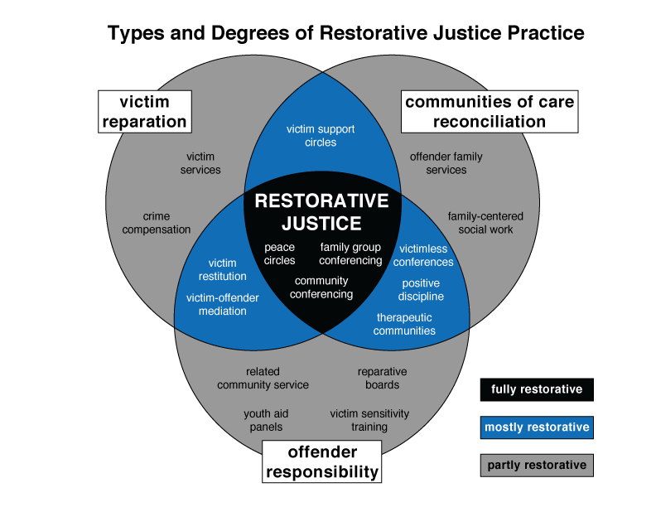
International Institute for Restorative Practices

Slide 16
Uses of Restorative Approaches
“Institutionalizes peaceful approaches to harm, problem-solving and violations of legal and human rights” – Dr. Carolyn Boyes-Watson
Criminal legal response
Juvenile justice systems
Schools/colleges and universities
Communities
Families
Workplaces
Re-integration
Prevention

Slide 17
Three Pillars of Restorative Justice
Focus on harms and needs
Wrongs/ harms result in obligations
RJ promotes engagement and participation
The Little Book of Restorative Justice, Howard Zehr

Slide 18
UNDERSTANDING restorative APPROACHES
PART II
NASTIA GORODILOVA
Nastia Gorodilova
NYC Alliance Against Sexual Assault
Senior Coordinator of Systems and Training
ngorodilova@svfreenyc.org| 212.229.0345 ext 312

Slide 19
Three Pillars of Restorative Justice
PROCESS and STAKEHOLDERS are important
Focus on harms and needs
Wrongs/ harms result in obligations
RJ promotes engagement and participation
The Little Book of Restorative Justice, Howard Zehr

Slide 20
5 Key Principles
Focus on the harms and consequent needs of those harmed first of all, but also on those of the community, and of those causing harm;
Address the obligations that result from those harms (obligations of offending persons, as well as of community and society);
Use inclusive, collaborative processes;
Involve those with legitimate stake in the situation – including those victimized, those causing harm, community members, and society; and
Seek to repair the harm and put right the wrongs to the extend possible.
The Little Book of Restorative Justice, Howard Zehr

Slide 21
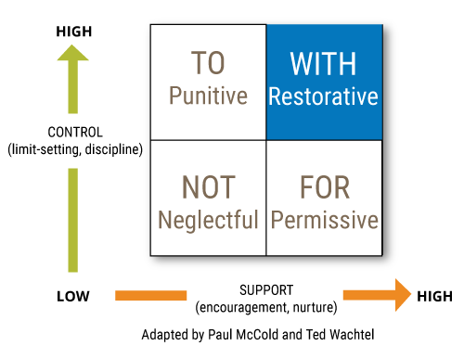
Social Discipline Window
International Institute for Restorative Practices

Slide 22
Goals of Restorative Justice
RJ programs aim to:
Put key decisions into hands of those most affected by the harm;
Make justice more healing and transformative; and
Reduce likelihood of future offenses.
The Little Book of Restorative Justice, Howard Zehr

Slide 23
Process to Achieve Goals
Achieving these goals requires that:
Harmed parties are involved in the process and come out satisfied;
Offenders understand how their actions affected others and take responsibility;
Outcomes (using specific tailored plans and accountability mechanisms) help to repair the harms and address the reasons for the offenses; and
All parties gain a sense of ‘closure’ and are reintegrated into the community.
SOMEWHAT or TO SOME EXTENT
The Little Book of Restorative Justice, Howard Zehr

Slide 24
“Wounds Should Engender Needs”
Mariame Kaba
Harm creates needs – so justice must aim to meet these needs
- Judah Oudshoorn
Safety and care
Support and education
Information and options
Grieving and expression
Voice and empowerment
To be believed, absolved, and vindicated

Slide 25
Philosophies of RJ
Inclusive Decision-Making
Accepting Responsibility
Repairing Harm
Rebuilding Trust

Slide 26
Restorative Justice Circles
Convening
Connection
Concern
Collaboration
Closing
Skidmore College’s College PRISM Project

Slide 27
RJ Conferencing
Restorative justice conferencing “focuses on the facilitated dialogue between the offender and harmed parties.”
What was the harm
“What impact has this had on your and on others.”
What can be done to repair the harm?
“What do you think needs to happen to make things right?
What can be done to rebuild trust?
“What can you do that can demonstrate you can be a positive member of our community
David Karp, “The Little Book of Restorative Justice for Colleges and Universities: Repairing Harm and Rebuilding Trust in Response to Student Misconduct”

Slide 28
RJ vs. Mediation
Restorative Justice
Mediation
Goal: Address harm
Offender must take responsibility
Pre-work is essential
Includes community
Outcome: Agreement, understanding, feeling of being heard
Goal: Resolve the conflict
Offender does not take responsibility prior to beginning the process
Pre-work not required
Separated from community
Outcome: Agreement

Slide 29
Examples of Current Restorative Practices
Restorative schools e.g. James Baldwin NYC, Oakland, California
New Zealand Juvenile Justice System – FGC
Pre-plea conferences
Pre-charge diversion e.g. Concord, Oakland, Baltimore, Nashville.
Post-charge diversion e.g. Common Justice, BK & BX
Alameda County, California
Red Hook Peacemaking Program
Circles of Support and Accountability, Canada
Hidden Water, NYC
Bridges to Life, Texas
Impact Justice
Longtermers Responsibility Project, NYS
Creative Interventions
Workplaces
“Transitional justice” e.g. Rwanda gacaca courts

Slide 30
Responses to Harm
RETRIBUTIVE
DISTRIBUTIVE/THERAPEUTIC
RESTORATIVE
TRANSFORMATIVE
Adapted from CREATIVE INTERVENTION’s Values to Guide Your Intervention; Guiding Questions

Slide 31
Thank you!
Questions?
Nastia Gorodilova
ngorodilova@svfreenyc.org | 212.229.0345 ext 312

