Slide 1
Reframing Preconception Health and Reproductive Life Planning
Rachel Flink-Bochacki, MD MPH FACOG
May 22, 2019

Slide 3
Risk factors for maternal mortality
Demographic Characteristics
Preconception Health
Pregnancy Factors
Creanga et al, Obstet Gynecol (2017)
D’Angelo et al. MMWR Surveill Summ (2015)
Johnson et al, MMWR (2006)
Kost et al, Demography (2015)
MacDorman et al, Obstet Gynecol (2017)
Moaddab et al, Obstet Gynecol (2018)
Wherry, Health Serv Res (2018)

Slide 4
Modifiable risk factors
Demographic Characteristics
Racism
Poverty
Preconception Health
Pregnancy Factors

Slide 5
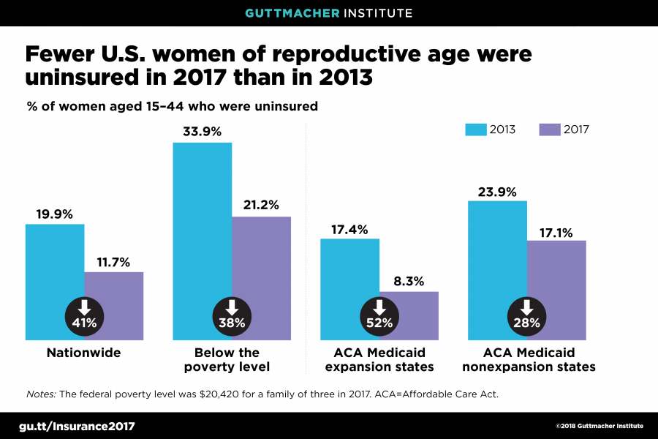
Limiting demographic inequalities

Slide 6
Modifiable risk factors
Demographic Characteristics
Racism
Poverty
Preconception Health
Preconception care
Pregnancy Factors

Slide 7
Preconception risk factors
Hypothyroidism
Diabetes
Teratogenic medications
Tobacco
Obesity
Asthma
Chronic diseases
Alcohol
Substance use
Dental caries
Mental illness
Illicit drugs
Genetic conditions
Preconception health
Workplace hazards
Domestic violence
High-risk sexual behaviors
Infection risk
Psychosocial problems
Folic acid deficiency
Economic insecurity
IV drug use
Immunizations
Johnson et al, MMWR (2006)

Slide 8
Modifiable risk factors
Demographic Characteristics
Racism
Poverty
Preconception Health
Preconception care
Pregnancy Factors
Pregnancy intention
Comprehensive obstetric care

Slide 9
History of intention measurement
1935: Milbank Memorial Fund
1941: Indianapolis Study
1955-1960: Growth of American Families Study
1965-1970: National Fertility Studies
1969: Commission on Population Growth and
the American Future
1970: Family Planning Services and Population
Research Act (Title X)
1973: National Survey of Family Growth (NSFG)
1987: Pregnancy Risk Assessment
Monitoring System (PRAMS)
Campbell et al, Mat Child Health J (2000)
CDC, PRAMS (2019)

Slide 10
Survey questions
NSFG
Unwanted pregnancy
PRAMS
Mistimed pregnancy
Intended pregnancy
CDC, PRAMS (2019)
U.S. DHHS, NSFG (2016)

Slide 11
Risks of unintended pregnancy
Maternal health risks:
Smoking in pregnancy
Alcohol use in pregnancy
Depression
Financial burden
Physical abuse
Unsafe abortion
Late to prenatal care
Child health risks:
Late to prenatal care
Birth defects
Preterm birth
Low birth weight
Lower rates of breastfeeding
Poor childhood functioning
Household dysfunction
ACOG, Obstet Gynecol (2016)
Barot et al, Guttmacher Pol Rev (2011)
D’Angelo et al, Perspect Sex Reprod Health (2004)
Gipson et al, Stud Fam Plann (2008)
Santelli et al, Perspect Sex Reprod Health (2003)

Slide 12
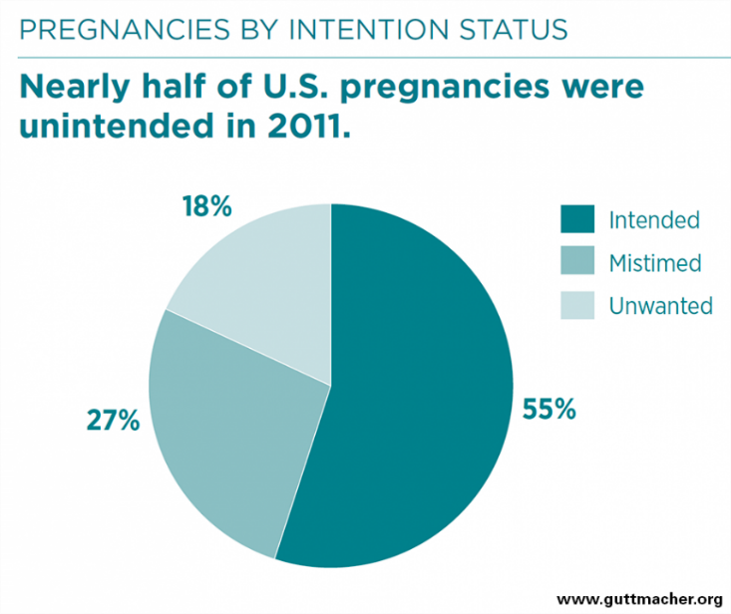
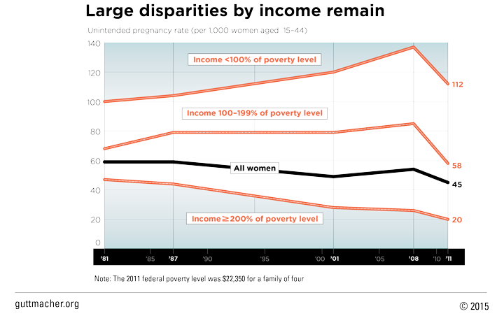
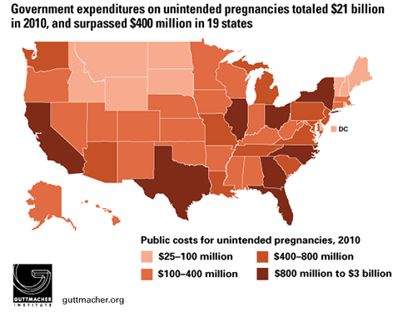
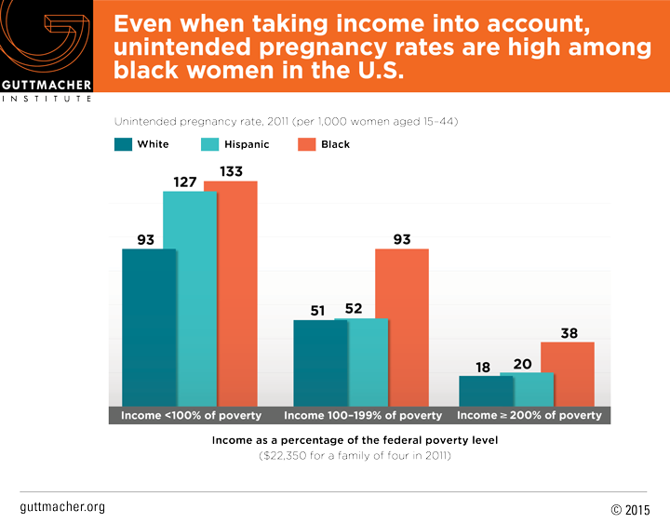
Public health scope

Slide 13
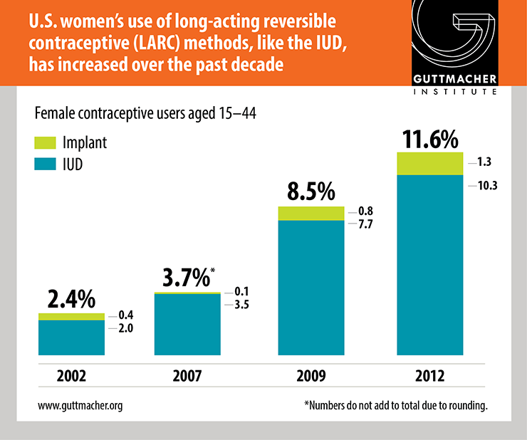
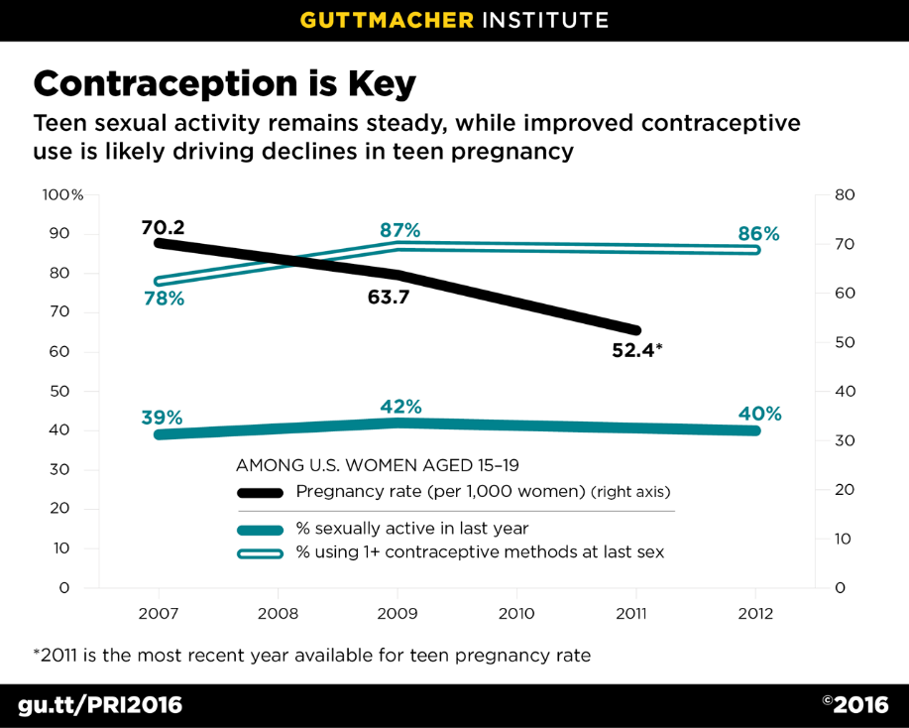
Solution #1. Contraception

Slide 15
Solution #2. Reproductive life planning
Do you have any children now?
Do you want to have (more) children?
How many (more) children would you like to have and when?
-CDC
Would you like to become pregnant in the next year?
- One Key Question®
ACOG. Obstet Gynecol (2016)

Slide 16
Theory of planned behavior
Behavioral Attitudes
Subjective Norms
Intention
Behavior
Perceived Behavioral Control
Actual Behavioral Control
Ajzen I. Org Behav Human Dec Proc (1991)

Slide 17
Behavioral attitudes
Perceived benefits
Lack of perceived harms
Feelings about planning
Behavioral Attitudes
Subjective Norms
Intention
Behavior
Perceived Behavioral Control
Actual Behavioral Control
Gomez et al. Perspect Sex Reprod Health (2019)
Moos et al. Perspect Intend Pregnancy (1997)
Richards et al. J Pediatr Adolesc Gynecol (2014)
Rocca at al. Perspect Sex Reprod Health (2013)

Slide 18
Subjective norms
Differing cultural norms
Attainability of ideal circumstances
Behavioral Attitudes
Subjective Norms
Intention
Behavior
Perceived Behavioral Control
Actual Behavioral Control
Borrero et al. Contraception (2015)
Richards et al. J Pediatr Adolesc Gynecol (2014)
Rocca at al. Perspect Sex Reprod Health (2013)
Stevens L. Soc Sci Med (2015)

Slide 19
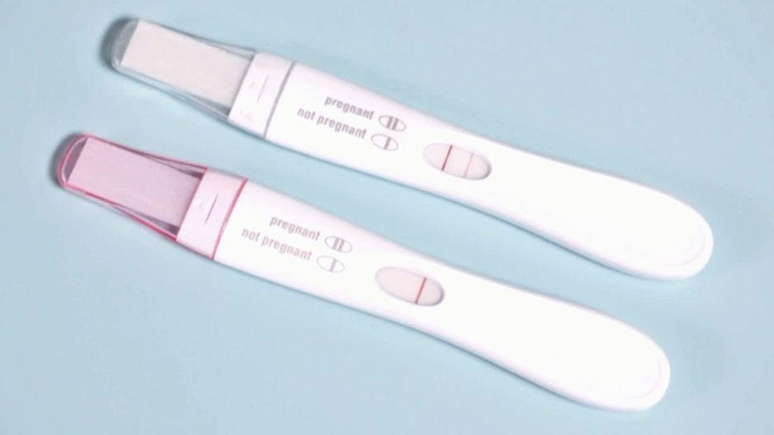
Perceived behavioral control
Fatalism
Perceived infertility
Behavioral Attitudes
Subjective Norms
Intention
Behavior
Perceived Behavioral Control
Aiken et al. Contraception(2015)
Borrero et al. Contraception (2015)
Gomez et al. Perspect Sex Reprod Health (2019)
Higgins et al. Perspect Sex Reprod Health (2012)
Moos et al. Perspect Intend Pregnancy (1997)
Polis et al. Perspect Sex Reprod Health (2012)
Actual Behavioral Control

Slide 20
Actual behavioral control
Access to care
Reproductive coercion
Behavioral Attitudes
Subjective Norms
Intention
Behavior
Perceived Behavioral Control
Actual Behavioral Control
Borrero et al. Contraception (2015)
Clark et al. Am J Obstet Gynecol (2014)
Dehlendorf et al. Am J Obstet Gynecol (2010)
Miller et al. Contraception (2010)

Slide 21
Breakdown in theory
Relationship between pregnancy intentions and sexual behaviors
Understanding of pregnancy intentions
Behavioral Attitudes
Subjective Norms
Intention
Behavior
Perceived Behavioral Control
Borrero et al. Contraception (2015)
Higgins et al. Perspect Sex Reprod Health (2012)
Moos et al. Perspect Intend Pregnancy (1997)
Richards et al. J Pediatr Adolesc Gynecol (2014)
Rocca at al. Perspect Sex Reprod Health (2013)
Actual Behavioral Control

Slide 22
Assessing intention
NSFG
PRAMS
CDC, PRAMS (2019)
U.S. DHHS, NSFG (2016)

Slide 23
Pregnancy ambivalence
Wants to avoid pregnancy
Desire to avoid pregnancy
Ambivalence
Desires pregnancy
Happiness about potential pregnancy
Aiken et al. Perspect Sex Reprod Health (2016)
Borrero et al. Contraception (2015)
Cutler et al. Women’s Health Issues (2017)
Higgins et al. Perspect Sex Reprod Health (2012)

Slide 24
True pregnancy intentions
410,420 pregnancies in New York State in 2014
Pregnancy intendedness, NYS 2014
Kost et al. Guttmacher Institute (2018)

Slide 25
Implicit bias and disparities
Everett et al. J Women’s Health (2017)
Gomez et al. Contraception (2017)
Light et al. Contraception (2018)
Stevens L. Soc Sci & Med (2015)

Slide 26
Public health vs. private decisions
Stevens L. Soc Sci Med (2015)

Slide 27
Rethinking risks
Kost et al. Demography (2015)

Slide 28
What does “unwanted” really mean?
“None of them were planned. It just happened … I never wanted to have kids. As a teenager I said I was never going to have kids …
[When I found out I was pregnant,] we were happy, we were excited. The whole family was excited … We love our children.”
Flink-Bochacki R. Unpublished data

Slide 29
Beyond intentions
Intention
Happiness
Flink-Bochacki et al. Obstet Gynecol (2018)
Gomez et al. Perspect Sex Reprod Health (2019)
Trussell et al. Fam Plann Perspect (1999)

Slide 30
Beyond intentions
Intention
Acceptability
Happiness
Aiken et al. Perspect Sex Reprod Health (2016)
Biggs et al. JAMA Psych (2017)
Borrero et al. Contraception (2015)
Foster et al. Poster presentation (2014)
Foster et al. Am J Pub Health (2018)
Kost et al. Demography (2015)
Santelli et al. Stud Fam Plann (2009)
Upadhyay et al. BMC Wom Health (2015)

Slide 31
New planning paradigm
Internal factors
External factors
Perceptions of pregnancy
Salience of pregnancy planning
Behaviors
Aiken et al. Perspect Sex Reprod Health (2016)

Slide 32
Patient-centered paradigm
Reproductive Goals Counseling
Preconception counseling
Contraceptive counseling
Women who desire pregnancy now
Women who do not desire pregnancy now and ARE open to preconception counseling
Women who do not desire pregnancy now and are NOT open to preconception counseling
Callegari et al. Am J Obstet Gynecol (2017)

Slide 33
PATH Questions
Do you think you might like to have (more) children at some point?
Pregnancy Attitudes
When do you think that would be?
Timing
How important is it to you to prevent pregnancy (until then)?
How important is prevention
Callegari et al. Am J Obstet Gynecol (2017)

Slide 34
Patient-centered counseling in practice
Identify risk factors
Preconception risks
Contraceptive contraindications
Elicit reproductive goals
PATH Questions
Nonjudgmental, open inquiry
Preconception counseling
Address personal risks
Folic acid
Contraceptive counseling
Individualized
Affirm autonomy

Slide 35
Take-home points
Universal problem
Personal decision
Pre-conception intentions
Post-conception acceptability
Defining goals
Optimizing outcomes

Slide 36
Questions?

