Slide 1
Intimate Partner Violence in Student Relationships:
Context and Consequences
Presented by:
Lorien Castelle, Director of Prevention

Slide 2
ABOUT US
Statewide Membership Organization
  Members:
    Domestic violence service providers, allied agencies and community members
  Mission:
    Create and support the social change necessary to prevent and confront all forms of intimate partner violence
  Work:
    Training, technical assistance, public policy, systems advocacy, best practices, broad-based collaboration
  Philosophy:
    Anti-oppression, trauma informed, and survivor centered principles integrated into all of our work

Slide 3
Objectives:
Participants will have a:
Better understanding of intimate partner violence (IPV) and programs designed to address it
Understand the research on IPV; what it tells us, what it doesn’t tell us
Understand recommendations for developing youth informed, youth led, prevention programming
Be able to identify concrete strategies for engaging and being an ally to youth using evidence based strategies for both prevention and intervention

Slide 4
Guiding Principles
1. If it’s learned it can be unlearned!
2. Prevention is an ongoing process, requiring a commitment to changing social norms with activities that compliment intervention strategies
3. Move from awareness to ACTION. Nurture a core group of leaders…Grow activists!!
4. Knowledge, changes in the environment and long-term programming is needed. Address KABBs (Knowledge, Attitudes, Beliefs and Behaviors,) at every level of social ecology.
5. Design programs to address those with greatest need/risk
6. Utilize an empowerment approach to youth leadership

Slide 5
Teen Dating violence:
The Basics

Slide 6
Definitions
Dating Violence is physical, emotional, or verbal abuse by one partner towards another in a dating relationship.
It is referred to by a variety of names—adolescent relationship abuse (ARA,) relationship violence, dating abuse, and intimate partner violence—terms used interchangeably.
Interpersonal violence suggests violence between people- not applicable here--Our analysis refers to a pattern of abusive behaviors aimed at controlling or hurting a dating partner and thus includes coercive tactics-threats and acts of intimidation.
(WomensLaw.org, 2007; CDC, 2007)

Slide 7
Definitions
The pattern of coercive tactics or behavior can include physical, emotional, economic, sexual or stalking behavior.
Culturally learned and socially condoned…

Slide 8
What about Bullying?
Over 60% of LGBTQ students report feeling unsafe at school.
Nearly 40% have been physically harassed and 18.3% assaulted.
Consequences: academic performance is often compromised, and LGBTQ students who are subjected to discrimination are at higher risk for depression.
Notes:
(GLSEN 2011 National School Climate Survey).

Slide 9
In addition,
Sexual and reproductive coercion is an often invisible tactic frequently experienced by students in dating relationships*
Consider all the ways these tactics can
impact health and overall wellness
Consider ways that universal notification,
screening, and primary prevention in health
care settings are interconnected
Notes:
The challenge of defining “dating” for young people. Terms “hanging out,” “hooking up, “Talking”

Slide 10
Prevention & Intervention
Prevention: preventing dating violence from initially occurring
-Focusing on conditions that support it
-Focusing on promoting conditions that inhibit
-Promoting behaviors you want others to adopt
Intervention*: addressing the effects of the violence after the violence has occurred and preventing a re-occurrence of violence
-Recognizing
-Responding
-Referring
*sometimes referred to as secondary and tertiary prevention
Notes:
As the Centers for Disease Control and Prevention we focus on preventing death, injury and illness from occurring in the first place.
So in regard to VAW the Division of Violence Prevention tends to focus on what we call primary prevention – preventing violence against women from initially occurring. We do this through funding programs and research, sponsoring conferences such as the National Sexual Violence Prevention Conference, and convening panels of experts, such as this one, who can provide us with information regarding the needs of the field. However, some of our activities also focus on intervention services in terms of how to reduce the harmful impact of the violence and prevent it from reoccurring.
Prevention and intervention services can focus on both men and women. Preventing men from perpetrating violence and preventing women from becoming victims.
All of us here today are working hard to end violence against women, whether through prevention or intervention. When I was Director of the Family Violence Program for the Houston Area Women’s Center we used to have staff retreats where we would develop a vision of what the world would be like without violence against women and we were out of jobs. CDC wants to help make this vision come true by promoting the complementary nature of violence against women prevention and intervention services.

Slide 11
Prevention is NOT
A one-time session or event
One skill-building session
One protocol
A poster or a palm card in a bathroom stall for those in need of support or resources
Having one staff understand primary prevention and being responsible for it
Prevention is:
an ongoing process, requiring a commitment to social change efforts that compliment intervention strategies

Slide 12
Youth Engagement Strategies
Youth informed, youth driven, youth led, youth directed…
Peer service learning model
Strength-based and pro-social, promoting positive behaviors not focused on stopping negative
Nurturing a core group of leaders…
Growing activists!!

Slide 13
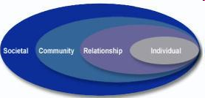
Promising Practice Framework:
Public Health Model:
  Social ecological model
  Prevention Principles- comprehensive, sufficient dosage, etc…(see handout)
  Risk and protective factors
  Prevents first-time perpetration/changes KABB’s (Knowledge, Attitudes, Beliefs & Behaviors)
Notes:
13
CDC Framework

Slide 14
The Social Ecological Model
Government/Policy
Organizations
Neighborhoods
Family
Healthcare
Places of Worship
Individual
Peers
Schools
Workplaces
Notes:
14
Traditionally, we have focused on changing individual behavior and to some extent relationships. It has become clear, particularly in the area of prevention that we need to focus on all the multiple layers and influences affecting individuals.
Environmental and Policy Interventions have the potential to affect many people rather than focusing on changing the behavior of one person at a time.
Include “best practices” from a growing body of literature.
Change the environment so that healthy decisions are supported by the environment.

Slide 15
Promising Practice Framework:
New York DELTA
  Promoting positive behavior vs. stopping “bad”
  Changing social norms—focusing on perpetration rather than victimization
  Saturation vs. sprinkling
  Domestic Violence Movement Analysis
    Anti oppression framework
    Social cultural context
  Community Organizing/Social Movement Theory
    Youth Informed to Youth Driven to Youth Led
    Awareness to ACTION

Slide 16
Prevention Principles
Comprehensive
Varied teaching methods
Sufficient dosage
Theory driven
Positive relationships
Appropriate timing
Socio-cultural relevance
Outcome evaluation
Well- trained staff
Notes:
Provide handout. Describe a few examples

Slide 17
K.A.B.B.s
What we are aiming to change:
Knowledge – For change in knowledge provide succinct and clear information; knowledge change can occur in one-time brief (up to one hour) encounter.
Attitudes – For change in attitude provide information and an appeal to emotions or personal impact; some practice is necessary; takes time and multiple encounters.
Beliefs & Behavior – For change in behavior people need to demonstrate and practice new skills and communicate with others during the learning process; usually takes multiple events that include practicing the skills.

Slide 18
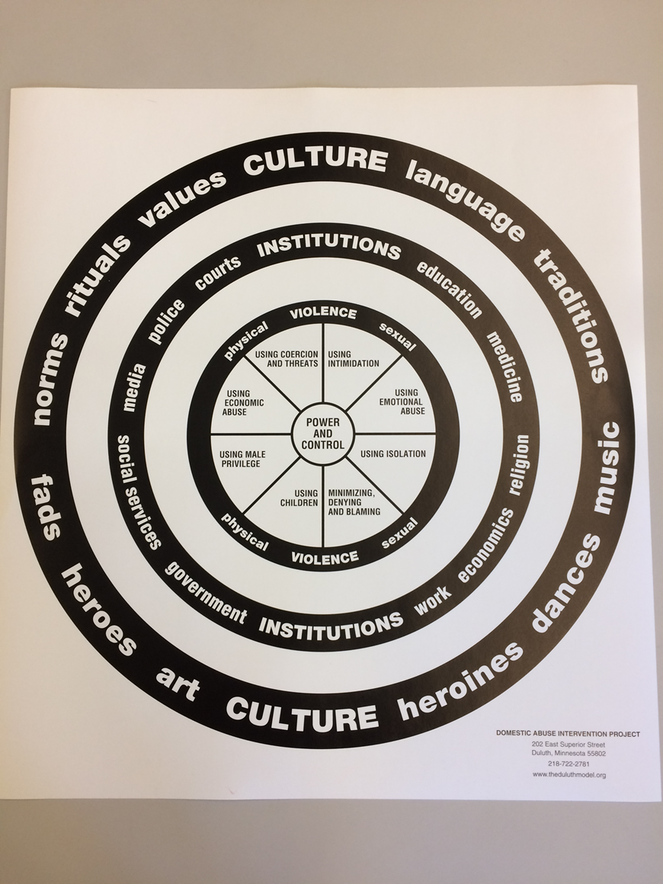

Slide 19
Prevalence
The prevalence of interpersonal violence among adolescents generally varies from 9% to 35%.
Why the discrepancy?
  Methodology
  Populations
  Definitions
  Context or consequences
Notes:
Bonomi
Most studies don’t include sexual violence or emotional and verbal abuse
YRBS
Whatever the true amount—whether it’s 9% or 35% it’s too many!!

Slide 20
The basics:
  Approximately one in three adolescent girls in the US will experience physical, emotional or verbal abuse from a dating partner – a figure that far exceeds victimization rates for other types of violence affecting youth.¹
1. Davis, Antoinette, MPH. 2008. Interpersonal and Physical Dating Violence among Teens. The National Council on Crime and Delinquency Focus. Available at http://www.nccd-crc.org/nccd/pubs/2008_focus_teen_dating_violence.pdf.
Notes:
Approximately one in three adolescent girls in the US will experience physical, emotional or verbal abuse from a dating partner – a figure that far exceeds victimization rates for other types of violence affecting youth.¹

Slide 21
The basics:
1 in 3 teenagers report knowing a friend who has been hit, punched, kicked, slapped, choked or physically hurt by their partner
Nearly 1 in 5 teenage girls who have been in a relationship said a boyfriend has threatened violence or self-harm if presented with a break-up
13% of teenage girls who said they have been in a relationship report being physically hurt or hit
(Liz Claiborne study, 2005)
Notes:
Approximately one in three adolescent girls in the US will experience physical, emotional or verbal abuse from a dating partner – a figure that far exceeds victimization rates for other types of violence affecting youth.¹

Slide 22
The basics:
More than 1 in 4 teenage girls in a relationship (26%) report enduring repeated verbal abuse
80% of teens regard verbal abuse as a serious issue for their age group
If trapped in an abusive relationship, 73% of teens said they would turn to a friend for help but only 33% who have been in or known about an abusive relationship said they have told anyone about it.

Slide 23

National CDC Survey
  A 2011 national survey by the CDC*:
    Nearly 1 in 5 women reported being raped in their lifetime.
      Almost half before the age of 18.
  * The National Intimate Partner and Sexual Violence Survey (NISVS), December 14, 2011. Centers for Disease Control and Prevention. National Center for Injury Prevention and Control, Division of Violence Prevention.
Notes:
The National Intimate Partner and Sexual Violence Survey (NISVS), December 14, 2011. Centers for Disease Control and Prevention, National Center for Injury Prevention and Control, Division of Violence Prevention.

Slide 24
A 2015 CDC Study
Further found that among victims of contact sexual violence, physical violence, or stalking by an intimate partner, nearly 23% of females and 14% of males first experienced some form of violence by that partner before age 18.

Slide 25
More basics:
81% of parents surveyed in a recent study said that they didn’t believe dating violence was an issue OR admitted they didn’t know. (Liz Claiborne Study)

Slide 26
The research
Analysis of recent Youth Risk Behavior Survey (YRBS,) findings revealed that 33 % of girls had been victimized by a dating partner.
Although variations were found among racial and ethnic groups, these differences were not statistically significant - a finding contrary to that of some studies.
Notes:
YRBS LA and SF of 9th through 12th graders

Slide 27
Context & Consequences
Girls who had experienced physical dating violence had a substantially higher risk of other violence-related behaviors and conditions than their peers.
These included:
  fighting,
  being a victim of theft at school,
  staying home from school because of feeling unsafe,
  carrying a weapon in school, or being threatened or injured with a weapon at school.
The risk of fighting or being injured in a fight was twice as high for girls who had experienced physical dating violence as for girls who had not. The rate of sexual victimization was four times as high. Silverman, et al.
Notes:
Silverman, J, Raj A, et al. 2001. Dating Violence Against Adolescent Girls and Associated Substance Use,
Unhealthy Weight Control, Sexual Risk Behavior, Pregnancy, and Suicidality. JAMA. 286:572-579.

Slide 28
Context & Consequences
Adolescent girls who had experienced physical dating violence had considerably increased risks for other problems.
They were substantially more at risk for using alcohol, tobacco, and marijuana than were girls who had not experienced dating violence. (Why?)
Their risk of high-risk sexual behaviors was four times that of their peers (Why?).
Depression and suicidal ideation was significantly higher among girls who had experienced dating violence. On average, these girls attempted suicide at over twice the rate of other girls their age.
Notes:
Silverman, J, Raj A, et al. 2001. Dating Violence Against Adolescent Girls and Associated Substance Use,
Unhealthy Weight Control, Sexual Risk Behavior, Pregnancy, and Suicidality. JAMA. 286:572-579.

Slide 29
A conservative estimate is 1 in 3 teens has experienced physical or sexual violence in a dating relationship
Add verbal abuse and the rate goes up.

Slide 30
Factors that may contribute:
Holding norms accepting or justifying the use of violence in dating relationships
Having friends who are being abused or who are abusive
“Exposure” to violence in one’s family*
Exposure to violence in the community
Interestingly, for males, the most consistent factor that puts them at risk for being a victim of dating violence is inflicting violence
Notes:
It is important here to clarify “risk factor” language..

Slide 31
Why Prevention?

Slide 32
An important risk factor that analysis of the research reveals is that a factor for inflicting dating violence is a past history of having been aggressive or violent in previous relationships (Riggs & O’Leary, 1989, Chase, et al, 1998.)
This indicates that once the norm is established the behavior is unlikely to change without intervention*

Slide 33
What does it mean to be “comprehensive”
Adolescents are influenced by many factors that support or condone intimate partner dating and sexual violence. Each of these factors needs to be addressed in a consistent, systemic manner.
Knowledge, behaviors, changes in the environment and long-term programming is needed.

Slide 34
A Comprehensive Approach
Examples of this approach include:
  Individual level
    Curricula, counseling, mentoring, developing youth leadership
  Relationship
    Support programs, mentoring, training for adult influencers
  Community
    Social norms, community education, policy changes
  Societal
    Media campaigns, policy changes
Notes:
Slide Title: An Example: A Comprehensive Approach
Module: Planning and Implementation
Main Concept: How to develop, plan and implement prevention strategies
Core Content: Prevention Strategies
Trainer notes: This new way of thinking includes a comprehensive approach to the problem by integrating all levels of the social ecology together.

Slide 35
Research &
“Gender Symmetry”
What about sexual orientation and gender identity?
What the research says about “Gender parity”
Cautions about the concept of “Mutual” aggression
Are girls “just as violent” as boys
Violence “between” girls
“Mean Girls Syndrome”
Notes:
Discuss magnitude and prevalence across gender and sexual orientation

Slide 36
Obvious problems
Greater physical harm inflicted by males
Compared to boys, girls more likely to sustain injuries requiring medical attention
Girls report greater emotional consequences, i.e., fear, feeling unsafe at school, drop in grades
The nature and dynamics of dating violence- the meaning, context, intent and consequences may all be different depending on the way gender plays into it.

Slide 37
Language matters
Passive voice
  Relationship violence, violence between partners, Mutual combat or mutual aggression, high conflict, interpersonal violence
“Boys will be boys”
Gender neutral language ≠ gay positive or trans inclusive

Slide 38
Language matters
The minimization of injury and other measures of harm along with the failure of research to establish context in current research matters because these findings will be used in policy making, program development and funding decisions.
Design programs to address those with greatest need/risk
Notes:
Guiding Principle #5

Slide 39

Incorporating primary prevention

Slide 40
Incorporating primary prevention
“…early identification of risk is effective in preventing future violence, and …we can take steps in the community to foster an environment that focuses on safety.”
The online version of this article can be found at
http://ajl.sagepub.com/content/5/5/390.citation

Slide 41
Incorporating primary prevention
“…We must assess for risks of violence in our patients, much as we look for other risks to health. Exploring these risks during a health care encounter aids in ensuring that patients at risk for violence will be identified early, that violence will be recognized by health care practitioners and health systems as a preventable health problem, and that appropriate actions are taken to prevent violence from occurring in the first place.
Foreword to Sage Publication, Linda C. Degutis, DrPH, MSN, and Robin M. Ikeda, MD, MPH

Slide 42
Incorporating primary prevention
Sexual Violence Victimization of Women: Prevalence, Characteristics, and the Role of Public Health and Prevention
Kathleen C. Basile, PhD, and Sharon G. Smith, PhD
“…It is also important to note that primary prevention of violence should focus on the source of the violence namely, the perpetrators.”

Slide 43
A Promising Strategy
“Health care providers could talk about prevention strategies with male patients with signs and symptoms of known risk factors, especially teens and young adults given that sexual violence perpetration happens very early in the lifespan.”
Bystander Intervention,
Educate on consent and alcohol use,
Consent (could be a gendered strategy.)

Slide 44
Identify ways we can provide trauma-informed services to victims- from report/intake to support group and counseling to legal advocacy and navigating legal remedies.
Identify ways we can assist health care providers to screen for, assess and treat victims of DV/SA and particularly Reproductive Coercion.
Identify ways health care providers can integrate prevention messaging into clinical encounters as a prevention strategy.

Slide 45

Domestic Violence Victims
Access health care 2 to 2.5 times more frequently than those without a history of abuse
Have 20% higher total Health Care costs (approx. $439 annually) due to abuse

Slide 46

People who have been victimized have:
A higher use of medical and mental health care services
Higher levels of depression
More frequent suicide attempts
Increased use of alcohol and other substances
Notes:
Addressing violence and exposure to violence as a health care issue makes sense….
Research has found that exposure to violence and abuse increased the victim’s need for
“surgical procedures, mental health services, and visits to general practitioners, emergency departments, and hospitals.”
Abuse also has negative effects on the body’s systems: nervous, immune, endocrine,
and other organ systems because of stress hormones released.

Slide 47
Prevention Continuum
Before the violence occurs
After the violence occurs
Notes:
Slide Title: Prevention Continuum
Module: Framing
Main Concept:
Trainer notes: Describe primary, secondary and tertiary prevention through examples

Slide 48
Primary Prevention
Primary Prevention is about preventing intimate partner violence before it begins. It promotes healthy relationships and messaging. Creating safe, healthy relationships and safe, healthy communities means addressing and challenging
Gender stereotypes and inequities
    Men as the "head of the household," unequal pay, being a boy means being tough
Media stereotypes and inequities
    Sexist/classist/racist depictions of individuals
    “Glamorizing" violence against women, etc.
Notes:
Think of a time when you remember being indoctrinated into a gender role.
When we look at our communities we can see our intervention services empowering people who have already experienced IPV. In order to see less people needing our intervention services, though, we need to start prevention earlier; this means working with young people, and changing the way that people who interact with young people act.
It also means collaborating with social change allies in the community because we know that IPV is supported by many forms of oppression, including sexism, racism, classism, heterosexism, ableism, etc.

Slide 49
Primary Prevention helps us identify
Social norms that accept violence as normal and inevitable
Norms that generate a social climate where violence against a partner is unthinkable, healthy relationships prevail and we know our options
Notes:
While intervention reaches those who live with domestic violence (this is fabulous), primary prevention addresses violence from a different view: Primary prevention changes our society from one that accepts violence as the norm to one that accepts healthy relationships and healthy communication as the norm

Slide 50

Healthy Relationships
Notes:
Besides breastfeeding, what is happening here? Parent-infant bonding including eye contact, mutual physical contact, smiling, focused attention – these are all strong aspects of healthy relationships in infancy which actually begins to develop in utero. Medical providers can observe parental interactions and reinforce what they see – if mother is breastfeeding: “breastfeeding is such a wonderful thing, I am happy to see/hear you are doing that, is there anything you have questions about?” “ I am happy to see that you and your child have such a great bond, your child is fortunate to have loving parents. Keep up the good work” Even if the parent does not seem so good to you, find one thing that is a gesture of care and use that to emphasize good care on the part of the parent. Suggest Dr. Sears The Baby Book as an advocate, provider or parent resource for positive attachment parenting information.

Slide 51

Healthy Relationships
Notes:
What is going on here? We see boys and girls happily playing a sport together and the boys also celebrating something the girl did – maybe scored a goal? Docs can discuss with kids their interests and how that is going. They may be able to get a sense of healthy or unhealthy relationships with peers. Respond in a caring and interested way to comments about problems, questions or what the child enjoys. This is not just a parent’s job, but the work of all adults in a child’s life, especially care providers.

Slide 52
Primary Prevention and Youth
A Primary Prevention Approach with youth seeks to prevent youth from becoming victimized or perpetrators of DV/SA by promoting skills and knowledge to build healthy relationships.
    Teaching, modeling and participating in healthy relationships in communities and families
    Creating community opportunities for learning healthy relationships
Notes:
For providers, this may mean learning about and promoting healthy relationships with patients and staff, as well as trauma informed care with patients as an uplifting way to practice.

Slide 53

Adult & Youth Work
The adults that youth have relationships with (health care providers, parents, teachers, coaches, counselors and mentors) can build the tools necessary for their own change as they practice and model healthy relationships.
Notes:
As we have relationships, we are also training those who are just learning relationships. Healthy relationships are a work in progress for just about everyone. Youth can tell when someone cares and is skilled enough to deal with issues that may come up.

Slide 54

Overall…
Adults can work as allies to young people in school based and community settings and work together on changing community attitudes and values that promote violence, including dating violence
    Stereotypes
    Media Imaging/Perspectives
    Legislative policy, laws, workplace
    policy, community expectations
Notes:
In health care, this may mean a health care group or organization asks for teens participate in a focus group on advertising ideas or in schools it could mean that the school nurse, students, counselor, and a key teacher develop school hc projects that address healthy relationships (includes anti-oppression, dating violence and bullying).

Slide 55
Let’s Examine a Few promising practices
Youth
  Strategies
    Technology (texts, Snapchat, IPhones)
    Conventional (group, retreat, peer service learning, training, training of trainers, mentor/mentee)
  Settings
    Schools, campuses
    Other (neighborhood centers, associations, malls, delinquency settings, group homes, Gay Straight Alliances (GSAs))
Notes:
Share CDC’s evidence continuum handout

Slide 56
Futures without violence
COACHING BOYS
INTO MEN
“I have always believed that a role model can be anyone. It’s important for people to realize that young people are always looking at them for guidance, whether that grown person is aware of it or not.”
- Dean Smith, Hall of Fame Coach, UNC

Slide 57

CBIM Coaches Kit
The CBIM Playbook
  Developed to take advantage of “Teachable Moments”
  Designed as an introduction to the issue with tips for addressing it.
The CBIM CARD SERIES
  Messages delivered in 15 minute discussions once a week
References & Resources
  Assists coaches during implementation
  Includes CBIM Overview, professional referral information
Notes:
There are three major pieces to the CBIM materials that are included in what we call the CBIM Coaches Kit. That’s everything.

Slide 58
CBIM Works!
Three-year CDC study* of 16 high schools in Sacramento working with approximately 2,000 athletes and 150 coaches
Results:
  Athletes in the program are more likely to report doing something when they witness disrespectful and harmful behavior (e.g., telling their coach or another adult)
  Greater knowledge of abusive behaviors (e.g., language, pressure, control)
  Trend toward directly reducing abusive behaviors
* Evaluation conducted by a research team at Children’s Hospital of Pittsburgh/University of Pittsburgh Medical Center. Special thanks to Dr. Elizabeth Miller, MD, PhD and Maria Catrina Virata, MPH.
Notes:
Sioux City paved the way for Sacramento – large evaluation and research study.

Slide 59
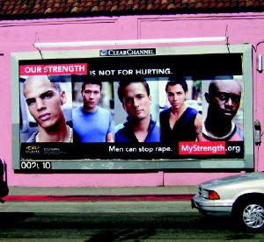
Promising Practices:
Men of Strength (MOST) Clubs
Settings:
  Group home for adolescent boys
  School
  Neighborhood Centers
Strategies:
  Check-Ins
  Topic Discussions
  Learning Exercises
  Regular Meetings
  Ongoing or Drop-In
  Strength Campaign
Notes:
How it ties in to PH 4 Step Model: steps 1 and 2, most sexual assault is perpetrated by men. My Strength is not for hurting and most clubs are designed to address the root causes of male violence by engaging young men in dialogue re: notions of masculinity and how that plays into the oppression of women.
Definitely Awareness to Action model- seeks to change K A B AND Behaviors

Slide 60
Why is it promising?
Public health model:
  Incorporates prevention principles - varied learning methods, sufficient dosage, positive relationships, and appropriately timed;
  Addresses risk factor for perpetration
  Addresses KABBs
  Social ecological model-individual and strength campaign (community level); could be bolstered by working with parents and working with staff
NYS model:
  Pro-social messages
  Saturation
  Address anti-oppression (sexism, racism, homophobia)
Notes:
How it ties in to PH 4 Step Model: steps 1 and 2, most sexual assault is perpetrated by men. My Strength is not for hurting and MOST clubs are designed to address the root causes of male violence by engaging young men in dialogue re: notions of masculinity and how that plays into the oppression of women.
Step 3 and 4- develop and test prevention strategies- testing now
RE; NYS Model MOST Clubs are also Awareness to Action model- seeks to change K A B AND Behaviors

Slide 61
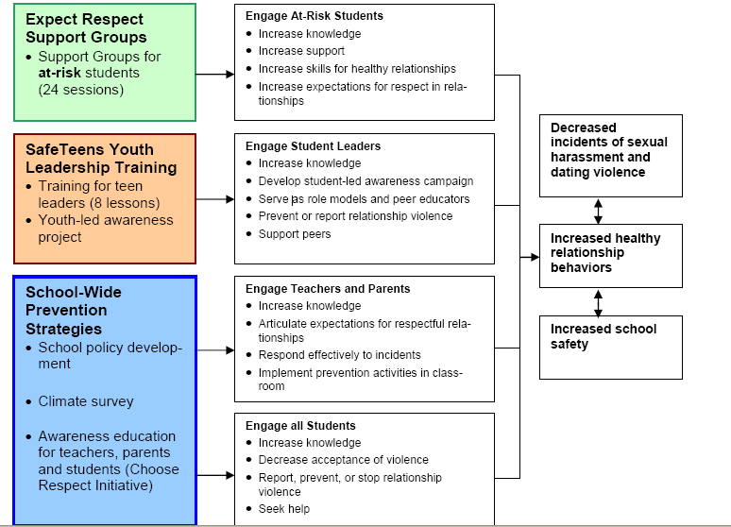
Promising Practices: Expect Respect
Notes:
Incorporating CDC’s Choose Respect Campaign strengthens this program, making it more comprehensive, addressing additional levels of the soc. Eco: parents and teachers, and school policy development = community level change.
Re: Step Model—has been tested and shows evidence of being effective in XXX
Setting:
High school youth
Strategies:
Support groups
Training of trainers – 2 per year, 4 day co-facilitation
Group meets monthly
Based on Expect Respect, Power and Possibilities, Jackson Katz and Paul Kivel’s work.

Slide 62
Why is it promising?
Public health model:
  Incorporate prevention principles - varied learning methods, comprehensive, sufficient dosage, and appropriately timed
  Addresses KABBs
  Social ecological model- individual and school-wide prevention strategies (community)
NYS model:
  Saturation
  Awareness to action
  Could be improved by being less heteronormative and addressing race and class more (Youth Leadership Component has a lesson on power, status and privilege)
  Says it can be augmented by program facilitators to address socio-cultural concerns.

Slide 63
Promising Practice: White White Ribbon Campaign
(Education And Action Kit)
Settings:
  School (middle and secondary)
Strategies: Pick and choose:
  In class exercises that promote healthy relationships and gender equality.
  Social norms exercise that provides information between real and perceived group attitudes and behavior towards gender equality, healthy relationships and violence against women.
  Facilitation notes for teachers on how to teach on the issues of violence against women.
  Specially designed approach that speaks to boys and young men on their role to end violence against women.
  Suggested activities and action for planning White Ribbon Days in schools.

Slide 64
Why is it promising?
Public health model:
  Incorporates prevention principles - varied learning methods, positive relationships and appropriately timed. Dosage is lacking because of pick and choose approach.
  Addresses KABBs
  Social ecological model – individual level with students and teachers; school-wide campaigns at the community level, could be augmented with a parent component and/or relationship level
NYS model:
  Pro-social messages
  Changes social norms
  Address gender oppression-analysis is firmly linked to other forms of oppression*
  Awareness to action
Notes:
Awareness to Action--13 possible action plans for launching white ribbon campaigns of their own-
4 step PH Model– addresses risk factors and promotes protective factors (2)
*Healthy relationship activities are 13 and 14 out of 15 activities. In other words, the lessons don’t get there until the socialization, gender communication and sex role stereotyping lessons. Lessons build on each other establishing a foundation before healthy relationship behaviors are even introduced.

Slide 65
Promising Practice: Mentors for Violence Prevention (MVP)
Settings:
  Schools, campuses
MVP is a gender violence, bullying, and school violence prevention approach that encourages young men and women from all socioeconomic, racial and ethnic backgrounds to take on leadership roles in their schools and communities.
Strategies:
  Bystander training of trainers
    Role-plays for responding to incidents of harassment, abuse, and violence before, during, or after the fact.
    Media literacy
    Gender specific and mixed gender discussions

Slide 66
Why is it promising?
Public health model:
  Incorporates prevention principles - varied learning methods, sufficient dosage, socio-culturally relevant, outcome evaluation.
  Addresses KABBs
  Social ecological model – individual and relationship (bystander), could be improved with community level activities
NYS model:
  Pro-social messages
  Awareness to action
  Changes social norms (sports)
  Address anti-oppression (sexism, heterosexism)
Notes:
Step 3- developed and tested?- The high school/middle school version is currently being systematically evaluated in several schools, although there is a wealth of anecdotal and qualitative evidence for its effectiveness. The standard MVP evaluation is a pre and post-test that measures attitudes and behaviors that relate to the role of bystanders in creating and sustaining peer culture climates that discourage abusive behavior and reward pro-social, proactive responses to situations of harm or potential harm.”
Lacks a deeper anti-oppression analysis

Slide 67
Strategies: Paul Kivel
Days of Respect: Organizing a School-wide Violence Prevention Program (HS, Middle)
  Step-by-step instructions for putting together an event that brings together students, parents, teachers and community leaders for a common goal: preventing violence and creating an atmosphere of respect in school so that everyone can feel safe.
Making Allies, Making Friends: A Curriculum for Making the Peace in Middle School
  Flexible, multi-track curriculum design has over 30 innovative, creative classroom sessions designed to prepare young people to build a healthy multi-cultural community and prevent violence. They address issues of race, class, gender and sexual identity that middle-schoolers face and can be adapted to the needs of many different school environments.

Slide 68
Strategies: Paul Kivel
Making the Peace: A 15-Session Violence Prevention Curriculum for Young People
  “Once again, the Oakland Men’s Project leads the way in our field in creating a thoughtful, sensitive and user-friendly curriculum. Their comprehensive approach helps young people deal with the deeper more sensitive issues around violence in a caring safe and respectful manner.”
I Can Make My World a Safer Place: A Kid’s Book about Stopping Violence (6-11 yr olds)
  This book, which was written for adults to read with 6-11 year olds, is about the first steps in preventing, healing from and finding alternatives to violence. Topics include what to do about teasing and bullies, fights, gangs and weapons, anger, drugs and suicide, child abuse and domestic violence.

Slide 69
Why promising?
Public health model:
  Incorporates prevention principles (varied learning methods, sufficient dosage, positive relationships)
  Addresses KABBs
  Social ecological – individual and relationship
NYS model:
  Address anti-oppression (sexism, racism, classism, homophobia)
  Pro-social messages
  Saturation
  Youth led
  Community organizing methods

Slide 70
Ways to involve students:
Utilize a peer service learning model
  Students are deliverers of the message
Conduct focus groups- “rap sessions”. Have students facilitate!
Have students design activities, programs, curricula, author and act in plays, conduct poster contests
Have students help to interpret research- help to design “research”
Nurture a core group of leaders…
Grow activists!!

Slide 71
Guiding Principles
1. If it’s learned it can be unlearned!
2. Prevention is an ongoing process, requiring a commitment to changing social norms with activities that compliment intervention strategies
3. Move from awareness to ACTION. Nurture a core group of leaders…Grow activists!!
4. Knowledge, changes in the environment and long-term programming is needed. (Address KABB’s at every level of social ecology.)
5. Design programs to address those with greatest need/risk
Notes:
Review

Slide 72
WHAT CAN YOUTH DO?
“ There is virtually no limit to what young people can do, no social need or injustice they cannot address.
Teenagers throughout history have filled positive social roles:
from leading crusades, commanding armies, advising kings – being kings – to making scientific discoveries, composing symphonies, and exposing injustices.”
Notes:
Shostakovich was 19 when he completed his first symphony No 1 in F Minor- referred to as Opus 10 but history tells us he began composing much earlier in life.
Esther of the Bible was a teenager when she saved her people
Alexandar the Great was 16 when he founded his first colony and named it Alexandroupolis
Conquering pretty much all of the world known to ancient Greece including Syria, some of India and Egypt, he was one of the most successful military commanders in history.
Pope John the XII was 18 when his papacy began
Mary Shelley wrote Frankenstein when she was 19
Joan of Arc,
King Tut ruled for more than a decade when he died before he was 19.

Slide 73
WHAT CAN YOUTH DO?
What youth can do is limited more by social and political convention than by capacity, energy, or willingness."
– Dan Conrad and Diane Hedin, 1991

Slide 74
Homework
For Adults ~
What’s one thing you can do right away to promote youth leadership?
Think of one thing you can do to support a young person you know?

Slide 75
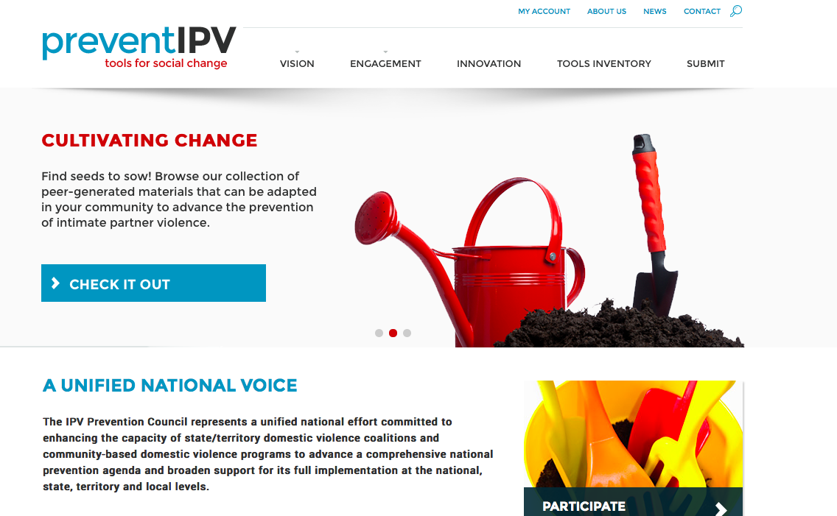
PREVENTIPV.ORG

Slide 76
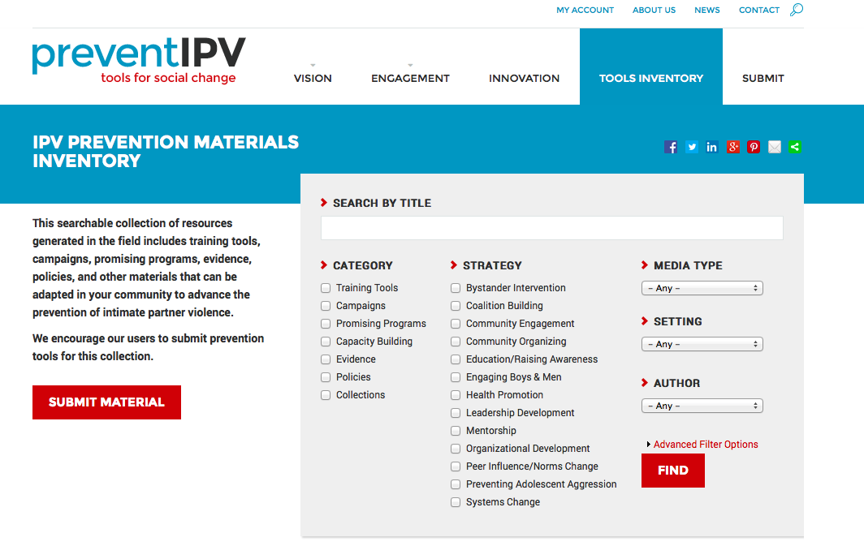
PREVENTIPV.ORG

Slide 77
Recommended Readings
American Journal of Lifestyle Medicine, 2011 articles include:
  Intimate Partner Violence and Adverse Health Consequences: Implications for Clinicians, by Michele C. Black
  Sexual Violence Victimization of Women: Prevalence, Characteristics, and the Role of Public Health and Prevention by Kathleen C. Basile and Sharon G. Smithand
  Violence Prevention and Lifestyle Medicine, by Linda C. Degutis and Robin M. Ikeda
  http://ajl.sagepub.com/content/5/5.toc
Notes:
As we can see, some articles help articulate the context for IPV as a health issue and some articles help make the case for incorporating primary prevention strategies into health care practices. We will send files out.

Slide 78
More Readings….
Institute of Medicine of the National Academies 2011 journal articles
    Clinical Preventative Services for Women: Closing the Gaps
    Preventing Violence Against Women and Children
    http://www.iom.edu/.

Slide 79
For more info Re: Dating Violence, Prevention and Youth Engagement Strategies
Lórien Castelle,
lcastelle@nyscadv.org
585.413.0887

